Slide 1



Is practical AutoML more than CASH?
GHOST Day
Alexandre Quemy
IBM

Slide 2
CASH aka non-practical AutoML

Slide 3
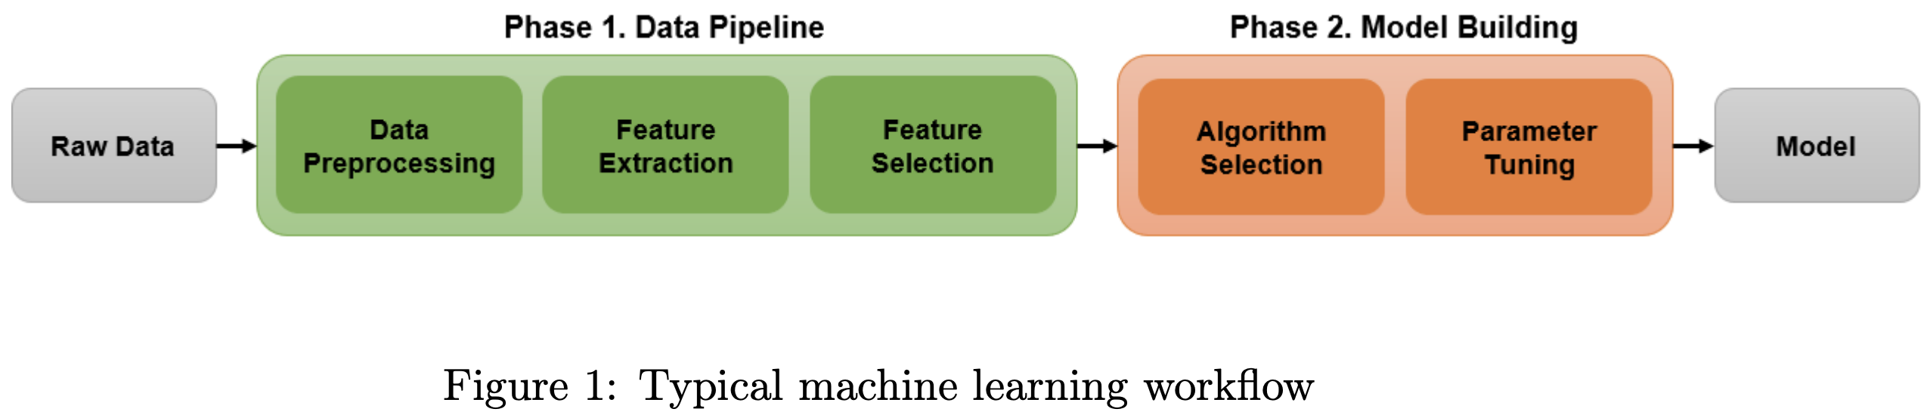
The quantitative rule of thumb
80%
20%
Notes:
What do you see here?
Effect of regularisation of Big Data, i.e. Prevention of overfitting -> data ARE very important.

Slide 4
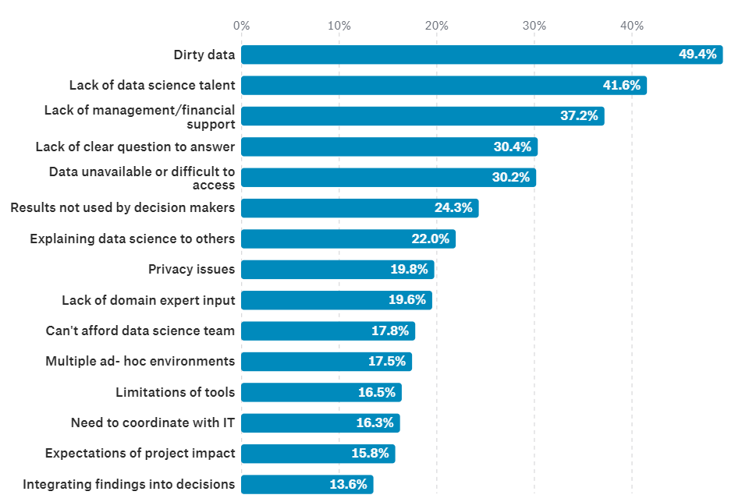
The milion-dollar question
Question: If we know data are so important, why we treat them less seriously than algorithms?
Notes:
What do you see here?
Effect of regularisation of Big Data, i.e. Prevention of overfitting -> data ARE very important.

Slide 5
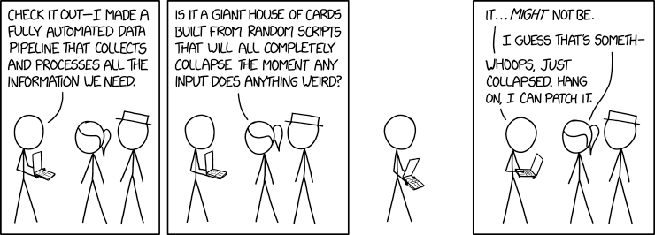
The fifty-cents answer
Answer: for this guy to still have a job!
Notes:
80% of work of datascientists is preparing data.
Back to the original question: what does it mean „treating seriously”? Well, data pipeline are relying on data scientists expertise and Subject Matter Expert.

Slide 6
My qualitative rule of thumb
This is difficult
This is not easy
Notes:
What do you see here?
Effect of regularisation of Big Data, i.e. Prevention of overfitting -> data ARE very important.

Slide 7
The hard life of a data scientist
  Dealing with missing value:
    Discarding? Row? Column?
    Imputation? What imputation? Mean? Median? Model-based? What model?
  Imbalanced datasets:
    Downsampling? Oversampling?
    Nothing? What bias it implies?
  Data too large:
    Dimensional reductions: what algorithm? PCA? normalization or not?
    Subsampling: what technique? what bias?
  Outliers detection and curation:
    What threshold? What deviation measure?
    Trimming? Truncating? Censoring? Winsorizing?
  Encoding for method domain requirements:
    Discretization? Grid? What step? Cluster? What method? What hyperparameter?
    Categorial encoder? Binary? Hot-One? Helmert? Backward Difference?
  NLP:
    How many tokens?
    Size of m-grams?
Notes:
Left censoring – a data point is below a certain value but it is unknown by how much.
Interval censoring – a data point is somewhere on an interval between two values.
Right censoring – a data point is above a certain value but it is unknown by how much.
Type I censoring occurs if an experiment has a set number of subjects or items and stops the experiment at a predetermined time, at which point any subjects remaining are right-censored.
Type II censoring occurs if an experiment has a set number of subjects or items and stops the experiment when a predetermined number are observed to have failed; the remaining subjects are then right-censored.
Random (or non-informative)

Slide 8
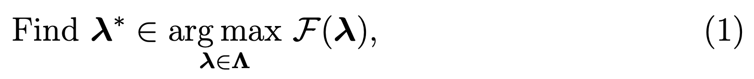
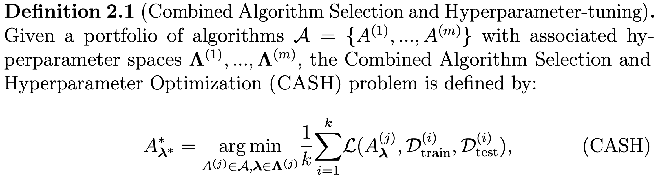
Black-box optimization
Notes:
What do you see here?
Effect of regularisation of Big Data, i.e. Prevention of overfitting -> data ARE very important.

Slide 9

CASH
The greatest trick the Devil ever pulled was convincing the world he didn`t exist.
Roger Kint*
*Charles Baudelaire
Notes:
What do you see here?
Effect of regularisation of Big Data, i.e. Prevention of overfitting -> data ARE very important.

Slide 10
CASH
Academia
The greatest trick the Devil ever pulled was convincing the world he didn`t exist.
data pipelines do not exist
“trust me” dude
Roger Kint*
*Charles Baudelaire
Notes:
What do you see here?
Effect of regularisation of Big Data, i.e. Prevention of overfitting -> data ARE very important.

Slide 11
The CASH hold-up
Why building data pipelines is hard:
Non-separable objective
marginal performance of an operator depends on all the operators
Complex intertwined parameter space
dependencies/conditions between the hyperparameters
e.g. Neural Networks, the coefficients 𝛼, 𝛽1 and 𝛽2 make sense only for Adam solver
Using standard hyperparameter techniques on the whole problem is fishy…
Notes:
Left censoring – a data point is below a certain value but it is unknown by how much.
Interval censoring – a data point is somewhere on an interval between two values.
Right censoring – a data point is above a certain value but it is unknown by how much.
Type I censoring occurs if an experiment has a set number of subjects or items and stops the experiment at a predetermined time, at which point any subjects remaining are right-censored.
Type II censoring occurs if an experiment has a set number of subjects or items and stops the experiment when a predetermined number are observed to have failed; the remaining subjects are then right-censored.
Random (or non-informative)

Slide 12
The CASH hold-up
Most AutoML frameworks proposes:
Static search space
Fixed pipeline prototype
e.g. AutoSklearn:
one feature selection operator among 13 operators,
one up to three data preprocessing operator among only four,
different nature of preprocessing operators
one-hot encoder, a specific imputation, balancing and rescaling method
Using standard AutoML tools are not aligned on practices…
Notes:
Left censoring – a data point is below a certain value but it is unknown by how much.
Interval censoring – a data point is somewhere on an interval between two values.
Right censoring – a data point is above a certain value but it is unknown by how much.
Type I censoring occurs if an experiment has a set number of subjects or items and stops the experiment at a predetermined time, at which point any subjects remaining are right-censored.
Type II censoring occurs if an experiment has a set number of subjects or items and stops the experiment when a predetermined number are observed to have failed; the remaining subjects are then right-censored.
Random (or non-informative)

Slide 13
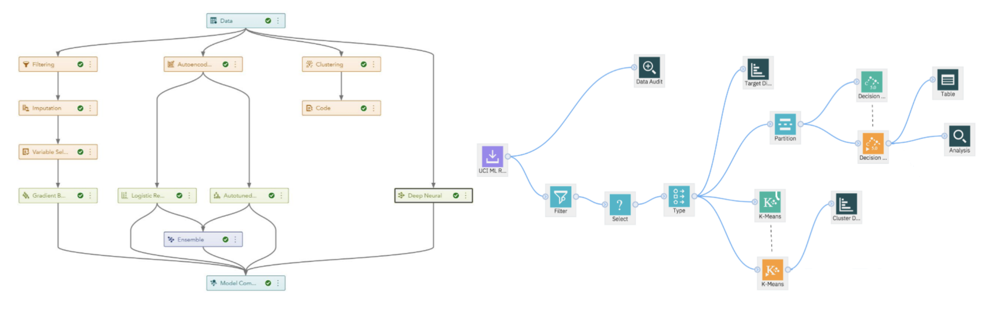
The practice is a bit more complex
Notes:
What do you see here?
Effect of regularisation of Big Data, i.e. Prevention of overfitting -> data ARE very important.

Slide 14
Hyperparameter tuning

Slide 15
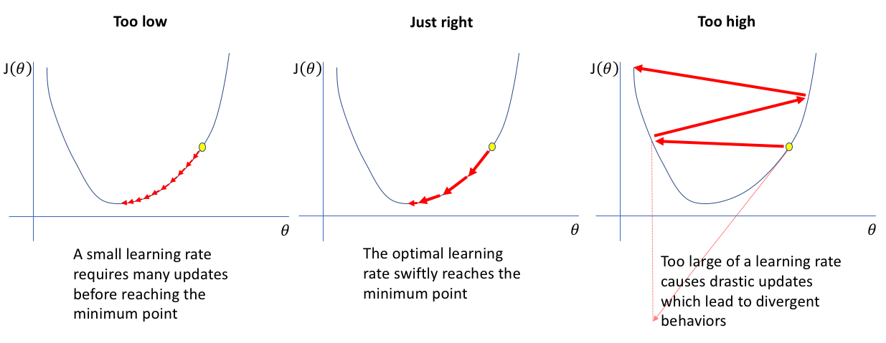
Hyperparameter tuning
The most famous example:
Image: https://www.jeremyjordan.me

Slide 16
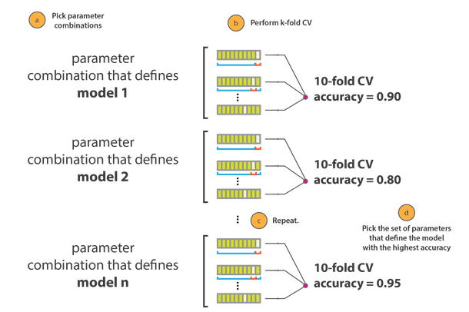
Hyperparameter tuning
Procedure:
Image: https://cambridgecoding.wordpress.com

Slide 17
Hyperparameter tuning
Sequential Model-Based Optimization (SMBO):
A configuration space over which to search
A metric to optimize (e.g. model accuracy, ROC AUC, etc.)
The surrogate model of the objective function
A criteria to select the next promising configuration
A history (score, configuration)
Also called SMAC (Sequential Model-based Algorithms Configuration):
Warmstarting of Model-Based Algorithm Configuration, Marius Lindauer, Frank Hutter,
Conference on Artificial Intelligence (AAAI-18)
Notes:
Surrogate easier to optimize. Become less wrong with more data -> requires a sufficient amount of data

Slide 18
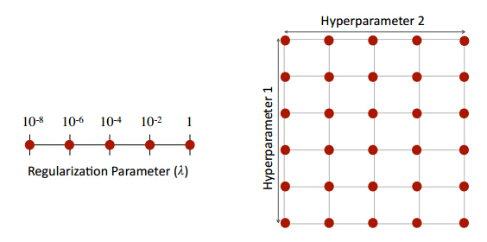
Hyperparameter tuning
Main techniques:
  Grid Search
  Random Search
  Iterated Local Search
  Bayesian approachs
Notes:
Not suitable for large configuration spaces.

Slide 19
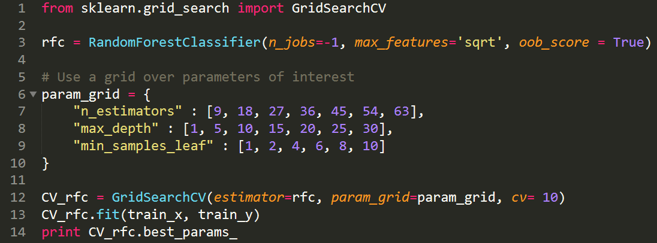
Hyperparameter tuning
Basic implementation with Scikit-Learn:
Notes:
Slight problem with stochastic methods: not very robust (what is the variation in the result is due to the seed of the algorithm rather than a change in hyperparameters?)

Slide 20
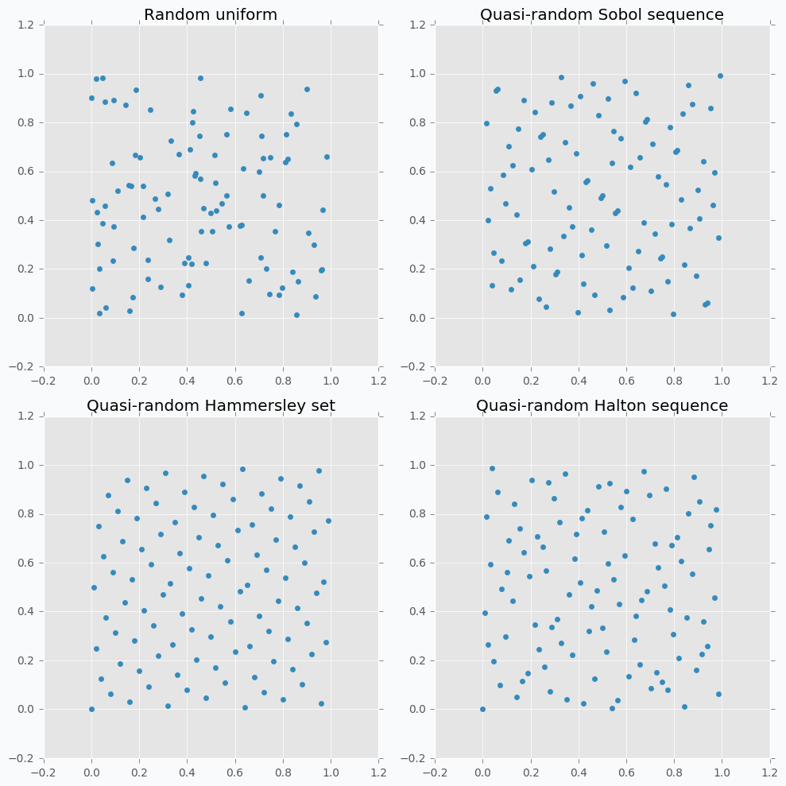
Hyperparameter tuning
Main techniques:
  Grid Search
  Random Search
  Iterated Local Search
  Bayesian approaches
Notes:
Discrepancy. Not taking into accont previous generated point.

Slide 21

Hyperparameter tuning
Basic implementation with Scikit-Learn:
RandomizedSearchCV
Notes:
Slight problem with stochastic methods: not very robust (what is the variation in the result is due to the seed of the algorithm rather than a change in hyperparameters?)

Slide 22
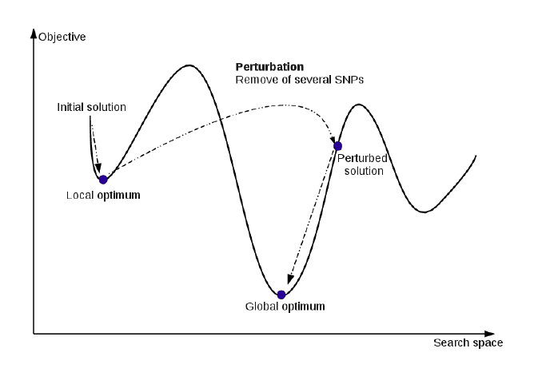
Hyperparameter tuning
Main techniques:
  Grid Search
  Random Search
  Iterated Local Search
  Bayesian approaches
Implementation:
ParamILS
http://www.cs.ubc.ca/labs/beta/Projects/ParamILS/
Notes:
Discrepancy. Not taking into accont previous generated point.

Slide 23

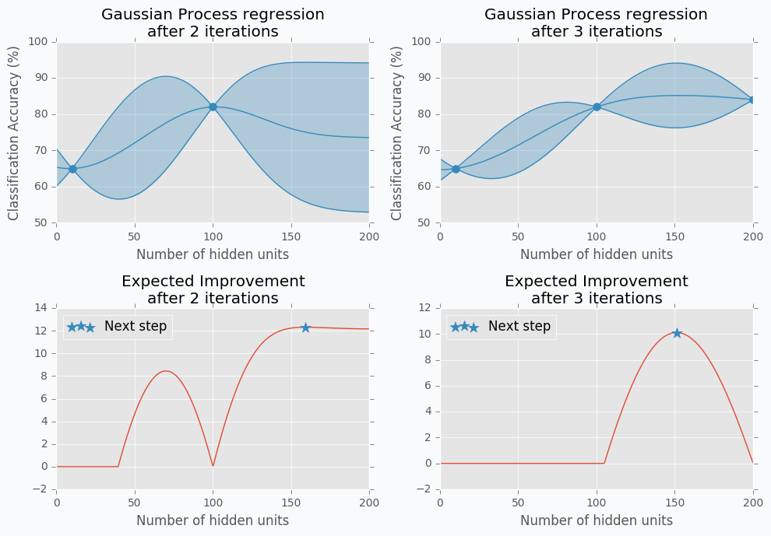
Hyperparameter tuning
Main techniques:
  Grid Search
  Random Search
  Iterated Local Search
  Bayesian approaches
Implementations:
Spearmint
RoBO
Hyperopt / Bayesopt
Image: http://http://neupy.com
Notes:
Surrogate easier to optimize. Become less wrong with more data -> requires a sufficient amount of data

Slide 24
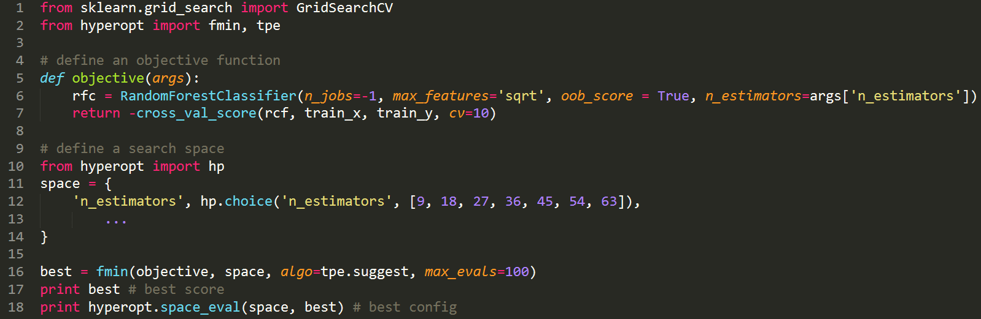
Hyperparameter tuning
Basic implementation with hyperopt:

Slide 25
DPSH aka practical AutoML

Slide 26
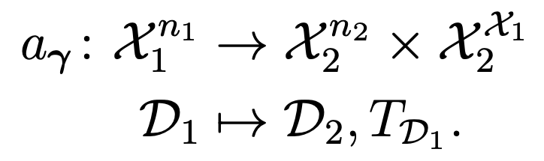
Data Pipeline Selection and Hyperameter optimization
A formal definition of an operator:
Pipeline prototypes: particular graph topology organized in layers
Notes:
The size of the dataset may be modified (e.g. rebalancing operation), the input and output space may be the same (e.g. removing outliers) and the dimension of the input and output space may differ (e.g. Principal Component Analysis). The operator initially operates using the whole dataset (e.g. PCA or missing values imputation using a value derived from the available data such as the mean or median). It also returns a functor from 𝒳1 to 𝒳2 that is used to project a single element during the prediction phase. For instance, a PCA on the training set expresses this dataset in a 𝑘 dimensional space. The associated functor is the projector from the original space to the new space. For a rebalancing operator, as it operates only on the training set, the functor is the identity. Note that the functor is implicitly parametrized by 𝛾 (e.g. the parameter 𝑘 in a PCA is forwarded to the functor)

Slide 27
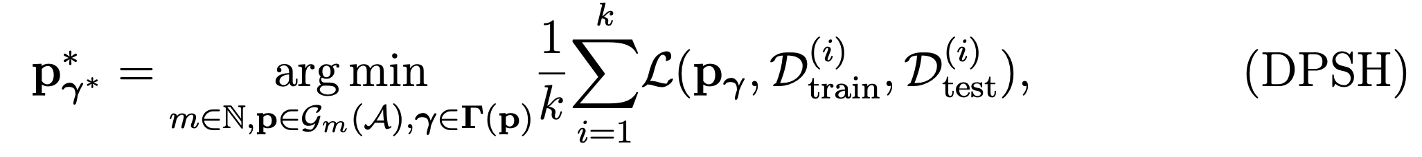
Data Pipeline Selection and Hyperameter optimization
The new problem:
Advantages:
Aligned on practices and real use-cases
Cheap offline compatibility check
Flexible w.r.t. domain knowledge / search space
Drawbacks:
Expensive search space if no domain knowledge
Notes:
The size of the dataset may be modified (e.g. rebalancing operation), the input and output space may be the same (e.g. removing outliers) and the dimension of the input and output space may differ (e.g. Principal Component Analysis). The operator initially operates using the whole dataset (e.g. PCA or missing values imputation using a value derived from the available data such as the mean or median). It also returns a functor from 𝒳1 to 𝒳2 that is used to project a single element during the prediction phase. For instance, a PCA on the training set expresses this dataset in a 𝑘 dimensional space. The associated functor is the projector from the original space to the new space. For a rebalancing operator, as it operates only on the training set, the functor is the identity. Note that the functor is implicitly parametrized by 𝛾 (e.g. the parameter 𝑘 in a PCA is forwarded to the functor)

Slide 28
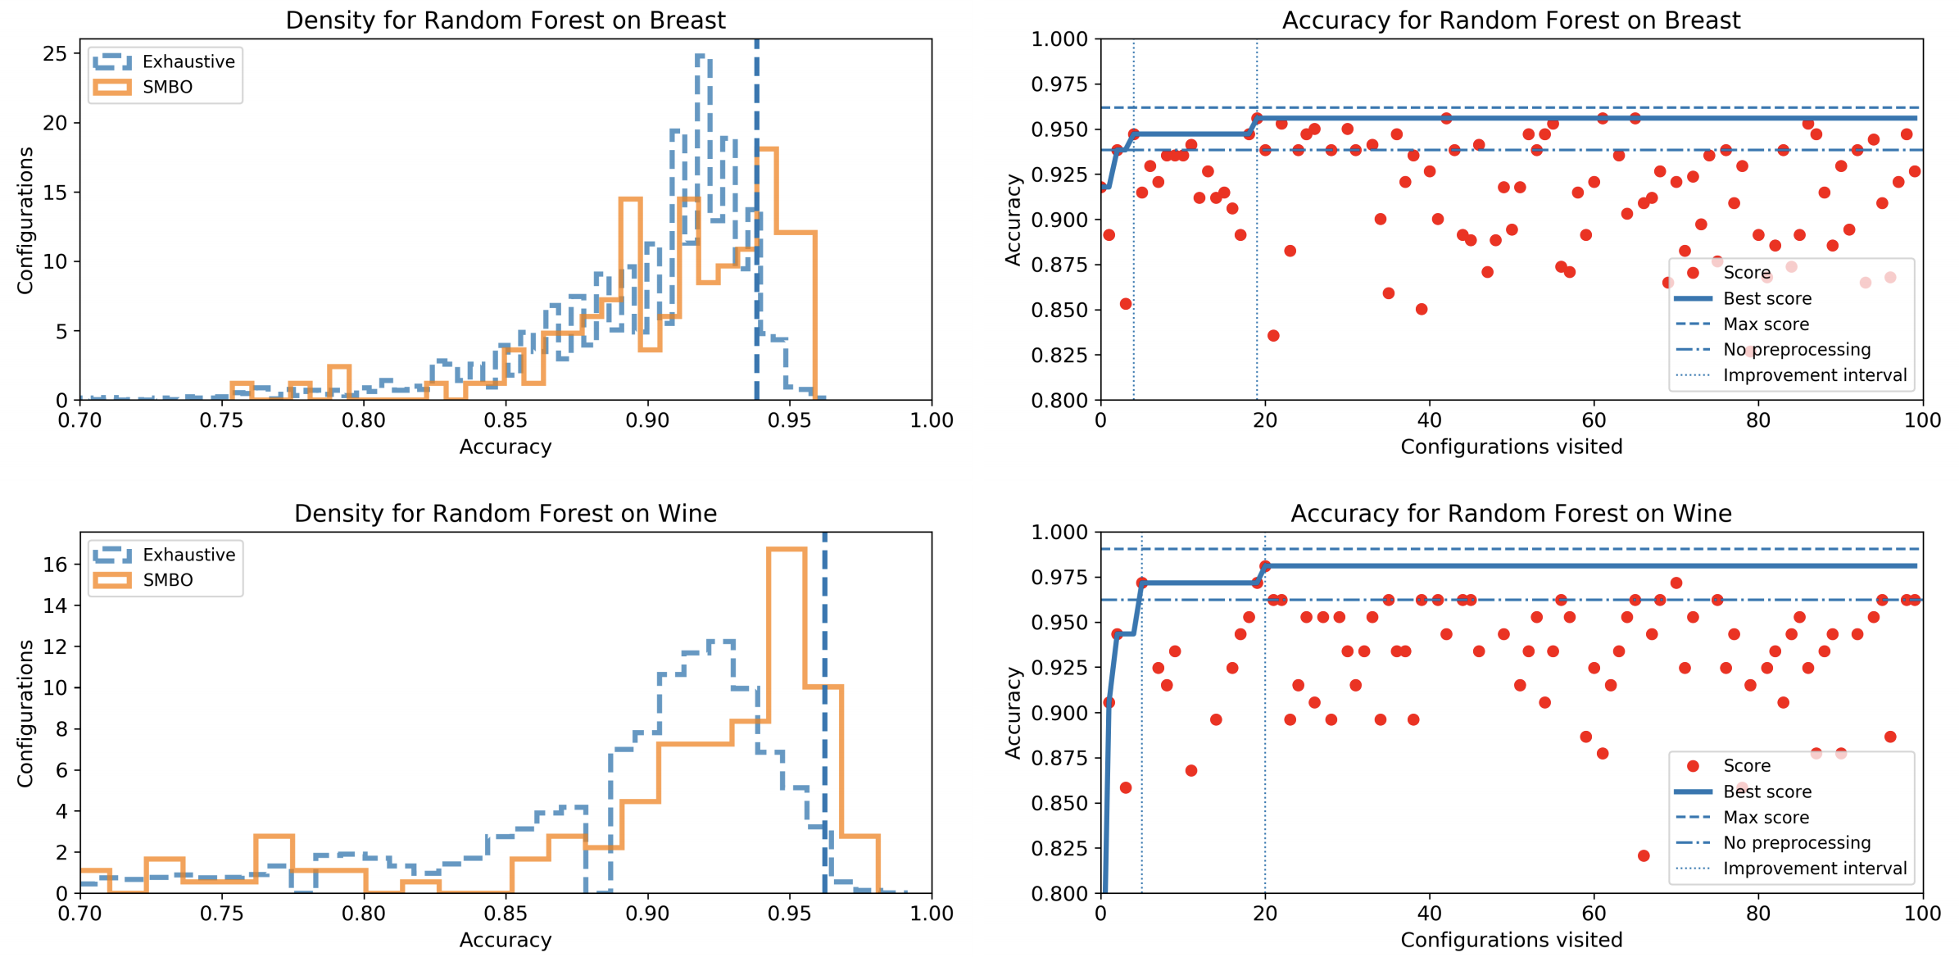
Is this approach tractable in practice?
Notes:
What do you see here?
Effect of regularisation of Big Data, i.e. Prevention of overfitting -> data ARE very important.

Slide 29
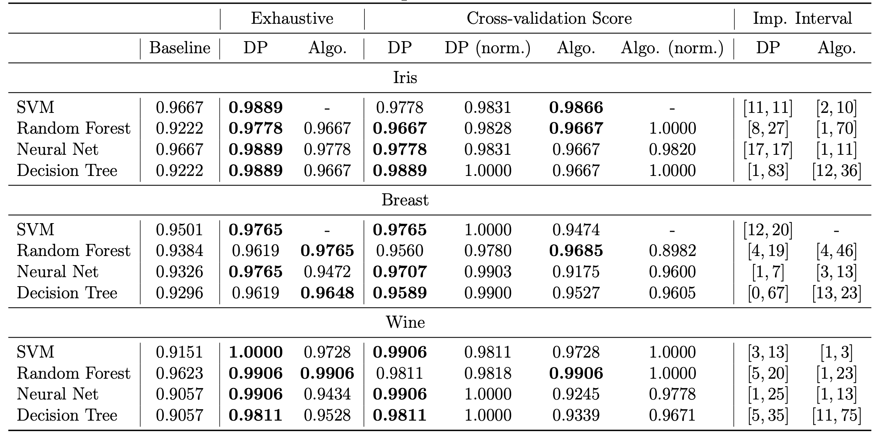
Is building good pipelines more important than selecting a good algorithm?
Notes:
What do you see here?
Effect of regularisation of Big Data, i.e. Prevention of overfitting -> data ARE very important.

Slide 30
Two-stage optimization

Slide 31
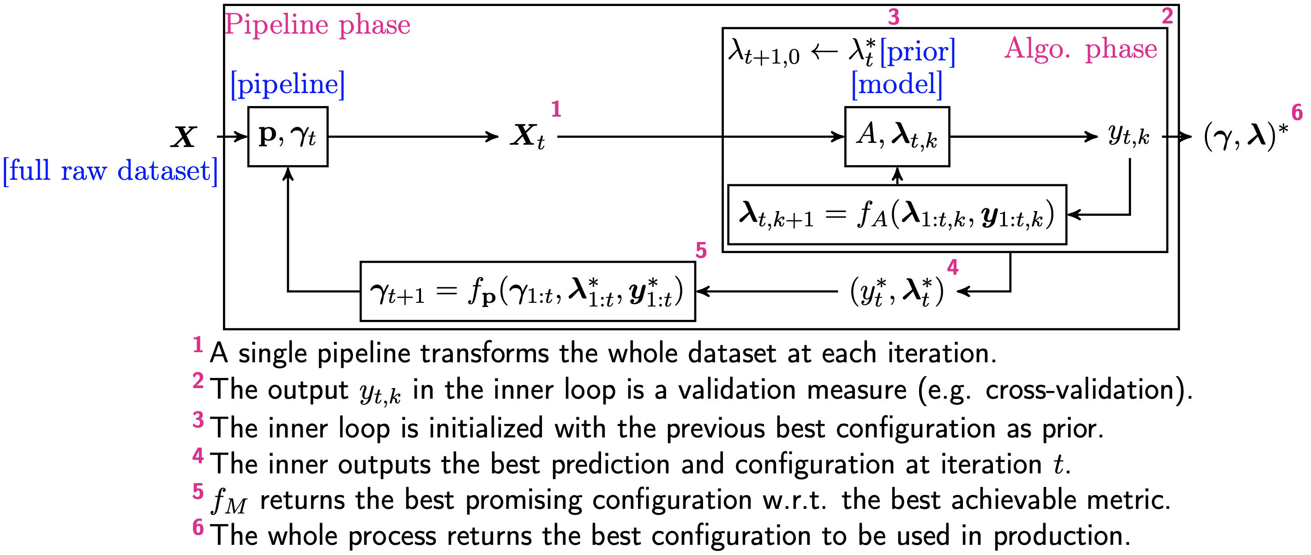
Two-stage optimization process
Notes:
What do you see here?
Effect of regularisation of Big Data, i.e. Prevention of overfitting -> data ARE very important.

Slide 32
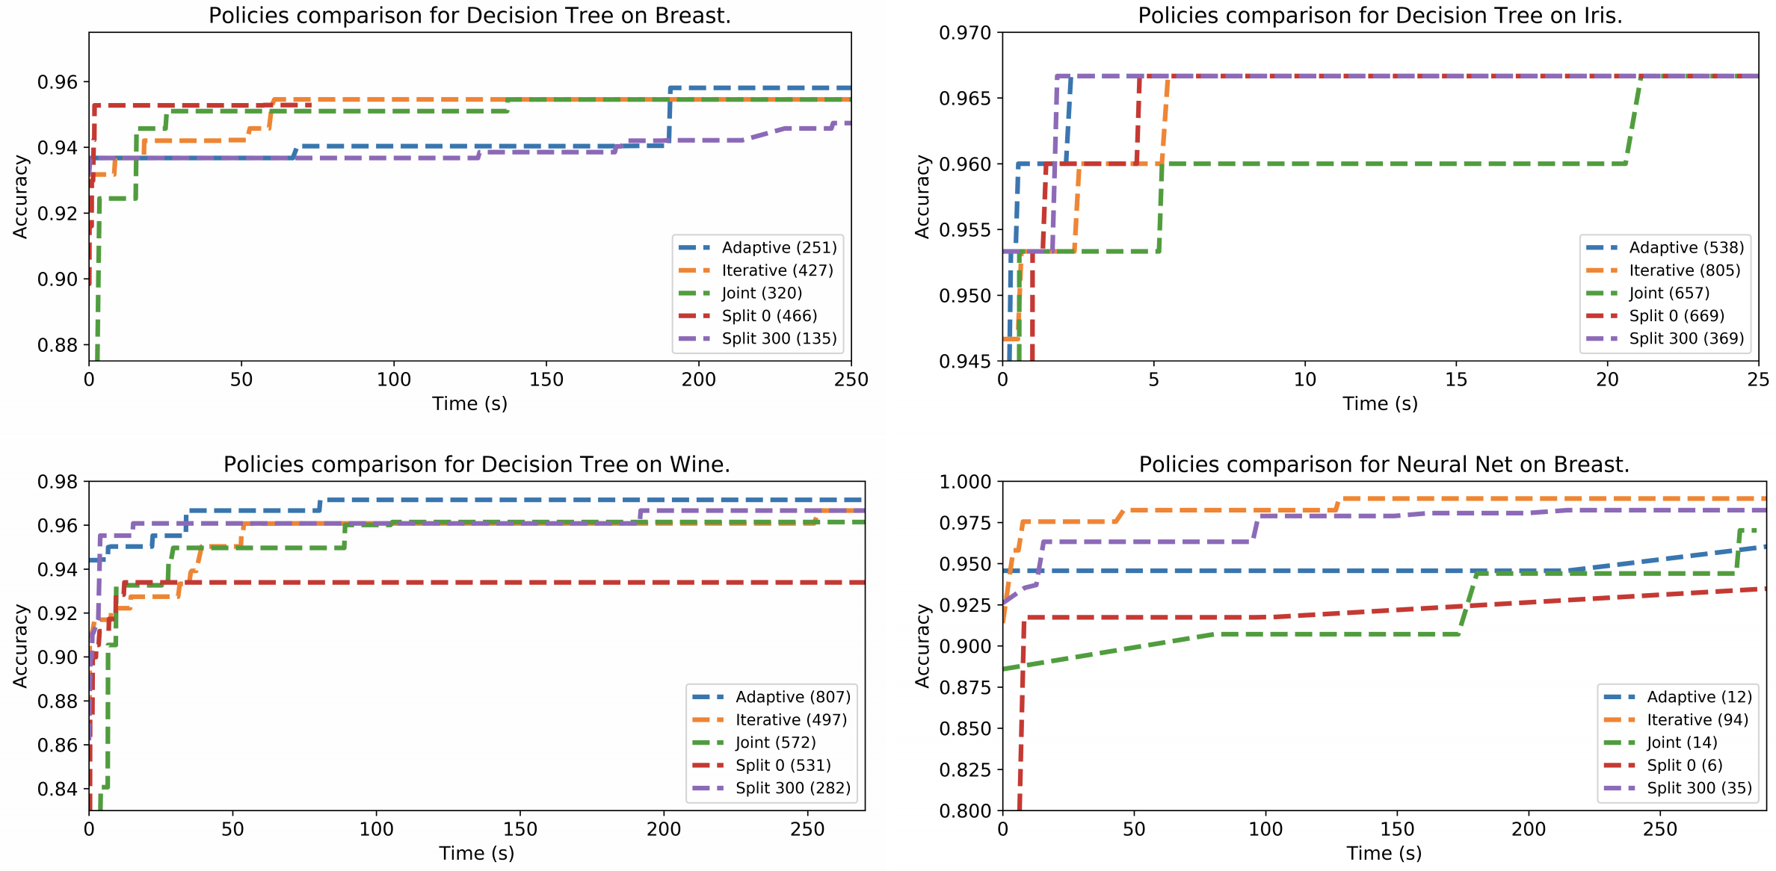
What are the benefits of the two-stage optimization process?
Notes:
What do you see here?
Effect of regularisation of Big Data, i.e. Prevention of overfitting -> data ARE very important.

Slide 33
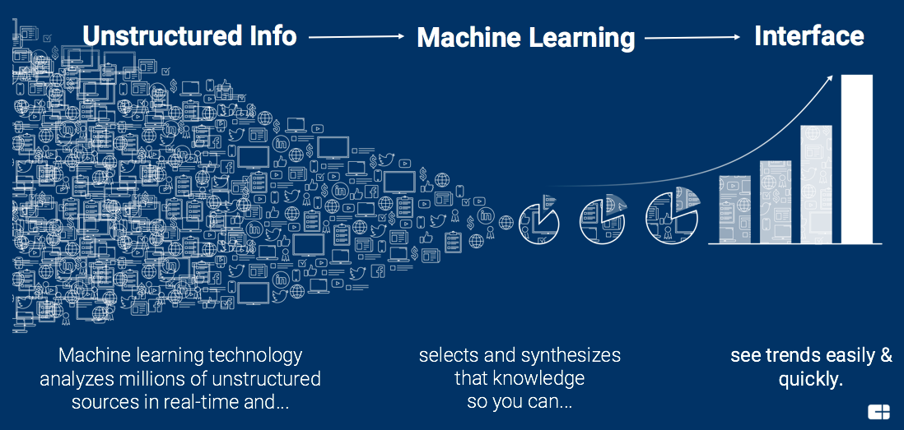
Future work
Work in progress:
  Tests on larger configuration spaces
  Predicting good pipelines without building them
  Online / offline architecture
  Open source framework
Notes:
Explanation in three steps:
Blue area: points that are all forming a sample of the exact same points => clearly zero
For each green points, the blue points are really close, lowering the NMAP
Red points are very far from every other points on the second componant on the first parameters they are exactly matchin in a green sample such that it limitate the NMAP.

Slide 34

Thank you
Idea-generator Pipeline

