Slide 1


CESTAC Method
Controlling the propagation of numerical calculation errors
Alexandre Quemy
IBM Analytics

Slide 2
AGENDA
Reminder on floating-point arithmetic
CESTAC: Control and Stochastic Estimation of Calculation Roundings
Application to the stopping problem
Discussion on the validity

Slide 3
Reminder on Floating-point arithmetic
Notes:
Within this section we will show how within 5 minutes we can create and deploy basic Node.js application with github as a code repository using Bluemix platform.

Slide 4
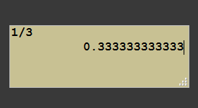
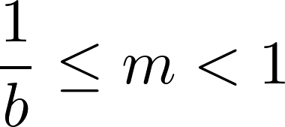




The problem of representation
Scientific notation
Example:
• In base 10:
• In base 2:
Problem: only finite memory!

Slide 5
The problem of representation
Sad reality:
For any base, there exist an infinite amount of numbers such that the representation has a mantissa with an infinite amount of digits.
⇒ impossible to perfectly represent the set of real numbers with a computer
Approximation of real number = floating point numbers
Proof (sketch):
• normal number: every finite sequence of digits appears an infinite number of time in its mantissa
+ uniform probability of appearance.
• Borel-Cantelli Lemma ⇒ set of non-normal number has null Lebesgue measure
• ⇒ the probability that this number is normal is 1

Slide 6

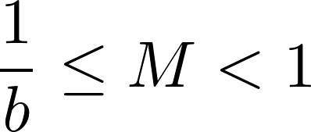
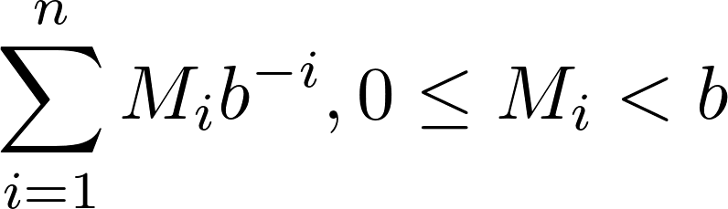
Floating-point arithmetic
Real numbers:
Floating-point:
Norm IEEE-754: (double precision)

Slide 7

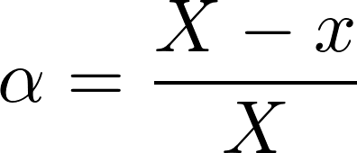

The problem of representation
Assigning is easy, choosing is hard:
Assignment operator:
Relative error of the assignment operation:
Any real number can be bounded by two floating-point numbers:
Which one to chose ?

Slide 8






The problem of representation
IEEE-754 chooses for you:
Rounding toward (or up):
returns except if
Rounding toward (or down):
returns except if
Rounding toward 0:
returns for positive numbers and for negatives.
Rounding to the nearest:
returns the closest floating number.

Slide 9

The problem of representation
IEEE-754 is good for you:
Essential property: correct rounding
Allow formal proof and proven bounds on numerical algorithms!

Slide 10
The various problems of the numerical analysts
Notes:
Within this demo session we will show how to create and deploy basic Node.js application „Hello analytics” on Bluemix.
We will also show how to create and connect github repository for our application on Bluemix. In the last part of demo session we will go through application overview dashboard, logs and binding additional Bluemix services to our application.

Slide 11


A pathological case
Aren’t you exagerating the importance of errors ?

Slide 12

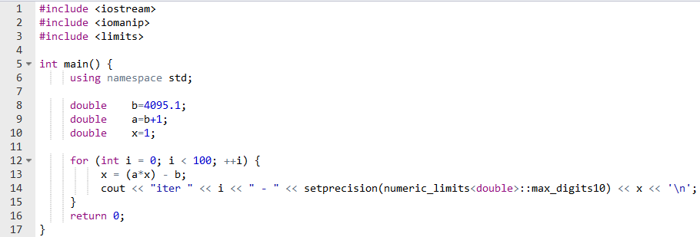
A pathological case
Aren’t you exagerating the importance of errors ?
Result

Slide 13
CESTAC: Control and Stochastic Estimation of Calculation Roundings
Notes:
Within this section we will show how within 5 minutes we can create and deploy basic Node.js application with github as a code repository using Bluemix platform.

Slide 14



The CESTAC core and errors propagation
The error propagation of the addition
and
Not a problem if
Result

Slide 15














The CESTAC core and errors propagation
The crual world of floating-point algebra:
Algebra :
Not associative
Not distributive
Commutative
Consider and its image on or... the set of its images :
Example:
•
•
•
(maybe)
Numerical example: (6 digits precision)

Slide 16
The CESTAC core and errors propagation
The ideas behind CESTAC:
Taking advantage of the large variability of results by propagating errors in a different way and randomly:
Use perturbations of the result of an operation
Use permutation of the operations
CESTAC does not improve the result:
It estimates the significant error and the exact part.

Slide 17



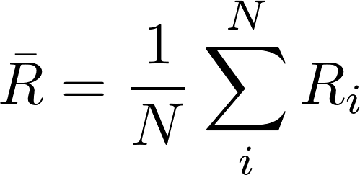
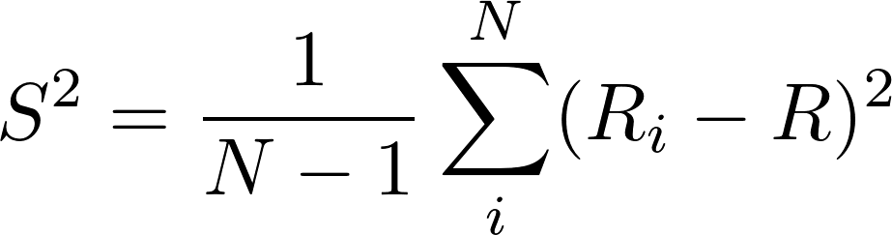



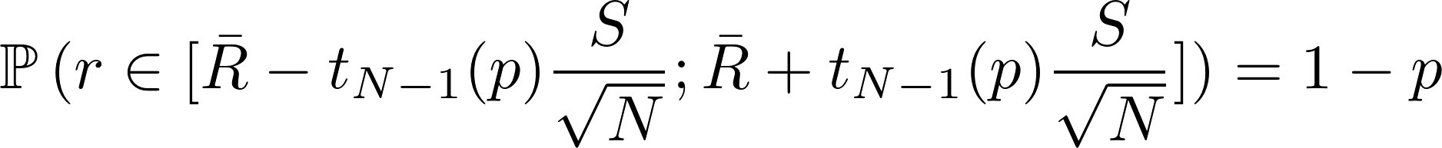
The CESTAC core and errors propagation
Looking for the number of significant figures:
Procedure repeated times with perturbations and permutations:
Assumption
Mean: Estimators:
Std. dev.:
The error part:
Direct application of the CLT:

Slide 18
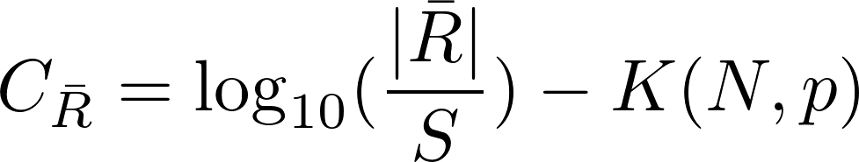
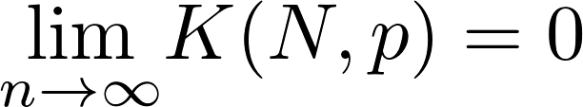
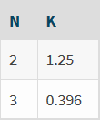


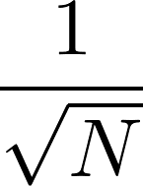
The CESTAC core and errors propagation
Looking for the number of significant figures:
In practice: less than one digit lost in average
The interval’s length evolves in
To gain an additional significant number:
the sample size must be multiplied by 100

Slide 19
The CESTAC core and errors propagation
Construction of the sample:
Function pert: randomly perturbates the last bit of the mantissa, i.e. add to the last bit by 1, 0 or -1 with uniform probability
Equivalent to select among or
Function perm: randomly permutes the operations of a procedure
In practice perm is not used!
There are two ways to use pert to construct the sample.

Slide 20
The CESTAC core and errors propagation
Asynchronous use:
Significant digits calculated a posteriori
Two major problems:
The procedure may converge to different numbers
They can take different conditional branching

Slide 21
The CESTAC core and errors propagation
Synchronous use:
Significant digits estimation available at any time!
Solve the problems:
Average value used for conditional branching
Convergence to the same value

Slide 22
Application to the stopping problem
Notes:
Within this section we will show how within 5 minutes we can create and deploy basic Node.js application with github as a code repository using Bluemix platform.

Slide 23




The stopping problem
Iterative algorithm:
or (Cauchy criterion)
Substracting two close floating-point numbers leads to unsignificant results!
Worst case scenario:
  is chosen to small ⇒ the accumulated errors are bigger
  ⇒ the algorithm never converges
  + the solution degrades itself and diverges
  (cf. Initial example of pathological case)

Slide 24





The stopping problem
Zero machine :
Detecting zero significant numbers:
and : error greater than its own value. Stop!
: the difference is only errors. Stop!
: the sequence is considered non-convergent. Stop!

Slide 25
Discussion on the validity
Notes:
Within this section we will show how within 5 minutes we can create and deploy basic Node.js application with github as a code repository using Bluemix platform.

Slide 26
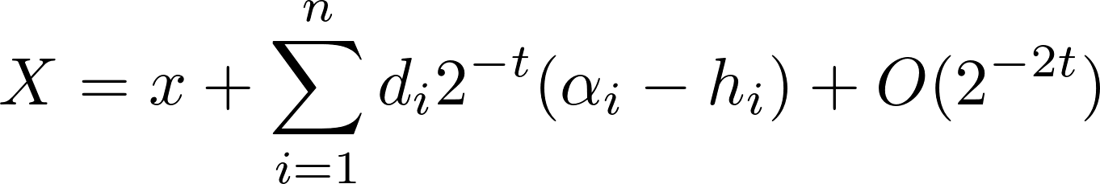




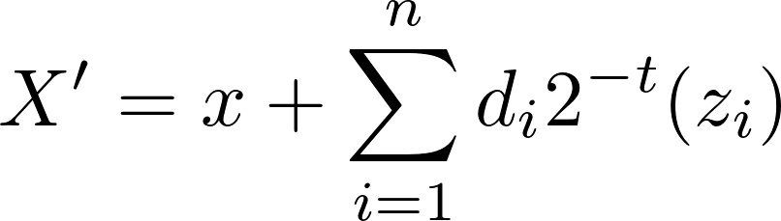

CESTAC validity
On the estimator bias:
Theorem: A perturbated result X obtained by a procedure F can be written:
with x the exact result, n the number of assignments and operations,
depending only on the data and F, the rounding errors and
the perturbations.
Biais: Hypothesis:
follow a uniform distribution
we can neglect the higher order terms
Then we can select such that
with

Slide 27
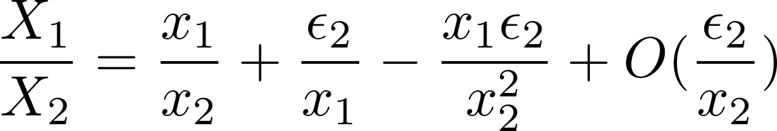
CESTAC validity
On the other hypothesis:
Hypothesis:
1) follow a uniform distribution
2) we can neglect the higher order terms
Number 1) is empirically validated for n large enough.
Number 2) ... well, it depends!
Consider :

Slide 28
CESTAC validity
Possible solutions:
Increase the precision of the representation.
Restrain as much as possible the error propagation.
Systematically control the results of multiplications or divisions (costly).

Slide 29
Conclusion on CESTAC
Notes:
Within this section we will show how within 5 minutes we can create and deploy basic Node.js application with github as a code repository using Bluemix platform.

Slide 30

Thank you
Notes:
Within this demo session we will show how Node.js application can use and display data from previously created model for customer satisfaction prediction.

