Slide 1
A Better Approach to Data Science
The example of COVID-19
Alexandre Quemy
IBM Data and AI
aquemy@pl.ibm.com

Slide 2
Agenda
Forewords
A highlight on methodology
Hypotheses and problem
Model and parameters estimation
Results
Discussions
Notes:
3 and 4 are technical. Mostly for data scientists.

Slide 3
My life in few icons
AutoML Classification in non-metric space Stochastic sequence of hypergraph
Applied to judicial domain
MSc. in maths
MSc. in HPC/AI
PhD. in AI
Parallel metaheuristics for
NP-hard problems
Autoadaptive parameter tuning strategies
Multiobjective discrete optimisation
Evolutionary planner

Slide 4
Why am I here today?

Slide 5
Forewords

Slide 6
Forewords
I do not claim the model developed here is better than any other
nor that it should be used in production.
Webinar goals:
Showing some pitfalls of naive data driven approach
Providing an example of better methodology
Modelling goal:
Predicting the number of detected cases in any country
Notes:
I actually do consider than bad models are as bad if not worst than fake news. It is especially true when it comes to decisions made based on a model.
Showing that the pure data driven approach, often blindly used in empirical data science, is not offering satisfying results because models are treated as ready-to-use black-boxes whose parameters are just mathematical proxies to optimize a loss function without any concrete reality¹. Sounds harsh but I believe this is a key point why so many DS and AI projects fails.
I try to details what better means all along
Detected case: detected means reported by the authorities.
Another important question is why? Because this is a solid base to answer all possible questions
Why so? Because it seems the easiest (less noisy, less factors) quantity to estimate.

Slide 7
A highlight on methodology

Slide 8
A highlight on methodology
Know what you can do and what you do not know:
I am good at math. That’s cool, but that’s it.
I know NOTHING about the domain.
I know perfectly the domain.
I may use basic or no models at all.
Data Scientist,
Mathematician
AI specialist
Epidemiologist
Virologist
Doctors
Notes:
It seems obvious but I can guarantee that it is not in practice.

Slide 9
A highlight on methodology
We should NOT do anything like: “I used data released by doctors, and I have a model to make predictions”
Notes:
It seems obvious but I can guarantee that it is not in practice.

Slide 10
A highlight on methodology
We should instead:
Prevent experts to fall in statistical traps
Illustration:
You go the hospital, you are diagnosed with a tumor (sorry).
First doctor: Surgery 66%, Chemio 76%
Second doctor: Surgery Chemio Large tumor: 63% 49% Small tumor: 90% 82%
 | Chemio |  |  | Surgery
Large tumors | 92 | 90 | 49% | 331 | 564 | 63%
Small tumors | 147 | 671 | 82% | 11 | 94 | 90%
 | 239 | 761 | 76% | 342 | 658 | 66%
Notes:
But to do that we need to really know what are those statistical traps and how to find them
A model can totally fall into this and only expert knowledge can detect it and correct it.
We need 1) data science math knowledge to point out the phenomena 2) expert knowledge to solve it
Cofounding factor => expert knowledge only
Treat statistical traps and paradoxes as Pokemons: catch tchem all

Slide 11
A highlight on methodology
We should instead:
Prevent experts to fall in statistical traps
Stop with descriptive statistics (really) unless you know what you’re doing
Illustration:
Notes:
I am sorry but I will say, a bit in provocative way but descriptive statistics are the lowest level of scientific proof, barely above the personal anecdote
This study is just showing a correlation because PM and COVID-19 infection in Italy. Well, again, let’s use expert knowledge on epidemiology: we know for decades that particules are a vector of viral infections. So what is the point of this study?
Either the correlation is here and we kind of already know, it is not surprising, but it would need to be tested to reinforce our belief in this theory
Or there is an absence of correlation and this goes against our belief a priori, but as correlation is no causation and no correlation does not mean no causation, it tells ABSOLUTELY NOTHING.
Those types of studies are barely here to inspire researchers to formulate hypothesis or have intuitions on phenomena or how to model something. But unless you are a going to do a scientific study or model after, do not use descriptive stats to advocate any sort of decisions. Best way to fall into all statistical traps.

Slide 12
A highlight on methodology
We should instead:
Prevent experts to fall in statistical traps
Stop with descriptive statistics (really)
We should develop purely mathematical framework with
good properties (convergence, error bounds, etc.)
few realistic and testable hypotheses
the possibility to insert expert knowledge everywhere we can
a clear separation between the types of uncertainties
TL;DR: We need to assist experts, not to bypass them
Notes:
Often Epistemic uncertainty vs Aleatoric
Structural uncertainty: lso known as model inadequacy, model bias, or model discrepancy, this comes from the lack of knowledge of the underlying physics in the problem.
So, so far I’ve been just criticizing everyone, and very paternalistic, so let’s try to be a bit more constructive, shall we?

Slide 13
Hypotheses and problem
Notes:
Again, I insist, the model is not to be used or trusted. It is an example of how to build a solid mathematical model assuming we have zero knowledge about the field.

Slide 14
Hypotheses
Vocabulary point: I use sigmoid for any function convex
then concave around a given point.
Warning: we restrain ourselves to symmetric sigmoid.
: the growth rate,
: time at the midpoint,
: asymptotic number of detected cases,

Slide 15
Hypotheses
(H0) for a given relatively homogeneous geographical location,
the evolution of the epidemic follows an unknown stochastic process.
Consider a probability space and measurable space
for
with values in the state space
:all possible applications to T with value in S
is a single trajectory
Notes:
Basically, the number of detected cases can be modelled by a certain stochastic process.
So if we take the current time series available for one particular country, e.g. Italy, it corresponds to the beginning of ONE single trajectory. It is thus difficult not to say impossible to draw any conclusion on the stochastic process it-self. To do so, we would need to have many copies of Italy and restart the exact same epidemic several times, whichis obviously impossible. This is one of the most common and major pitfall of data science: it is sometimes difficult toknow if the time series we have come from the same stochastic process or are just trajectories for different processes. Itis very tempting to consider the underlying process is the same for all trajectories but fundamentally (epistemologicallyI would even say) wrong. In this paper, we will try to avoid this pitfall.
Ok, I am skipping some details about the ergodicity of the process

Slide 16
Hypotheses
(H1) : Asymptotically, and for any epidemic, is of the form
where is a sigmoid, and some random noise.
Notes:
The rationale behind this hypothesis is that, the number of cases will necessarily reach an asymptotic number: either the whole population, or a fraction of it. The fraction could a function of the virus characteristics, people developing immunity, effectiveness of social distancing, etc.
The noise is a random variable to model the day by day variation due to several possible factors that are hard to estimate or require expert knowledge (e.g. number of tests performed, number of people that decided to go to the hospital to take the test, or a new way of counting infected people as it happened in China, etc.).
As I don’t have more knowledge, we consider that the noise is iid but, as pointed out by Redha Moulla, it is more likely to behave as a Brownian motion with drift. For instance, for France, the trend of the number of tests performed is definitely not constant as illustrated by Figure \ref{tests}. However, we leave this improvement for future work.
Finally, this hypothesis can be tested on all the previous epidemics recorded by humanity, and models made by epidemiologists (e.g. advanced SIR-based models).

Slide 17
Hypotheses
(H1) : Asymptotically, and for any epidemic, is of the form
where is a sigmoid, and some random noise.
A common approach in DS: estimate parameters by fitting on data.
Why it does not work?
no empirical or "physical" justification
the available data represent only one trajectory!
Notes:
With a RMSE score
there is no empirical or "physical" justification for the estimation of these parameters. What is the rationale to support that the estimation of $t_\lambda$ through a simple RMSE minimization is actually the real peak in terms of new detected case per day? Or more concretely: I can perfectly fix $t_\lambda$ for any reason, and fit the curve. Most like, the result for a and $\lambda$ will be much different but no one will be able to see a reasonable difference between the two estimated curve when it comes to compare on the available data (the time series up to today). What I just do when fitting, is using a mathematical proxy in case I do not have a close form on my model.
\item more fundamentally, the available data represent only one trajectory. Even if the fit was perfect, it does tell nothing about the underlying stochastic process for the given country, and obviously even less when it comes to transfer this knowledge to other countries.

Slide 18
Hypotheses
(H1) : Asymptotically, and for any epidemic, is of the form
where is a sigmoid, and some random noise.
N countries, vector of stochastic processes
All we have is
familly of invertible mappings such that it aligns SP i.e.
Notes:
Due to many factors depending mostly on the country, the value of $\lambda^i$ and $t_\lambda^i$ are different for each $i \in [1, N]$.
We assumed all stochastic processes roughly follow the same law, such that we can find a transformation to calibrate the process and trajectories

Slide 19
Hypotheses
Parameters of Phi are obtained by minimizing RMSE. What? But you told us it is not good!
Notes:
ligning sigmoids is fairly easy in the case of symmetric sigmoids and we provide simply an illustration to explainthe effect ofΦ. Of course, aligning partial trajectories leads to potentially more errors. There is most likely a closedform to express the transformation and quantifying the error, but due to the time constraint, we chose to minimize the RMSE. Notice that this is not at all the same as fitting a curve to obtain "prediction": the optimizer is used as atool to solve a purely technical and mathematical problem, not to answer our initial problem.

Slide 20
A note on the sum of sigmoids
Notes:
ligning sigmoids is fairly easy in the case of symmetric sigmoids and we provide simply an illustration to explainthe effect ofΦ. Of course, aligning partial trajectories leads to potentially more errors. There is most likely a closedform to express the transformation and quantifying the error, but due to the time constraint, we chose to minimize the RMSE. Notice that this is not at all the same as fitting a curve to obtain "prediction": the optimizer is used as atool to solve a purely technical and mathematical problem, not to answer our initial problem.

Slide 21
Hypothesis (H2)
(H2) : As of today, the only known factor to have an exponential effect on the epidemic is social distancing.
: date of social distancing measures
(H2) concretly means
Notes:
We don’t have medication nor vaccines so far.
Social distancing takes different forms and has obviously different impact depending on how it is followed by people and many other factors.
Let's denote $t_L^i$ the date social distance or lockdown has been acted (in practice it often came with more and more restrictive measures but this is something that can be adjusted later with expert knowledge).
This implies that the random variable $t_\lambda^i$ depends on the known information. Let us assume then that $t_\lambda^i = f(t_L^i)$ where f is an unknown measurable map.
In other words, one of the two values we would like to estimate now depends (partly) on data available as of today for most countries. More concretely, it means that the point of inflection is a function of (at least) the moment social distancing measures are in place.

Slide 22
Model and
Parameters estimation

Slide 23
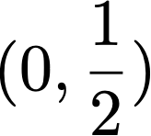
Model and Parameters estimation
Consider a reference full trajectory: Hubei.
Normalize it in such that the point of inflection
We will work only in this space now. Assume all trajectories have been calibrated on
We have now on SP with N (partiel) trajectories
All we have to do is estimating and
Notes:
We don’t have medication nor vaccines so far.
Social distancing takes different forms and has obviously different impact depending on how it is followed by people and many other factors.
Let's denote $t_L^i$ the date social distance or lockdown has been acted (in practice it often came with more and more restrictive measures but this is something that can be adjusted later with expert knowledge).
This implies that the random variable $t_\lambda^i$ depends on the known information. Let us assume then that $t_\lambda^i = f(t_L^i)$ where f is an unknown measurable map.
In other words, one of the two values we would like to estimate now depends (partly) on data available as of today for most countries. More concretely, it means that the point of inflection is a function of (at least) the moment social distancing measures are in place.

Slide 24
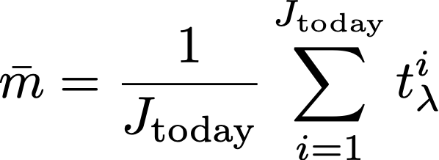
Estimation of
We have no knowledge about f
Assume
are sorted by
: number of trajectories that reached their peak
Standard unbiased estimator:

Slide 25
Estimation of
For the variance, it’s slightly more complex: very little trajectories
Cochran’s theorem to calculate the correction factor.
Notes:
REDUCTION OF STRUCTURAL UNCERTAINTY
Remark: Contrarily to most basic models I have seen, we use ALL information available as of today!

Slide 26
Estimation of
If ?
If not?
Without expert knowledge: observe the distribution, if you recognize one, change the assumption and estimators.
With expert knowledge: we have f but f is not exact so we can still assume the error is Gaussian as sum of iid errors
Notes:
We need to think WHAT IF everytime we make an hypothesis. And how we can refine it.
The difference lies in the interpretation of the Gaussian: in the first case it is a naive model for $f$ used as a prior, in the second case it models the error on $f$.

Slide 27
Estimation of
What if specialist made a model f to evaluate
the impact of social measures?
We left the door opened!
Transfer theorem:
Notes:
The question is more: how to integrate that to your model without changing everything?
Easy peasy!
ALWAYS TRY TO MINIMIZE THE EFFORT TO CHANGE YOUR HYPOTHESES
AND OFC KNOW YOUR MATHS
On top that, as suggested by RedhaMoulla, people would stick to drastic measures as long as the figures are perceived as bad, and be more relaxed at thebeginning and the end. We could test this hypothesis using a simple toy-model forffollowingUshape in time. Weleave this for future work

Slide 28
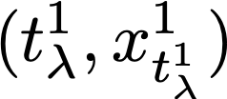
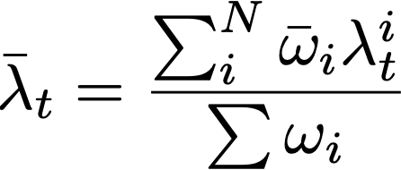
Estimation of
How to use all available information?
First, we have one reference full trajectory
Estimate using sigmoid regression with one parameter and RMSE loss
Two choices for the estimator:
1. Conservative choice: average of available full trajectories as of today only 2. Smarter choice:
Notes:
Note again that this is differentthat using a sigmoid model to make predictions since here, we have the full trajectory and we know that it behaves likea sigmoid

Slide 29
Estimation of
Notes:
Note again that this is differentthat using a sigmoid model to make predictions since here, we have the full trajectory and we know that it behaves likea sigmoid

Slide 30
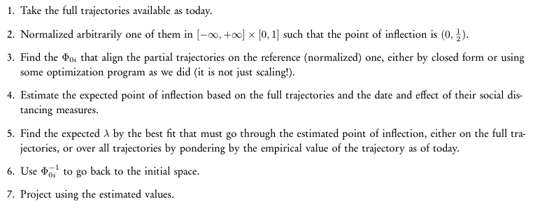
Summary

Slide 31
Results and Discussions
Notes:
Let's see what we can build from these two hypotheses.

Slide 32
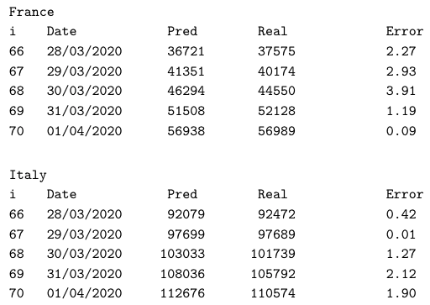
Results
Average relative error for the central scenario for a J+1 prediction from 28/03/2020 to 01/04/2020 as follows:
Italy: 1.14%
Poland: 1.35%
Portugal: 1.73%
France: 2.08%
Notes:
To evaluate the model, we use several validation metrics that are also used to recalibrate the model depending on the observed deviation:
we provide three scenarios: central, worst case at 5% and best case at 5\% (under a Gaussian assumption on the noise and on the uncertainty on estimation of $t_\lambda$). When the real curve starts to deviate from the central scenario, we readjuste the individual trajectory parameters to realign the central scenario on it. This affects positively all other trajectories.
we provide and monitor the absolute and relative uncertainty between the 5% scenarios and the average scenario to ensure it converges toward zero with time.

Slide 33
Results
Notes:
To evaluate the model, we use several validation metrics that are also used to recalibrate the model depending on the observed deviation:
we provide three scenarios: central, worst case at 5% and best case at 5\% (under a Gaussian assumption on the noise and on the uncertainty on estimation of $t_\lambda$). When the real curve starts to deviate from the central scenario, we readjuste the individual trajectory parameters to realign the central scenario on it. This affects positively all other trajectories.
we provide and monitor the absolute and relative uncertainty between the 5% scenarios and the average scenario to ensure it converges toward zero with time.

Slide 34
Results
Notes:
To evaluate the model, we use several validation metrics that are also used to recalibrate the model depending on the observed deviation:
we provide three scenarios: central, worst case at 5% and best case at 5\% (under a Gaussian assumption on the noise and on the uncertainty on estimation of $t_\lambda$). When the real curve starts to deviate from the central scenario, we readjuste the individual trajectory parameters to realign the central scenario on it. This affects positively all other trajectories.
we provide and monitor the absolute and relative uncertainty between the 5% scenarios and the average scenario to ensure it converges toward zero with time.

Slide 35
Results
Notes:
To evaluate the model, we use several validation metrics that are also used to recalibrate the model depending on the observed deviation:
we provide three scenarios: central, worst case at 5% and best case at 5\% (under a Gaussian assumption on the noise and on the uncertainty on estimation of $t_\lambda$). When the real curve starts to deviate from the central scenario, we readjuste the individual trajectory parameters to realign the central scenario on it. This affects positively all other trajectories.
we provide and monitor the absolute and relative uncertainty between the 5% scenarios and the average scenario to ensure it converges toward zero with time.

Slide 36
Discussion
Drawbacks:
Need at least one full trajectory
Works only for countries with social distancing measures
Advantages:
Few testable and realistic hypothesis
Few parameters in relation with physical quantities
The mathematical model converges, reasonable estimations
Risk evaluation, recalibration and drift monitoring
If the global traj. follows the sum of traj. we’re good boi!
Counterfactual analysis made easy

Slide 37
Discussion
Assume you know nothing more than your maths.
Know your maths!
Make few but testable hypotheses (better, valide them a priori with experts)
Let doors open for expert knowledge a posteriori
Try to reduce structural uncertainty, account for aleatoric uncertainty
Notes:
it is most likely the model estimationsthat are wrong rather than a country behaving differently than the others. Therefore we can adjust manuallyor automatically the bias on the impact of social measures.
The observed relative errors indicates the direction of the bias in our estimator fortλandλand a hint on how big this bias is.
the deviation of individual trajectories depending on the social distancing date
•the deviation of the trajectory by removing T dates in the available time series for a given country,•
the marginal influence of each country in the estimated model parameters

Slide 38
Thank you

