Slide 1

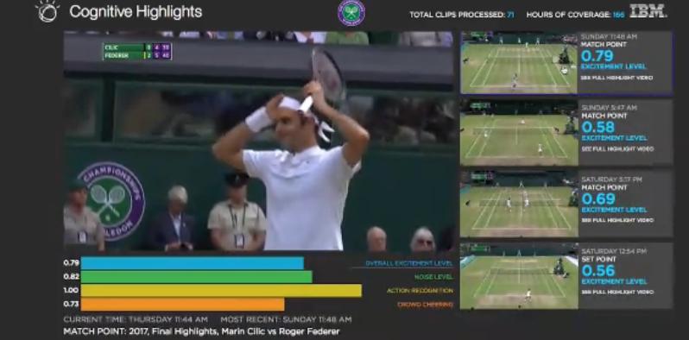

Unsupervised Video Semantic Partitioning Using IBM Watson and Topic Modelling
DARLI-AP 2018
Alexandre Quemy
Marcin Janiszewski
Krzysztof Jamrog
IBM Analytics

Slide 2

AGENDA
Video Semantic Partitioning
Feature Streams
Split-And-Merge Algorithm
Experiments & Results
Improvements, work in progress and future plans

Slide 3
Video Semantic Partitioning

Slide 4

Forewords
Context of the project:
  Internal but global contest „Cognitive Build” to valorize IBM Watson Services
  One of the winning project
Purpose:
  Automate knowledge transfer from customers to IBM outsourcing services
  Avoid sending IBMers on site (very costly)
  Better knowledge (and contract) managment
Training format: Videos describing a process step by step.
  Video Semantic Partitionning

Slide 5



Video Semantic Partitioning Problem
Problem formulation:
A video is temporal signal defined on .
Denote by the set of partition of into m elements,
i.e.
Goal: finding s.t. each pair of adjacent block holds a different semantic.

Slide 6

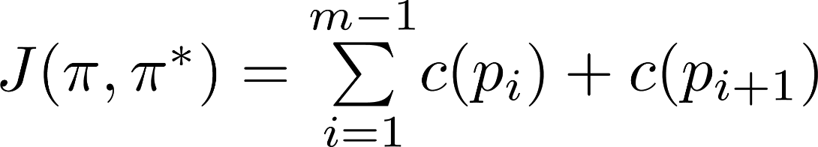


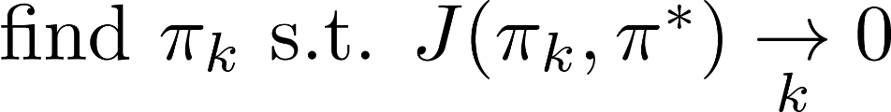
Video Semantic Partitioning Problem
Problem formulation:
Assume there exists an optimal partition .
Loss function:
If , then
Video Semantic Partitioning Problem:

Slide 7



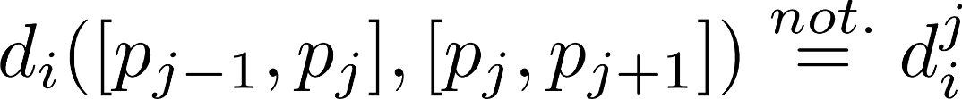
Video Semantic Partitioning Problem
In practice, there are problems:
  Does the optimal partition really exists?
  We do not know (or there is no problem!) and thus cannot calculate J
  We do not even know the optimal number of cutting points
Let us overcome those problems:
  If J is available, if is large enough, a strategy to minimize J is to remove unecessary cutting points.
  If J is not available, we need to approximate it
  feature streams, each being a signal on
  associated metric:
  Notation:

Slide 8
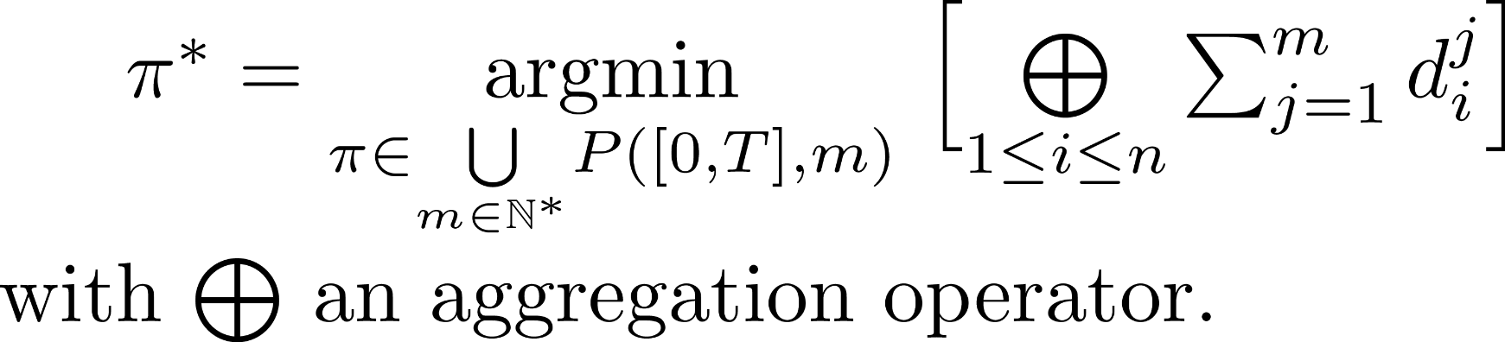
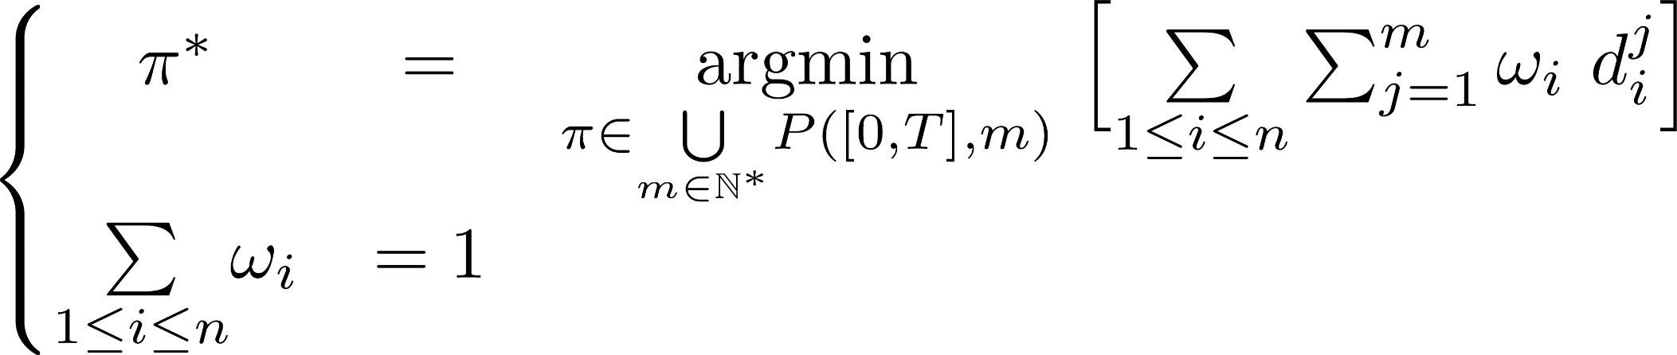
Video Semantic Partitioning Problem
New formulation:

Slide 9
Feature Streams

Slide 10
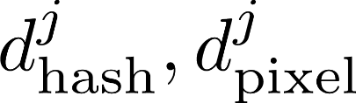

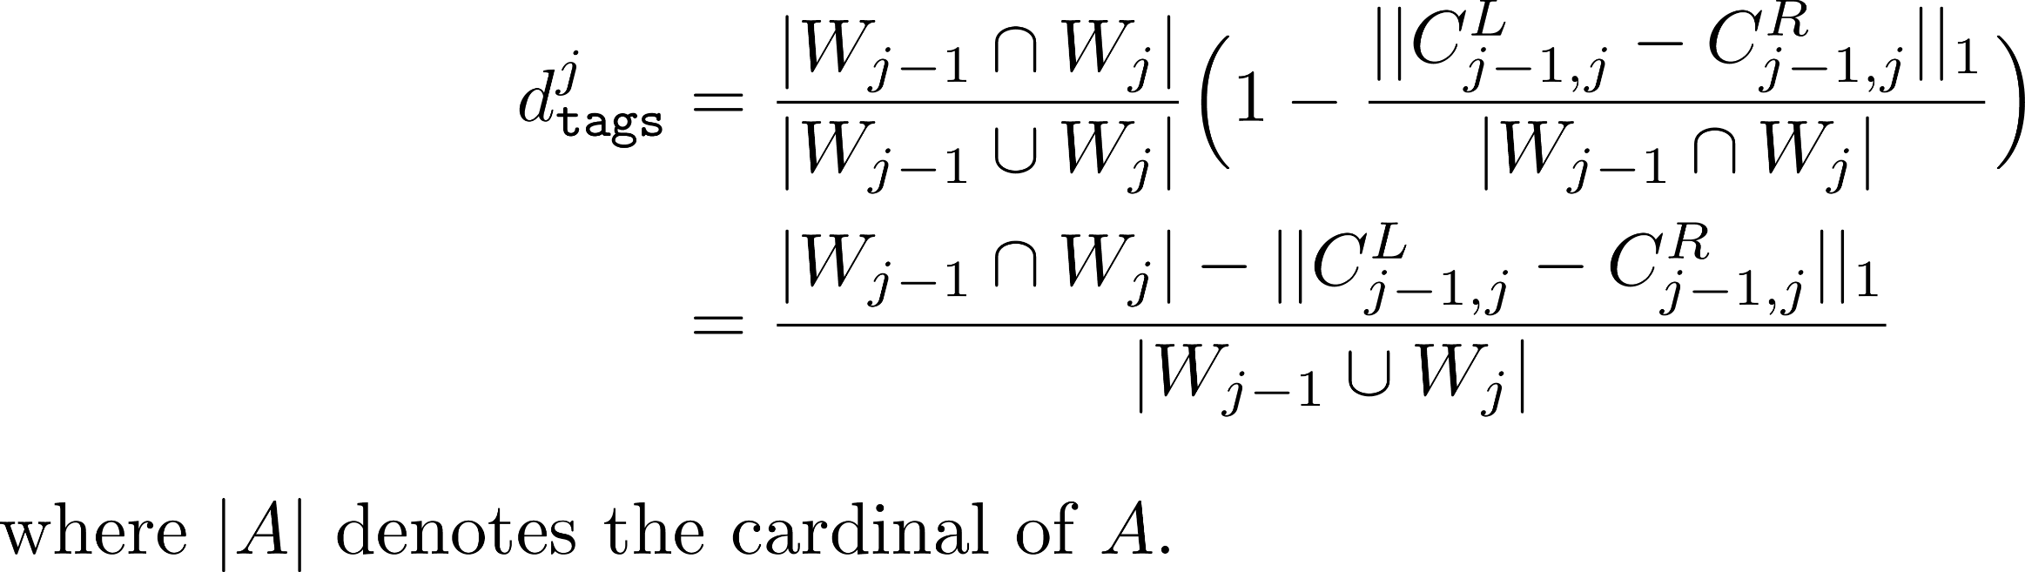
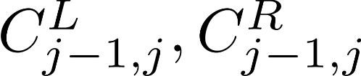
Feature Streams
Features from the visual part:
  We extract frames every 3 seconds.
  Between two frames, pixel-based Hamming distance and a perceptual hash:
  For two blocs, we use as representant the last and first extracted frames.
  With IBM Watson Visual Recognition we extracted from each frame a list of tags with confidence.
  the words in block j
  the confidence level for words
  in common between j and j-1

Slide 11
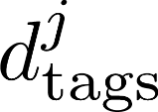
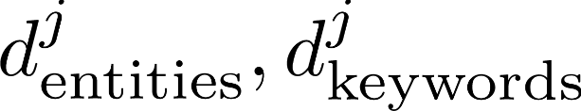
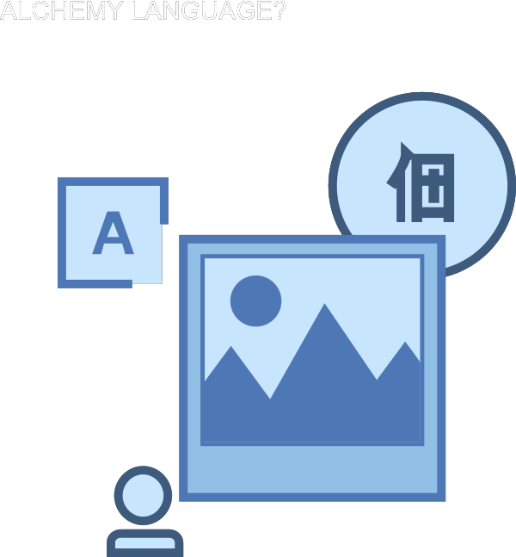
Feature Streams
Features from the audio part:
  With IBM Watson Speech-To-Text, we extracted the transcript from the audio.
  With IBM Watson Natural Language Understanding we extract from the transcript, the keywords and entities from each block.
  Using the keywords and entities, we define two similar measures to :
{ "text": "IBM is an American multinational technology company headquartered in Armonk, New York, United States, with operations in over 170 countries.",
"features": {
"concepts": {
"limit": 20 },
"keywords": {
"limit": 20 }
}
}

Slide 12


Feature Streams
Features using topic model:
  We normalized the transcript of each bloc (seen as „document”):
  Tokenization and token cleaning
    Part of Speech (PoS) Tagging
    Lemmatization
    N-Gram calculation and frequencies filtering
  We used a Latent Dirichlet Allocation to obtain a distance between blocks
  Three hyperparameters:
  number of topics
  priors distribution (doc-topic and topic-word)

Slide 13
Split-and-Merge Algorithm

Slide 14
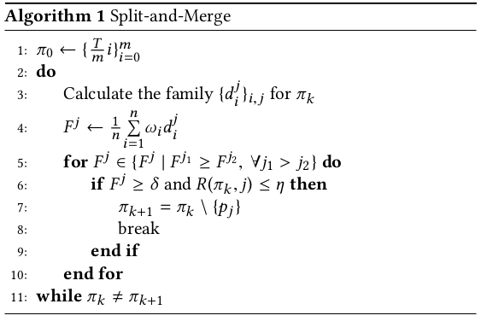
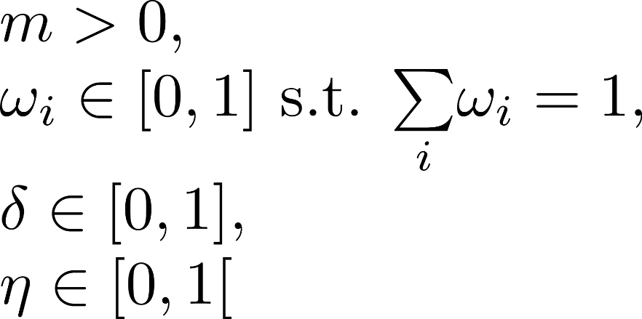
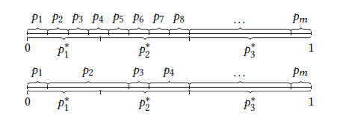
Split-and-Merge
Hyperparameters:

Slide 15
Experiments & results

Slide 16
Experiments & Results
The protocol
Public survey: For each video, describe how you would break it into "steps" (a bit like a chapter in a book).
Additional indication: Weak transition
(1) Running an experiment in the IBM Quantum Experience3
(2) IBM Bluemix - 3 minutes demo (NodeJS, SSO)4
(3) IBM Watson for Oncology Demo5
We collected respectively 7, 5 and 5 answers for each video

Slide 17

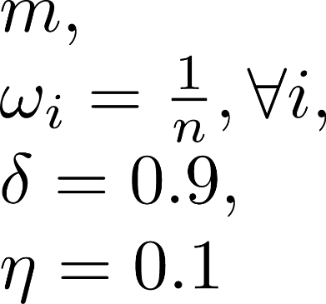
Experiments & Results
The results
  Example of answer:
  Hyperparameters:
We assumed a cutting point is ~ to a 3s interval centered on the it.

Slide 18
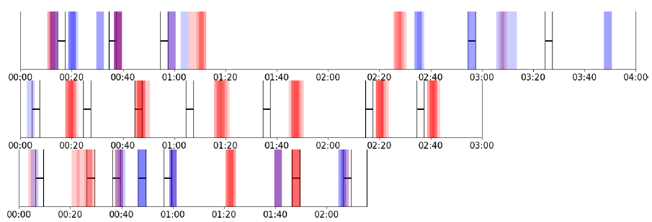
Experiments & Results
The results

Slide 19
Improvements, WIP
and future plans

Slide 20
Future plan
Many axis of improvements:
  Refine the evaluation protocol: better defined metrics or more data.
  Hyperparameter tuning (in particular the weights)
  Evaluation of the restricted hypothesis mentionned in the paper.
  Exploring multi-objective optimization (per feature stream)
  New features streams (OCR notably)
  Evaluating the importance of each feature stream (counterfactual analysis)

Slide 21
Thank you

