Slide 1




Data Pipeline Hyperparameter Optimization
PyData Warsaw 2018
Alexandre Quemy
IBM
Politechnika Poznańska

Slide 2
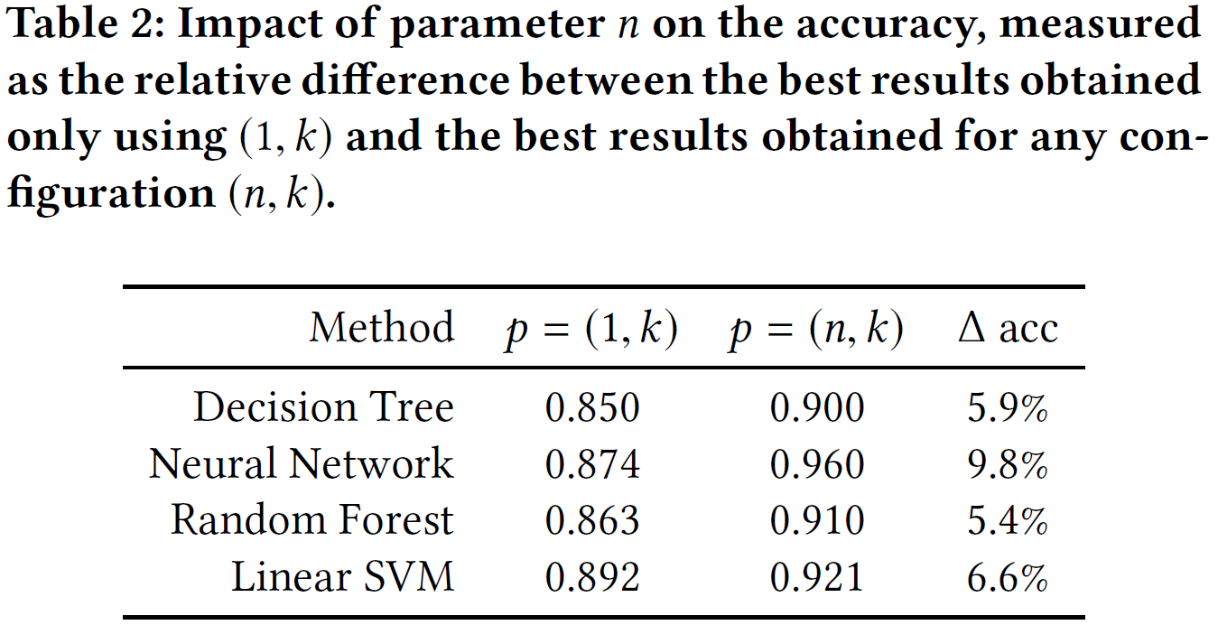
Main empirical result

Slide 3
Hyperparameter tuning

Slide 4
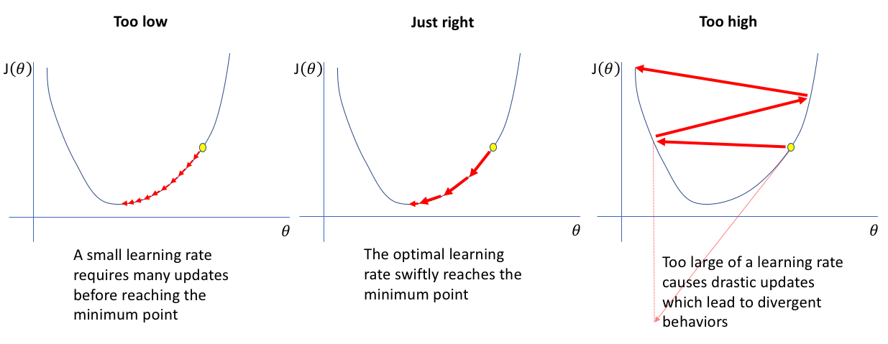
Hyperparameter tuning
The most famous example:
Image: https://www.jeremyjordan.me

Slide 5
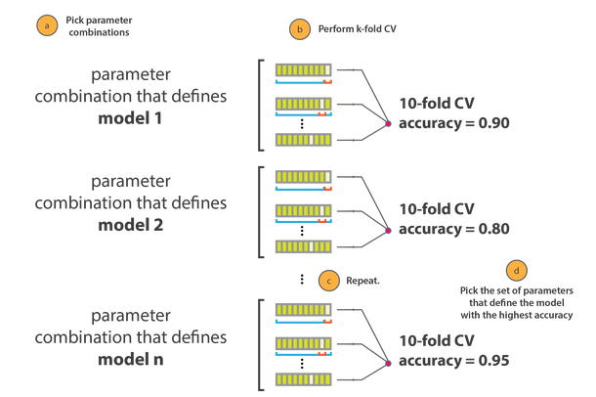
Hyperparameter tuning
Procedure:
Image: https://cambridgecoding.wordpress.com

Slide 6
Hyperparameter tuning
Sequential Model-Based Optimization (SMBO):
A configuration space over which to search
A metric to optimize (e.g. model accuracy, ROC AUC, etc.)
The surrogate model of the objective function
A criteria to select the next promising configuration
A history (score, configuration)
Also called SMAC (Sequential Model-based Algorithms Configuration):
Warmstarting of Model-Based Algorithm Configuration, Marius Lindauer, Frank Hutter,
Conference on Artificial Intelligence (AAAI-18)

Slide 7
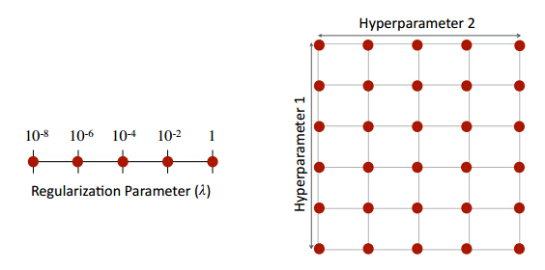
Hyperparameter tuning
Main techniques:
  Grid Search
  Random Search
  Iterated Local Search
  Bayesian approachs

Slide 8
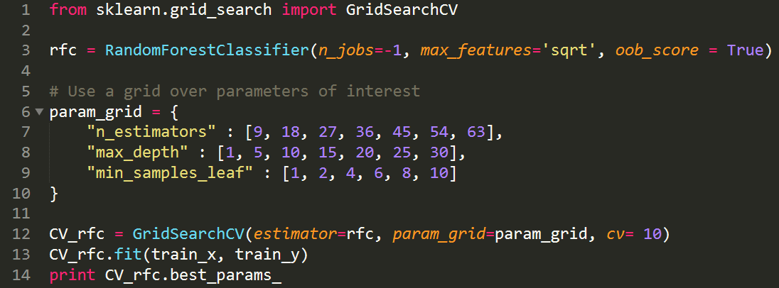
Hyperparameter tuning
Basic implementation with Scikit-Learn:

Slide 9
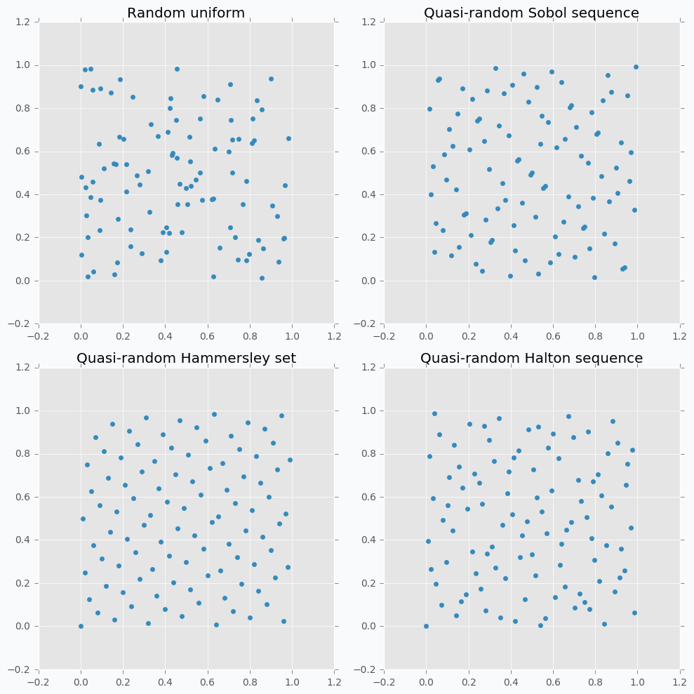
Hyperparameter tuning
Main techniques:
  Grid Search
  Random Search
  Iterated Local Search
  Bayesian approaches

Slide 10

Hyperparameter tuning
Basic implementation with Scikit-Learn:
RandomizedSearchCV

Slide 11
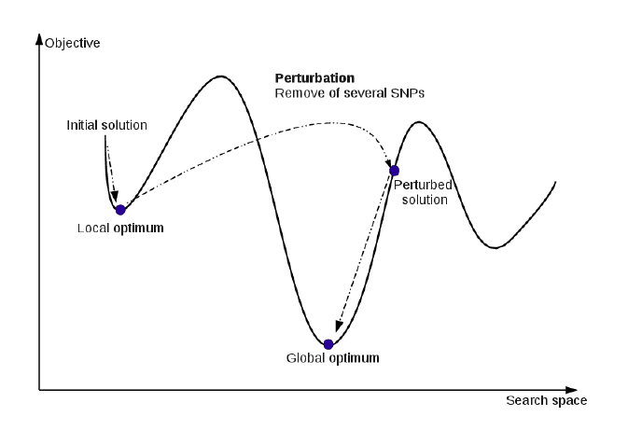
Hyperparameter tuning
Main techniques:
  Grid Search
  Random Search
  Iterated Local Search
  Bayesian approaches
Implementation:
ParamILS
http://www.cs.ubc.ca/labs/beta/Projects/ParamILS/

Slide 12

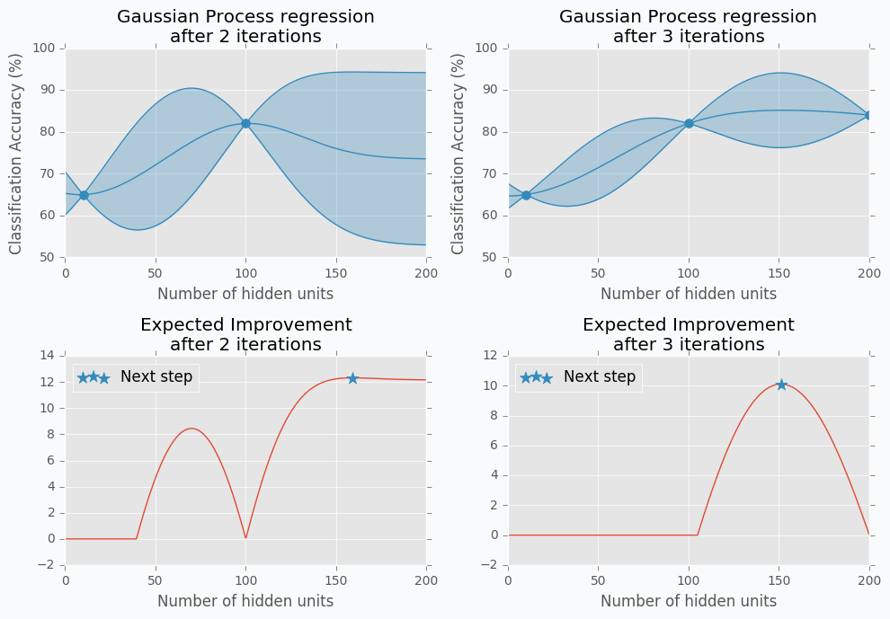
Hyperparameter tuning
Main techniques:
  Grid Search
  Random Search
  Iterated Local Search
  Bayesian approaches
Implementations:
Spearmint
RoBO
Hyperopt / Bayesopt
Image: http://http://neupy.com

Slide 13
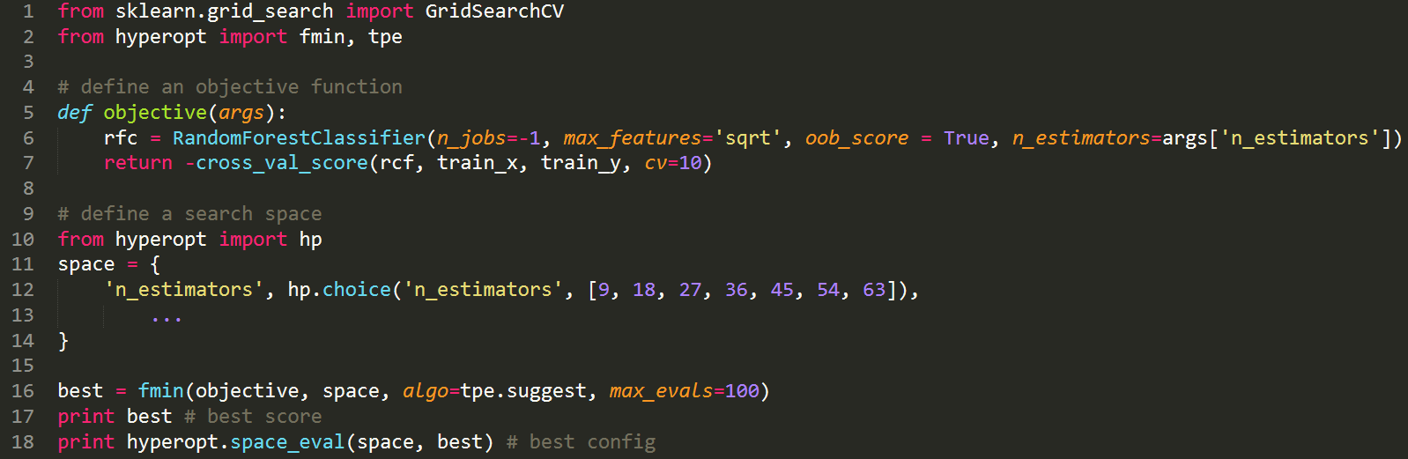
Hyperparameter tuning
Basic implementation with hyperopt:

Slide 14
Data pipeline optimization

Slide 15
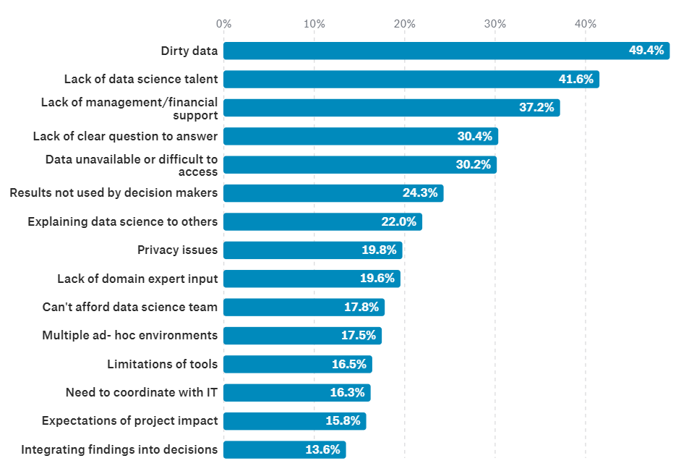
Data Pipeline Optimization
Question: If we know data are so important, why we treat them less seriously than algorithms?

Slide 16
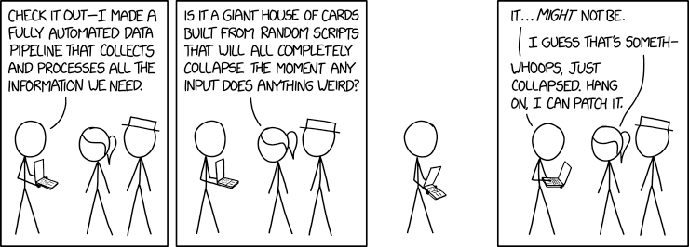
Data Pipeline Optimization
Answer: for this guy to still have a job!

Slide 17
Data Pipeline Optimization
  Dealing with missing value:
    Discarding? Row? Column?
    Imputation? What imputation? Mean? Median? Model-based? What model?
  Unbalanced datasets:
    Downsampling? Oversampling?
    Nothing? What bias it implies?
  Data too large:
    Dimensional reductions: what algorithm? PCA? normalization or not?
    Subsampling: what technique? what bias?
  Outliers detection and curation:
    What threshold? What deviation measure?
    Trimming? Truncating? Censoring? Winsorizing?
  Encoding for method domain requirements:
    Discretization? Grid? What step? Cluster? What method? What hyperparameter?
    Categorial encoder? Binary? Hot-One? Helmert? Backward Difference?
  NLP:
    How many tokens?
    Size of m-grams?

Slide 18
Data Pipeline Optimization
Data collection
Data pipeline
Model selection
Model selection
Raw data
algorithm
algorithm
model 1
Operation 1
Operation 2
Operation 3
model 1
model 2
model 2
metric
metric
model 3
model 3
p
metaoptimizer
metaoptimizer
best model
best model

Slide 19
Data Pipeline Optimization
Data collection
Data pipeline
Model selection
Raw data
O11
O21
O22
metric?
Best pipeline
algorithm
model 1
O12
O22
O23
model 2
metric
model 3
p
p
metaoptimizer
metaoptimizer
best model

Slide 20
Data Pipeline Optimization
Data collection
Data pipeline
Model selection
Raw data
O11
O21
O22
metric
Best pipeline
algorithm
model 1
O12
O22
O23
model 2
metric
model 3
p
p
metaoptimizer
metaoptimizer
best model
Feedback

Slide 21

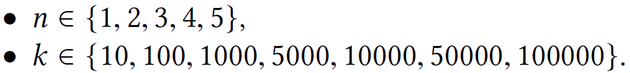
Data Pipeline Optimization
  Raw data:
    1000 judgements from HUDOC (prev. 0.5)
    removing the conclusion section
  Pipeline:
    Tokenization
    Stopword removal
    P-o-S tagging
    Lemmatization
    N-gram generation
    BoW projection
    Configuration space:
    Algorithms:
    Decision Tree, Neural Network, Random Forest and Linear SVM

Slide 22
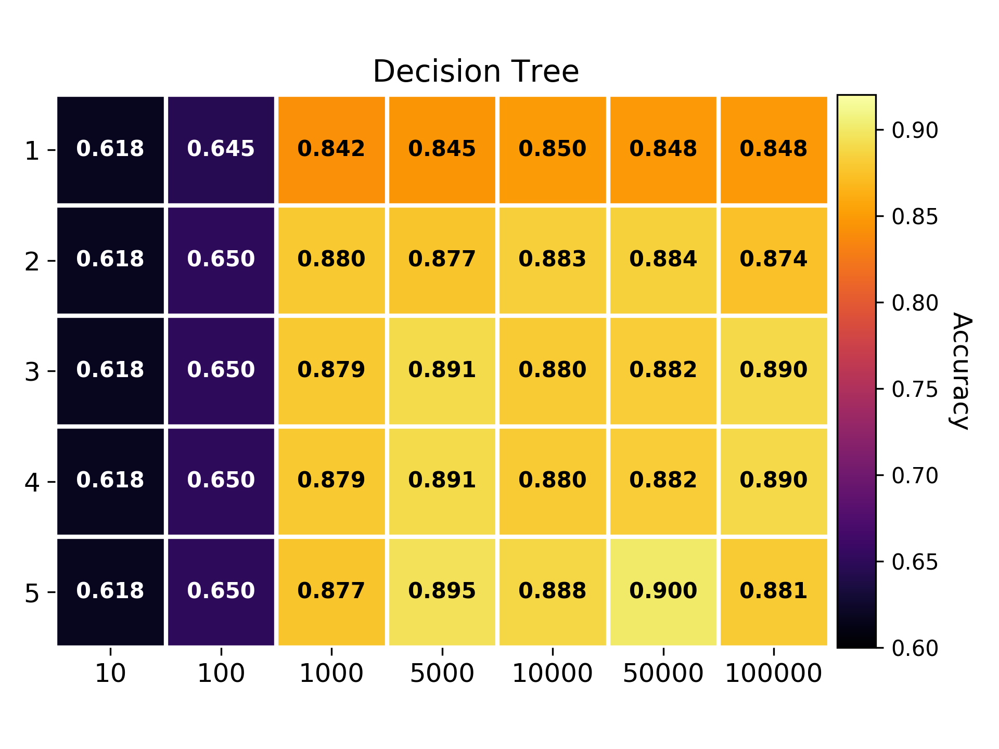
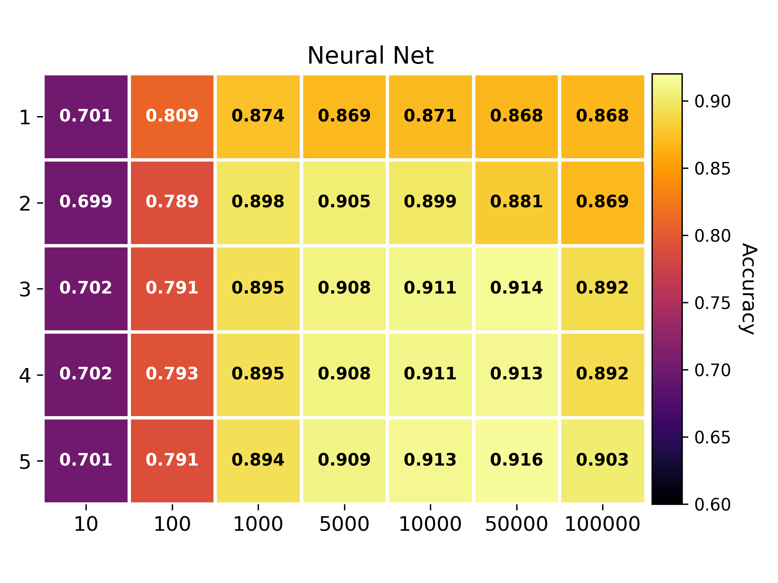
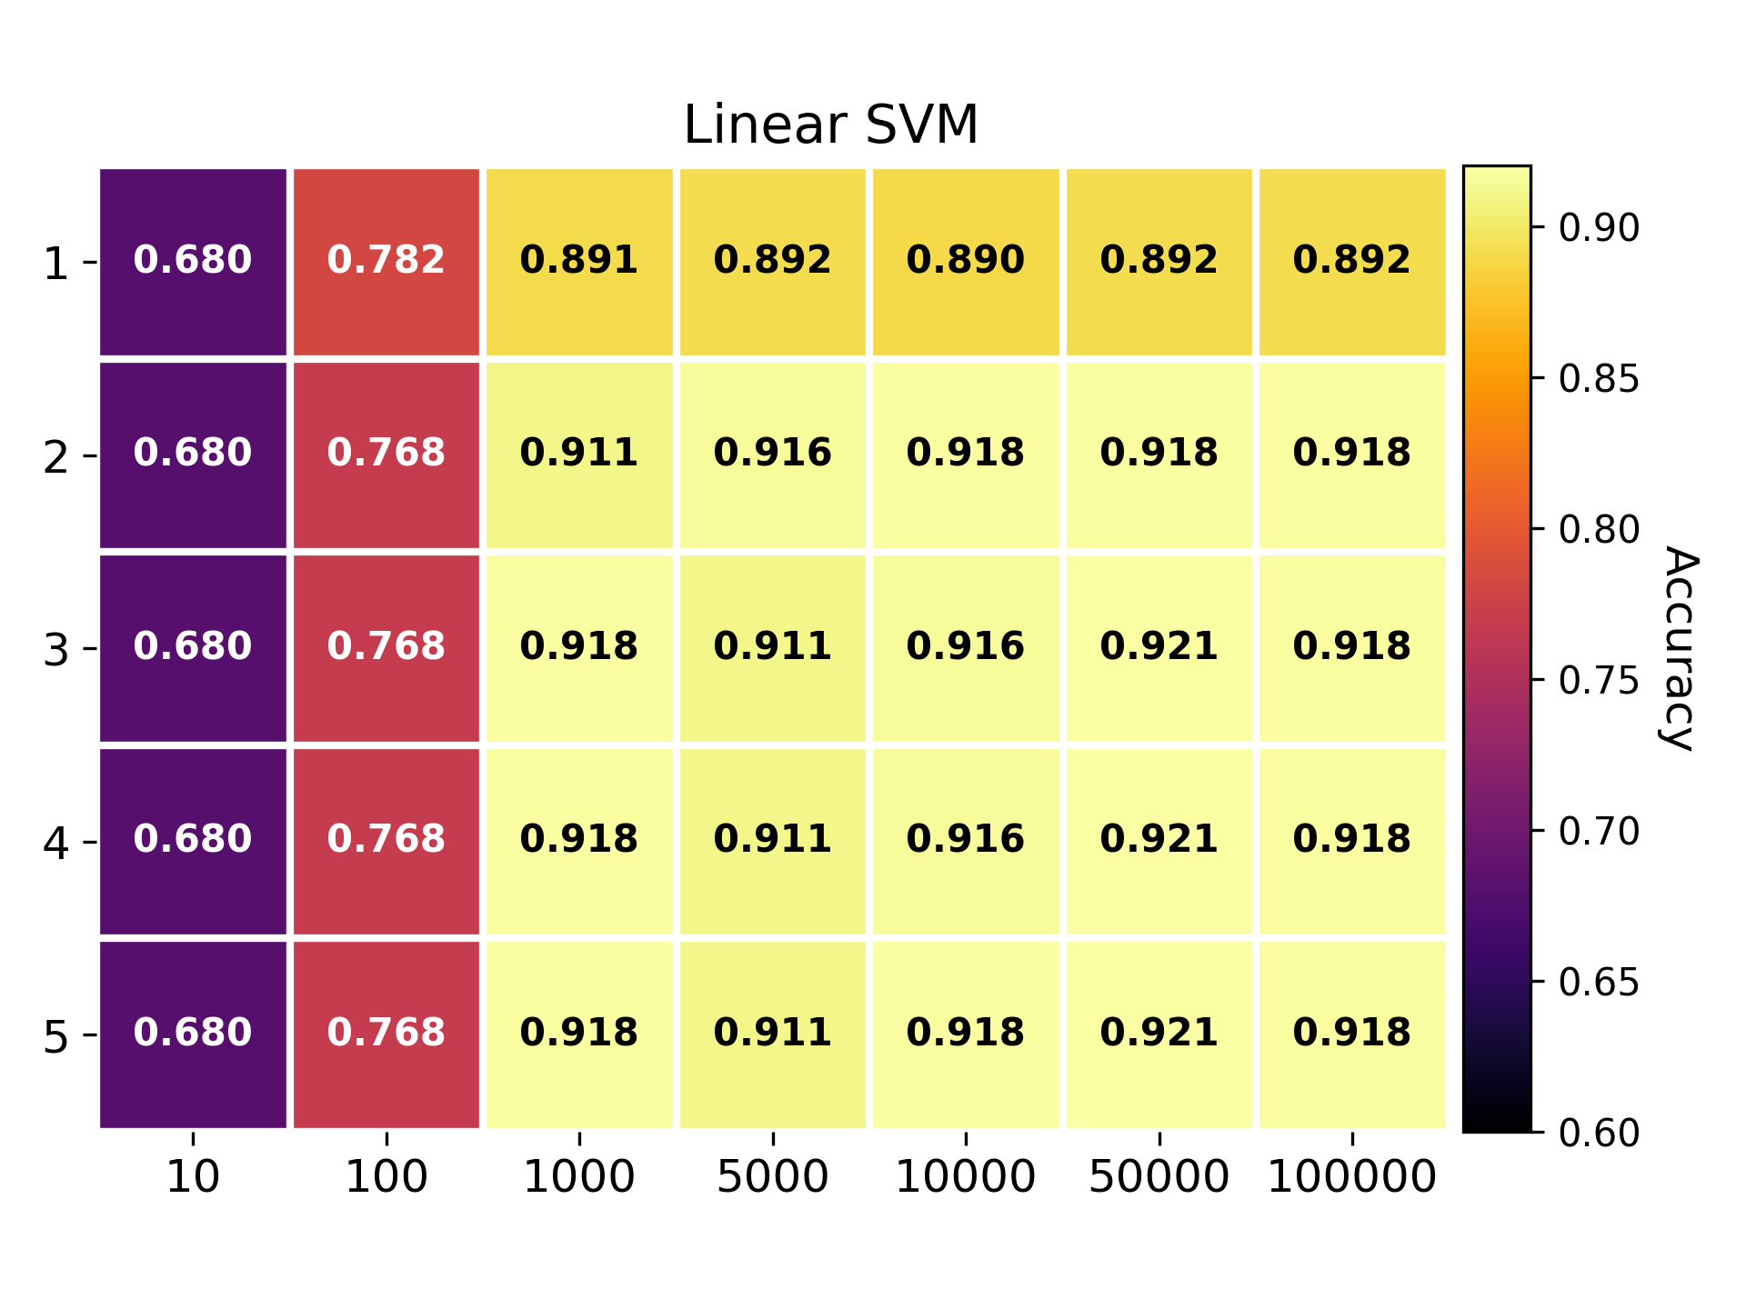
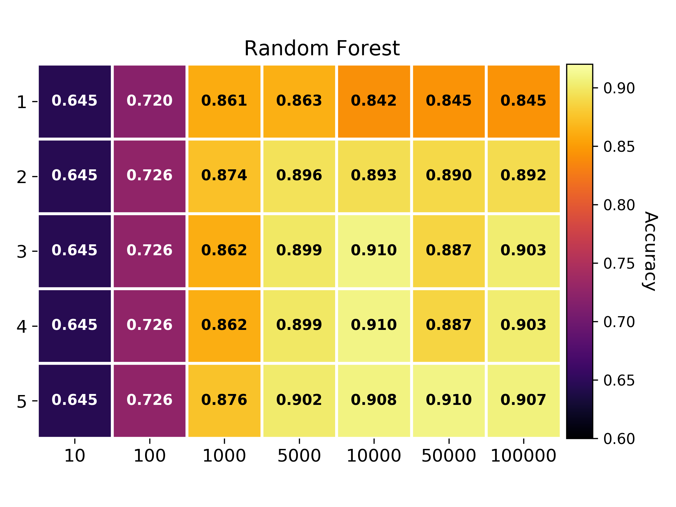

Slide 24
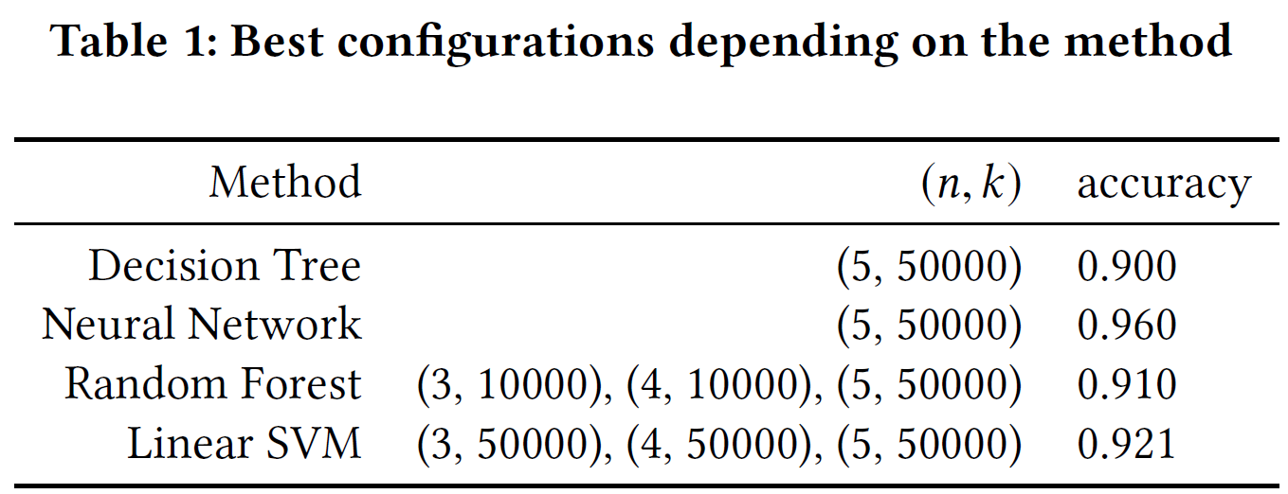
Data Pipeline Optimization

Slide 25
Data Pipeline Optimization
Question: How much time do I have to spend to find the optimal configuration?

Slide 26
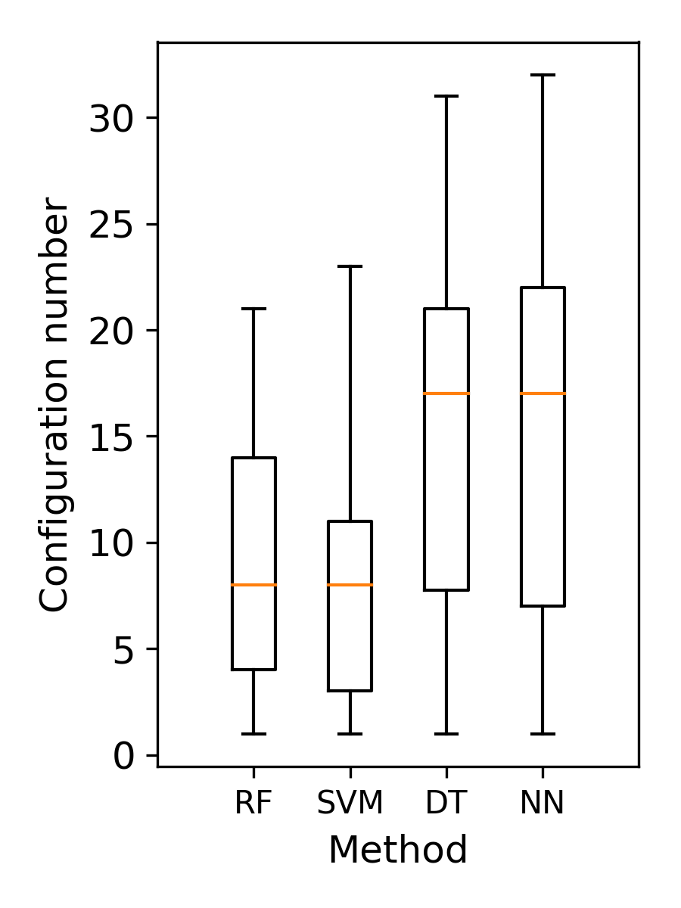
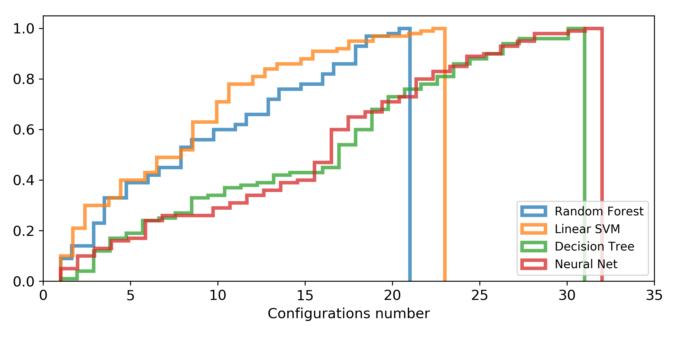
Data Pipeline Optimization
Question: How can I quantify if an optimal configuration is algorithm specific?

Slide 27
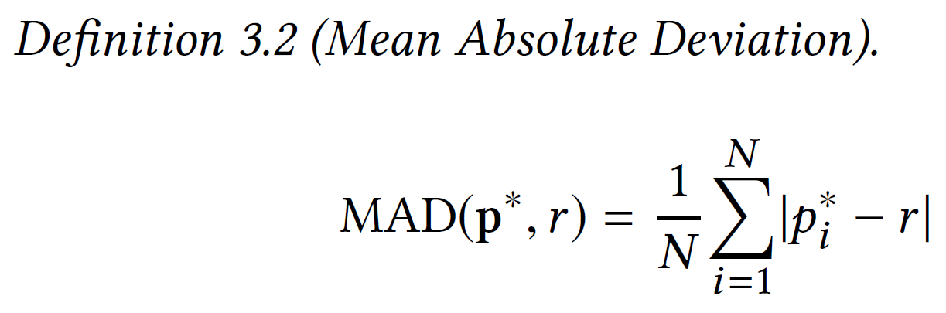
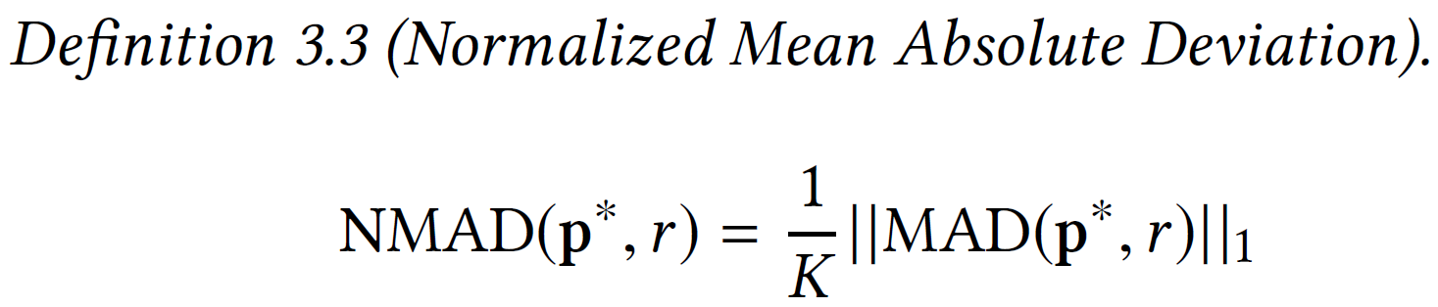
Data Pipeline Optimization
N: number of algorithms
K: dimension of the configuration space
r: a reference point
p*: sample of optimal configurations
For each optimal configuration r:
1. Build the sample w.r.t. to the algorithms:
  For each algorithm, select the optimal point that is the closest from the reference point.
  2.Express the sample in normalized conf. space
  3.Calculate the NMAD on the sample

Slide 28
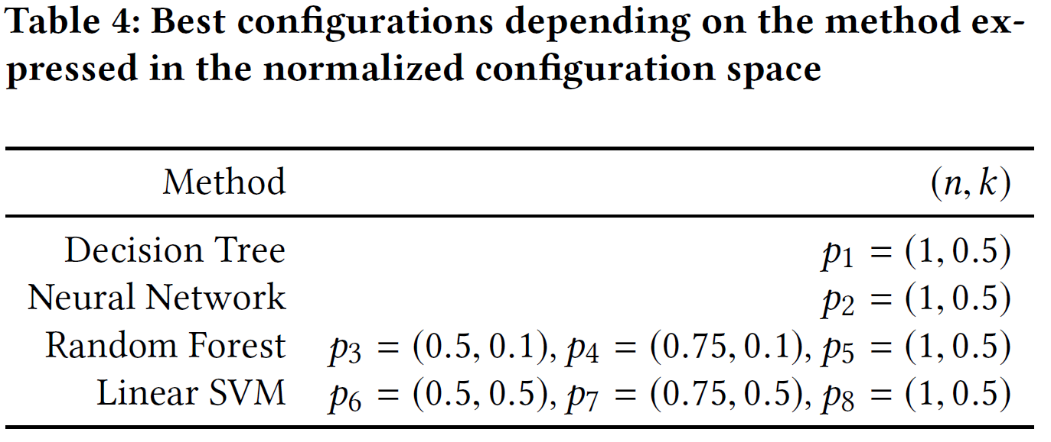
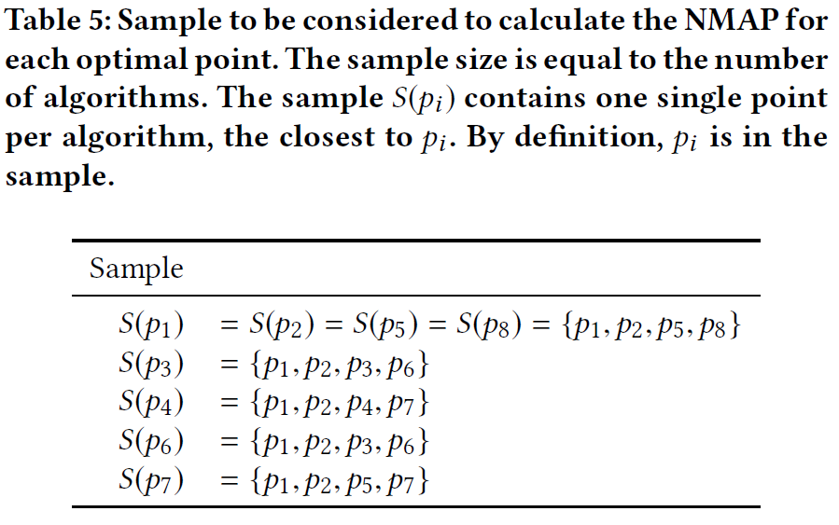

Slide 29
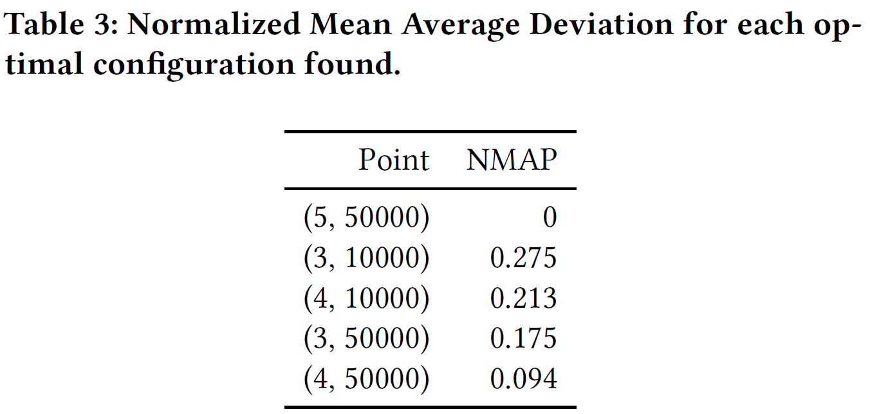

Slide 30
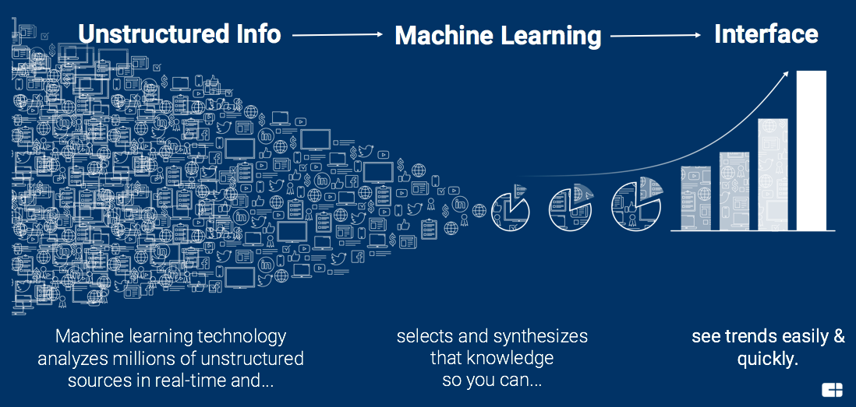
Future work
Work in progress:
  Tests on larger configuration spaces.
  Optimizing the Data Pipeline generation itself (chain of operators + order)

Slide 31

Thank you
Optimized Idea Generator Pipeline

