Slide 1
IBM Bluemix
Watson Cloud Services
Łukasz Ćmielowski, PhD Alexandre Quemy
IBM Analytics

Slide 2
AGENDA
Watson Cloud Services overview
Introduction to Watson Machine Learning
Demo: Product Line Prediction

Slide 3
Watson Cloud Services overview
Notes:
Within this section we will show how within 5 minutes we can create and deploy basic Node.js application with github as a code repository using Bluemix platform.

Slide 4
What is Watson?
Watson equations
AI methods + NLP = Watson Core
Watson Core + (REST) API + Bluemix = Watson Cloud Services
Watson Cloud Services + Engineer imagination = Cognitive Era

Slide 5
Watson Cloud Services
Generalities
• Each service provides a REST API. • Some services provide additional interfaces (e.g. Websocket). • Bluemix Cloud Service to deploy applications. • SDK for: Java, Python, Node.js, iOS, Unity.
Development tools
• Using the Bluemix web interface. • Using the Eclipse IDE (dedicated pluggin). • Using the Cloud Foundry CLI (PaaS by VMWare).

Slide 6
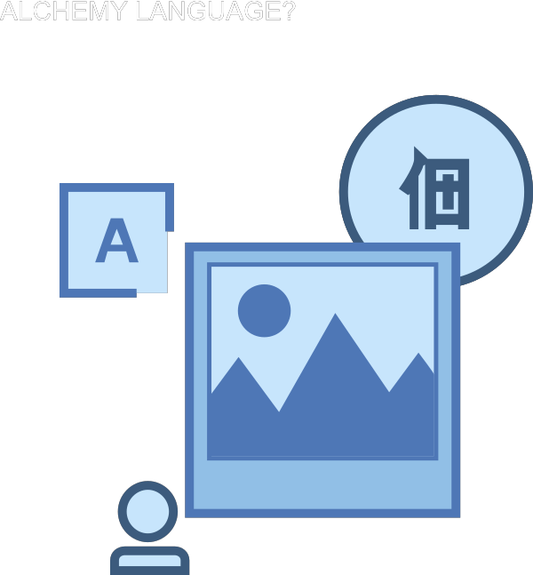
Watson Cloud Services – Alchemy Language
Collection of API for Natural Language :
• Entity Extraction • Sentiment Analysis • Keyword Extraction • Concept Tagging • Relation Extraction • Taxonomy Classification • Author Extraction • Language Detection • Text Extraction • ...

Slide 7
Watson Cloud Services - Conversation
Features
• Creation of natural language dialogues • Include pro le tracking for learning • Visual builder tool
Use cases
• Ordering online • First line online support • Intelligent home automation

Slide 8
Watson Cloud Services – Natural Language Classifier
Features
• Deep learning classification for Natural Language queries • Provide classification with con dence interval
Use cases
Automatic tagging of content, classification of emails, intelligent dialogues.

Slide 9
Watson Cloud Services – Personality Insight & Tone Analyzer
Features
• Personality (Five Factors Model), needs and values extraction • Needs at least 1.2k words. • Any source: twitter, book,... • Analyze emotion and language tones in text • Provide Emotion, Language and Social analysis
Use cases • Individual customer service or marketing, job applicant analysis, market analysis. • Study on the impact of your anouncements

Slide 10
Watson Cloud Services – Speech to Text & Text to Speech
Features
• Speech recognition to text output • Stream or recorded input • Several languages supported • Keyword extraction. • Low latency audio synthesis • Several languages supported • Specific words pronunciation tuning through the REST API
Use cases
Accessibility, transcription of conferences or meetings.

Slide 11
Watson Cloud Services – Visual Recognition
Features
• Deep-learning methods to classify images • Can be train with your own model • Face, words, persons detection • Age estimation, tagging and classification • Similar content suggestions
Use cases
Automatic organization of images, social media segmentation.

Slide 12
Watson Cloud Services – Others

Slide 13
Introduction to Watson Machine Learning
Notes:
Within this section we will show how within 5 minutes we can create and deploy basic Node.js application with github as a code repository using Bluemix platform.

Slide 14
Watson Machine Learning
The gap between data scientists and operations is an overlooked pain point

Slide 15
Watson Machine Learning
A place where data scientist meets with developer
Watson
Machine
Learning

Slide 16
Data Science Experience

Slide 17
Bluemix

Slide 18
Watson Machine Learning
Workflow

Slide 19
Watson Machine Learning – Sign up
Sign up for Watson Machine Learning Beta
Notes:
For this demo session we have chosen real New York motor accident data. By using SPARK and Notebook on Bluemix we will show how data exploration and visualization can be easily done.

Slide 20
Demo: Product Line Prediction
Notes:
Within this demo session we will show how to create and deploy basic Node.js application „Hello analytics” on Bluemix.
We will also show how to create and connect github repository for our application on Bluemix. In the last part of demo session we will go through application overview dashboard, logs and binding additional Bluemix services to our application.

Slide 21
Thank you
Notes:
Within this demo session we will show how Node.js application can use and display data from previously created model for customer satisfaction prediction.

