Slide 1



IBM Watson Cloud Services
A brief overview
Alexandre Quemy
IBM Analytics

Slide 2
AGENDA
What is Watson?
Watson Cloud Services overview

Slide 3
What is Watson Cloud Services?
Notes:
Within this section we will show how within 5 minutes we can create and deploy basic Node.js application with github as a code repository using Bluemix platform.

Slide 4
What is Watson?
Watson equations
AI methods + NLP = Watson Core
Watson Core + (REST) API + IBM Cloud = Watson Cloud Services
Watson Cloud Services + Engineer imagination = Cognitive Era
+ Products (combination of services for dedicated application / field)

Slide 5
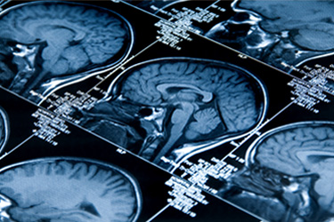
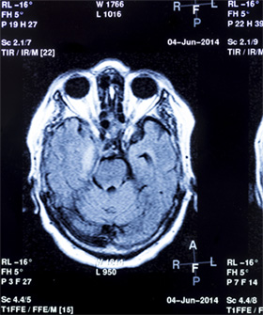
Some successful applications
Accelerate research and discovery
“ In the fields of radiology and cardiology there are over 40 modalities… and over 600 diseases to cover. ”
Watson Imaging Clinical Review
“ 80,000 to 160,000 people are killed or permanently disabled
every year as a result of misdiagnosis ”

Slide 6
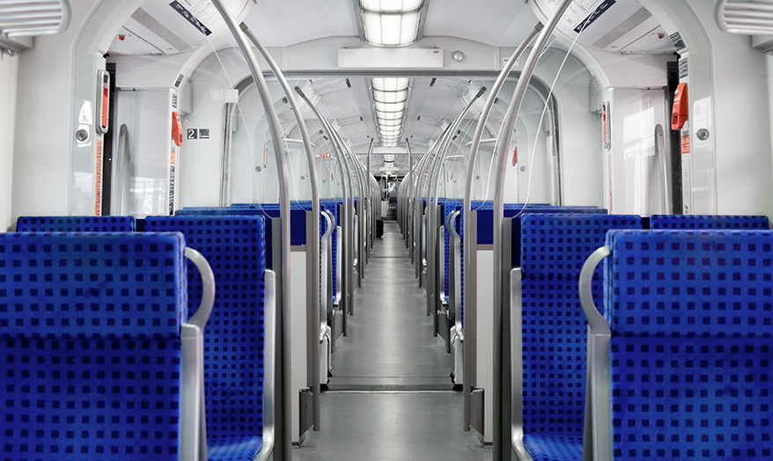
Some successful applications
Anticipate and preempt discruptions
“ SNCF: increasing safety, reliability and savings with
predictive maintenance ”
Watson Internet of Things (IoT)
“ [...] deploying thousands of sensors on trains and tracks which are securely sending
tens of thousands of data points in the cloud, all in real-time”

Slide 7
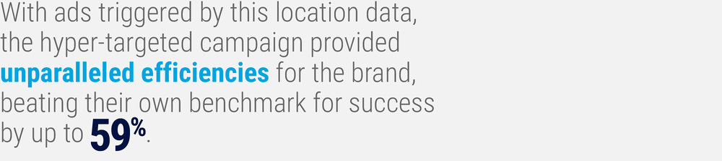


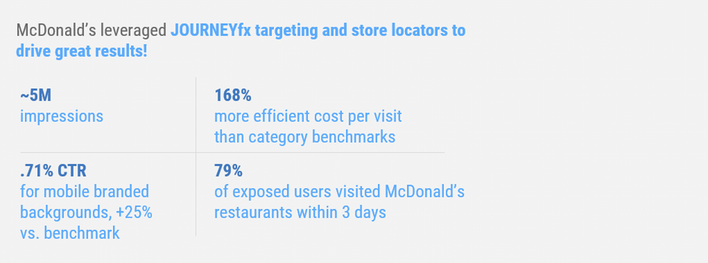
Some successful applications
Recommand with confidence

Slide 8
Some successful applications
Scale expertise and learning
Watson for Oncology:
Help identify evidenced-based, patient-centric treatment options.
Watson Drug Discovery:
IBM and Pfizer to Accelerate Immuno-oncology Research with Watson for Drug Discovery.
Barrow Neurological Institute engaged IBM Watson for Drug Discovery to search research documents for potential connections and help identify new RNA-binding proteins linked to ALS.

Slide 9
Some successful applications
Scale expertise and learning
90% concordance with tumor board* recommendations on breast cancer
* cancer specialists who review the most complex cancer cases each week
Source: Presentation by Prof. Dr. S.P. Somashekhar, Chairman, Manipal Comprehensive Cancer Center, Manipal Hospitals, Bangalore, India at the San Antonio Breast Cancer Symposium, December 9th, 2016

Slide 10
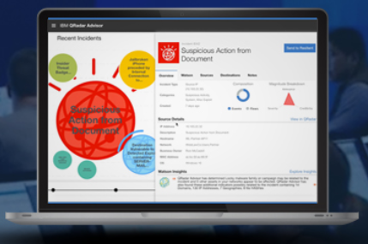

Some successful applications
Detect liabilities and mitigate risks
Cybersecurity: IBM QRadar Advisor with Watson
Enrich your interactions
First line support in Orange, IBM, etc.
IBM Ross to help lawyers

Slide 11
What is Watson?
Several services and products:
Conversation
Knowledge (management and discovery)
Vision
Speech
Language
Empathy

Slide 12
Watson Cloud Services overview
Notes:
Within this section we will show how within 5 minutes we can create and deploy basic Node.js application with github as a code repository using Bluemix platform.

Slide 13

Watson Cloud Services
Generalities
• Each service provides a REST API.
• Some services provide additional interfaces (e.g. Websocket).
• Bluemix IBM Cloud to create service instance, deploy applications, etc.
• SDKs for: Java, Python, Node.js, iOS, Unity officially, .Net, ...
Development tools
• Using the Bluemix web interface.
• Using the Eclipse IDE (dedicated pluggin).
• Using the Cloud Foundry CLI (PaaS by VMWare).
• Per service web interface (convenient and fast to prototype)

Slide 14
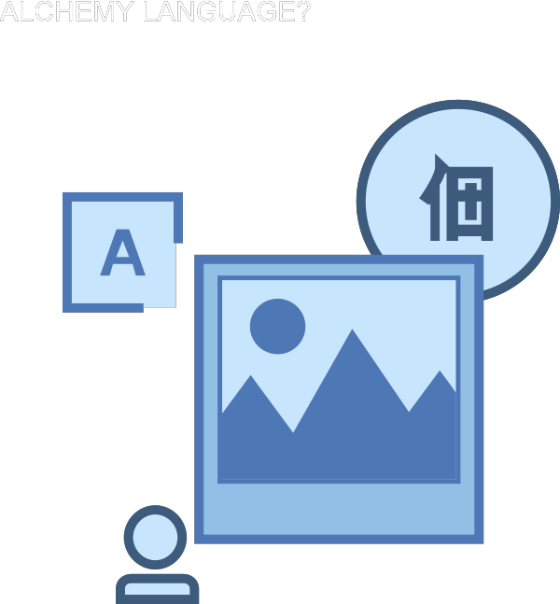
Watson Natural Language Understanding
Collection of API for Natural Language:
• Entity Extraction
• Sentiment Analysis
• Keyword Extraction
• Concept Tagging
• Relation Extraction
• Language Detection
• ...
... Merged into a single REST Endpoint

Slide 15
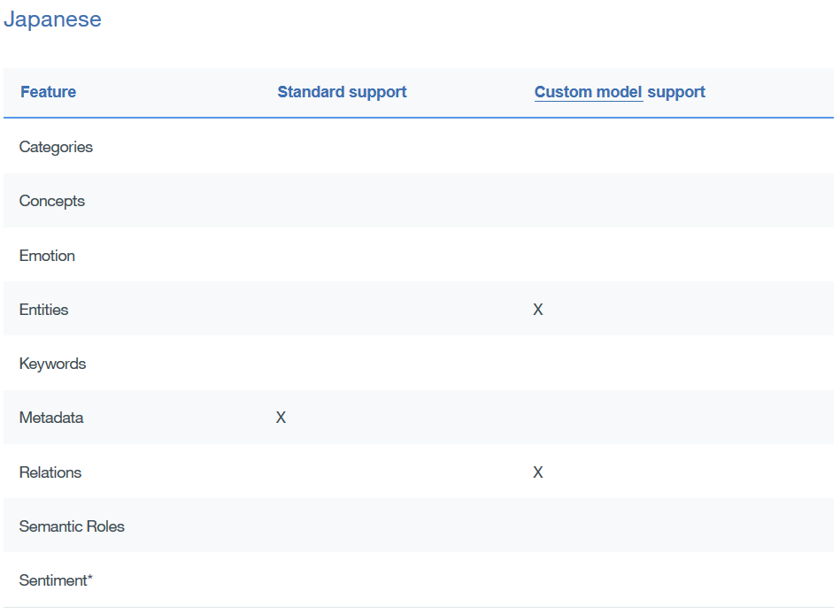
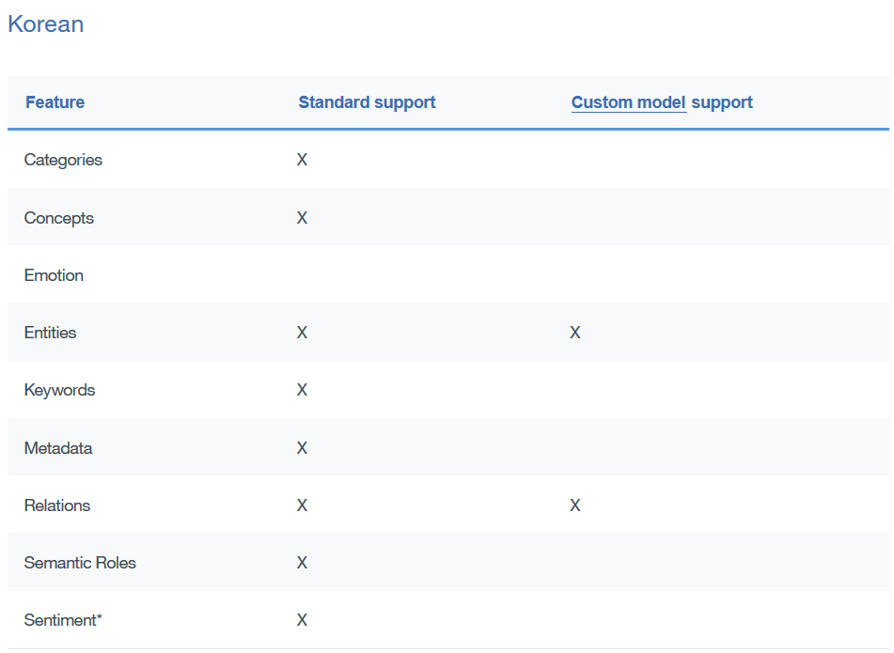
Watson Natural Language Understanding
Some characteristics:
• Replace AlchemyLanguage API
• Custom models (using Watson Knowledge Studio)
• Over a thousand nodes in a 5 level categories hierarchy
• Automatic language detection
• 433 entity types, >50 relations
• 11 supported languages

Slide 16
Watson Natural Language Understanding
Example:
curl -X POST -H "Content-Type: application/json"
-u "{username}":"{password}"
-d @parameters.json
"https://gateway.watsonplatform.net/natural-language-understanding/api/v1/analyze?version=2017-02-27"
{ "text": "IBM is an American multinational technology company headquartered in Armonk, New York, United States, with operations in over 170 countries.",
"features": {
"entities": {
"emotion": true,
"sentiment": true,
"limit": 2 },
"keywords": {
"emotion": true,
"sentiment": true,
"limit": 2 }
}
}

Slide 17
Watson Discovery
Document Corpus analysis:
• Environment: Container to store Collections
• Collection: Set of documents
• Document: Content + Metadata
• Configuration: What data are extracted from documents
• Query
One default environment: Discovery News, a pre-enriched public dataset.
CRUD API for Environment, Collections, Documents and Queries

Slide 18
Watson Discovery
The usual process:
• identify some sample content
• upload the content (API, crawler, studio)
• adjust the conversion process
• define enrichments
• normalize the results
Configuration

Slide 19
Watson Discovery
Conversion step:
Describe how to convert to JSON your original files from:
Microsoft Word, PDF, HTML, JSON
Word
HTML
JSON
Internal JSON
PDF

Slide 20
Watson Discovery
Enrichement and Normalization:
Enrichement: Same as Watson Natural Language Understanding!
Possibility to use Custom Entity / Relation Model
Normalization:
• Library Jsoup parser:
https://jsoup.org/apidocs/org/jsoup/select/Selector.html
• From CSS: CSS selector
• From HTML: exclude tags

Slide 21
Watson Discovery
Document Corpus analysis:
{
"extracted_metadata": { ... },
"html": "...",
"text": "...",
"extracted_fields": {
"authors": [ "Jane Rain", "Joe Snow" ],
"authors_str": "Jane Rain\n\nJoe Snow",
"chapters": [
"The Rain in Spain\n\nfalls mainly on the plain.",
"How I Learned to Stop Worrying\n\nand love my snowblower." ],
"comments": [
"Rain gives me pain.",
"All snow must go!"
]
}
}

Slide 22
Watson Discovery
Querying:
curl -u "{username}":"{password}" "https://gateway.watsonplatform.net/discovery/api/v1/environments/{environment_id}/collections/{collection_id}/query
?version=2017-06-25
&natural_language_query='Hybrid%20cloud%20companies’
&passages=true"

Slide 23
Watson Discovery
Querying:
{ "matching_results":2,
"passages":[
{ "document_id":"ab7be56bcc9476493516b511169739f0",
"passage_score":15.230205287402338,
"passage_text":"a privately held company that provides hybrid cloud recovery, cloud migration and business continuity software for enterprise data centers and cloud infrastructure.",
"start_offset":120
"end_offset":300
"field":"text" },
{ "passage_text":"Disaster Recovery Services for Hybrid Cloud</title></head>\n<body>\n\n\n<p>Published: Thu, 27 Oct 2016 07:01:21 GMT</p>\n" "passage_score":10.153470191601558,
"document_id":"fbb5dcb4d8a6a29f572ebdeb6fbed20e",
"start_offset":70
"end_offset":120 "field":"html" }, ...

Slide 24
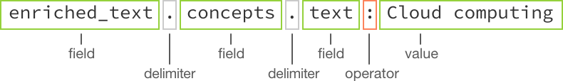
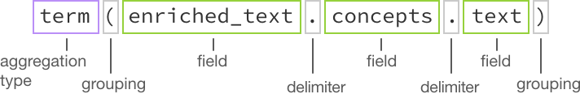
Watson Discovery
Querying:
Filters: top values, sum, min, max, average, timeslice, and histogram

Slide 25
Watson Discovery
Training the queries:
• Rating the results: Relevant / Not Relevant
• Min 49 unique training queries
{"training": {
"total_examples": 54,
"available": true,
"processing": false,
"minimum_queries_added": true,
"minimum_examples_added": true,
"sufficient_label_diversity": false,
"notices": 13,
"successfully_trained": "2017-02-08T14:18:22.786Z", "data_updated": "2017-02-10T14:18:22.786Z"
}}

Slide 26
Watson Discovery
Training the queries:
{
"natural_language_query": "why is the sky blue",
"filter": "text:meteorology",
"examples": [
{"document_id": "9afcf06e-2ef7-438e-b2a5-e4d9432dc877", "relevance": 0 },
{"document_id": "54f95ac0-3e4f-4756-bea6-7a67b2713c81", "relevance": 1 },
{"document_id": "01bcca32-7300-4c9f-8d32-33ed7ea643da",
"cross_reference": "my_id_field:1463", "relevance": 4}
]
}

Slide 27
Watson Natural Language Classifier
Features
• Deep learning classification for Natural Language queries
• Provide classification with confidence interval
Use cases
Automatic tagging of content, classification of emails,
intelligent dialogues.

Slide 28
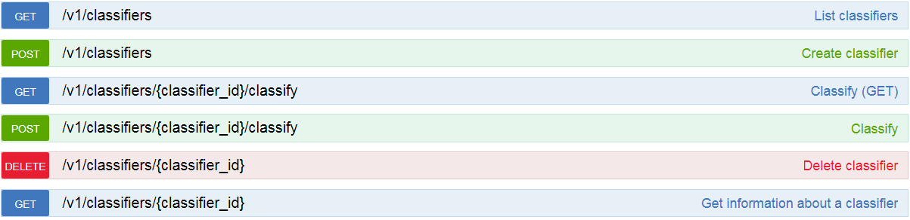
Watson Natural Language Classifier
REST API

Slide 29
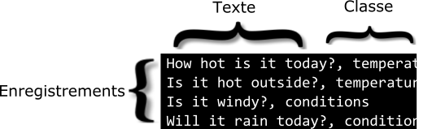
Watson Natural Language Classifier
Instance creation
• CSV format, UTF-8, escaped, double quotation marks.
• Minimum of 5 records, maximum of 15000 records.
• Maximum of 1024 characters per records.
• Supported languages: en, ar, fr, it, pt, jp, es.
Output consideration
• If less than 10 classes, relevance sum to 1

Slide 30
Watson Natural Language Classifier
Guidelines
• Avoid record with more than 60 words.
• Avoid to use more than ~100 classes.
• Do not use less than 5~10 records per class.
• Avoid to use more than 3 classes per record.

Slide 31
Watson Natural Language Classifier
A fast example:
curl -u aquemy:yoloPassword -X POST
-F training_data=@data_train.csv
-F training_metadata=$METADATA
”https://gateway.watsonplatform.net/natural-language-classifier/api/v1/classifiers”
METADATA={
"language":"en",
"name":"TutorialClassifier"
}

Slide 32
Watson Natural Language Classifier
A fast example:
curl -G --user "{username}":"{password}„
"https://gateway.watsonplatform.net/natural-language-classifier/api/v1/classifiers/{classifier_id}/classify" –
-data-urlencode "text=How hot will it be today?"
{ "classifier_id": "10D41B-nlc-1",
"text": "How hot will it be today?",
"top_class": "temperature",
"classes": [ {
"class_name": "temperature",
"confidence": 0.9998201258549781 }, {
"class_name": "conditions",
"confidence": 0.00017987414502176904 }
] }

Slide 33
Watson Personality Insight
Features
• Personality (Five Factors Model), needs and values extraction
• Needs at least 1.2k words.
• Any source: twitter, book,...
Use cases
• Individual customer service, job applicant analysis, market analysis.
• Study on the impact of your anouncements
With the most complex API...

Slide 34
Watson Personality Insight
{
"word_count": 15223,
"processed_language": "en",
"personality": [ . . . ],
"needs": [ . . . ],
"values": [ . . . ],
"behavior": [ . . . ],
"consumption_preferences": [ . . . ],
"warnings": []
}

Slide 35
Watson Personality Insight
Features
• Supported languages:
1. Arabic
2. English
3. Japanese
4. Korean
5. Spanish
Meaning of the score:
• Personality: percentile among a sample population
• Behavior: same but according to the temporal distribution
• Consumer preferences: {0,0.5,1}

Slide 36
Watson Tone Analyzer
Features
• Analyze emotion and language tones in text
• Provide Emotion, Language and Social analysis
Use cases
• Study on the impact of your anouncements
• Study of your customer reactions

Slide 37
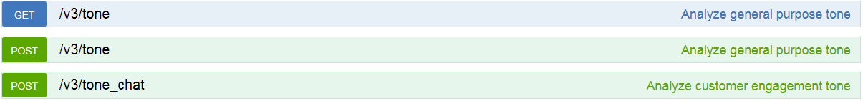
Watson Tone Analyzer
REST API
Two endpoints:
• General purpose endpoint
• Customer engagment endpoint

Slide 38
Watson Tone Analyzer
Example
curl -X POST --user "{username}":"{password}"
--header "Content-Type: application/json"
--data-binary @./request.json "https://gateway.watsonplatform.net/tone-analyzer/api/v3/tone?version=2017-09-21"

Slide 39
Watson Tone Analyzer
Example
curl -X POST --user "{username}":"{password}"
--header "Content-Type: application/json"
--data-binary @./request.json "https://gateway.watsonplatform.net/tone-analyzer/api/v3/tone?version=2017-09-21"
{ "text": "Team, I know that times are tough! Product sales have been disappointing for the past three quarters. We have a competitive product, but we need to do a better job of selling it!" }

Slide 40
Watson Tone Analyzer
Example
{ "document_tone":
{ "tones": [
{ "score": 0.6165, "tone_id": "sadness", "tone_name": "Sadness" },
{ "score": 0.829888, "tone_id": "analytical", "tone_name": "Analytical" } ]
}, "sentences_tone": [
{ "sentence_id": 0,
"text": "Team, I know that times are tough!",
"tones": [
{ "score": 0.801827, "tone_id": "analytical", "tone_name": "Analytical" }
] },
{ "sentence_id": 1,
"text": "Product sales have been disappointing for the past three quarters.",
"tones": [
{ "score": 0.771241, "tone_id": "sadness", "tone_name": "Sadness" },
{ "score": 0.687768, "tone_id": "analytical", "tone_name": "Analytical" }
] },
{ "sentence_id": 2,
"text": "We have a competitive product, but we need to do a better job of selling it!",
"tones": [
{ "score": 0.506763, "tone_id": "analytical", "tone_name": "Analytical" }
] }
]
}

Slide 41
Watson Tone Analyzer
Format for the POST endpoints:
• JSON (UTF-8)
• HTML
• Plain text
For HTML / plain text:
Content-Type: text/plain;charset=utf-8
In general, using CURL, use –data-binary and not --data

Slide 42
Watson Tone Analyzer
Emotions classes:
General purpose endpoint
• Anger
• Fear
• Joy
• Sadness
• Analytical
• Confident
• Tentative
Customer engagment endpoint
• Excited
• Frustrated
• Impolite
• Polite
• Sad
• Satisfied
• Sympathetic

Slide 43
Watson Tone Analyzer
Customer engagement:
{ "utterances": [
{ "text": "Hello, I'm having a problem with your product.",
"user": "customer" },
{ "text": "OK, let me know what's going on, please.",
"user": "agent" },
{ "text": "Well, nothing is working :(",
"user": "customer" },
{ "text": "Sorry to hear that.",
"user": "agent" }
] }

Slide 44
Watson Tone Analyzer
Customer engagement:
{ "utterances_tone": [
{ "utterance_id": 0,
"utterance_text":
"Hello, I'm having a problem with your product.",
"tones": [
{ "score": 0.718352,
"tone_id": "polite",
"tone_name": "Polite" }
]
},
…

Slide 45
Watson Translator
Features
• Context dependent translation („linguistic model”)
1. News (formal written language)
2. Conversational (informal language)
3. Patents (legal terms)
• Language identification (>60 languages)
• Custom model for specific context (up to 10 per instance)
Remark: source and target languages are per model!

Slide 46
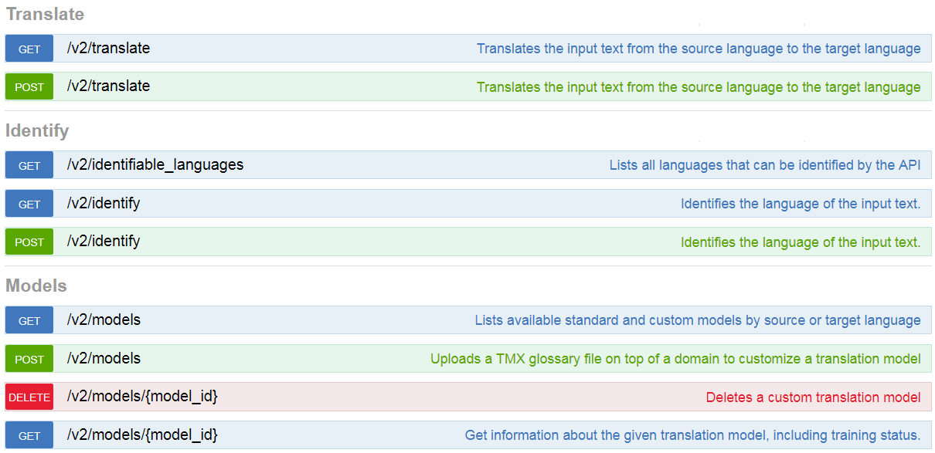
Watson Translator

Slide 47
Watson Translator
Example
curl -X POST --user {username}:{password}
--header "Content-Type: application/json"
--header "Accept: application/json"
--data $DATA "https://gateway.watsonplatform.net/language-translator/api/v2/translate"
DATA={
"text":"Hey world, whats up?",
"model_id":"en-es-conversational"
}"

Slide 48
Watson Translator
Example
curl -X POST --user {username}:{password}
--header "Content-Type: application/json"
--header "Accept: application/json"
--data $DATA "https://gateway.watsonplatform.net/language-translator/api/v2/translate"
DATA={
"text":"Hey world, whats up?",
"target":"fr",
"source":"en",
}"

Slide 49
Watson Translator
Custom models
• Not all models are customizable
• Training data in Translation Memory Exchange (TMX)
• Type of corpus:
1. forced_glossary: overwrite the previous examples. Absolute matching.
2. parallel_corpus: do not overwrite the previous examples.
3. monolingual_corpus: examples in target language (min 1000 sentences)
Remark: You can generate your glossary automatically!

Slide 50
<?xml version="1.0" encoding="UTF-8"?>
<tmx version="1.4">
<header creationtool="" creationtoolversion=""
segtype="sentence" o-tmf="" adminlang="EN"
srclang="en" datatype="rtf" o-encoding="UTF-8" />
<body>
<tu>
<tuv xml:lang="en">
<seg>International Business Machines</seg>
</tuv>
<tuv xml:lang="fr">
<seg>International Business Machines</seg>
</tuv>
</tu>
<tu>
<tuv xml:lang="en">
<seg>patent</seg>
</tuv>
<tuv xml:lang="fr">
<seg>brevet</seg>
</tuv>
</tu>
</body>
</tmx>

Slide 51
Watson Speech to Text
Features
• HTTP, Websocket, Asynchronous HTTP interface
• Stream or recorded input
• Several languages supported
• Keyword, timestamp extraction, speaker recognition,....
• Custom corpora,
custom words,
custom acoustic models,
custom language models
Use cases
Accessibility, transcription of conferences or meetings.

Slide 52
Watson Speech to Text
Example
curl -X POST -u {username}:{password}
--header "Content-Type: audio/flac"
--data-binary @{path_to_file}audio-file.flac
"https://stream.watsonplatform.net/speech-to-text/api/v1/recognize"

Slide 53
Watson Speech to Text
Example
{ "results": [ { "alternatives": [ { "confidence": 0.8691191673278809, "transcript": "several tornadoes touch down as a line of severe thunderstorms swept through colorado on sunday " } ], "final": true } ], "result_index": 0 }

Slide 54
Watson Speech to Text
Audio format
• Ogg or WebM audio with the Opus or Vorbis codec,
• MP3 or MPEG,
• Waveform Audio File Format (WAV),
• Free Lossless Audio Codec (FLAC)
• Linear 16-bit Pulse-Code Modulation (PCM),
• mu-law (or u-law) audio
Sampling rate
• Broadband, sampled at no less than 16kHz
• Narrowband, sampled at no less than 8kHz

Slide 55
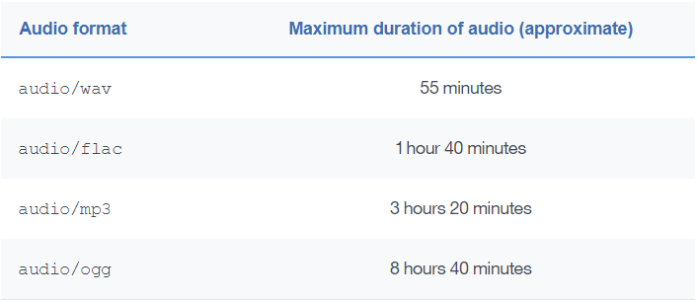
Watson Speech to Text
Limit:100Mb files or stream

Slide 56
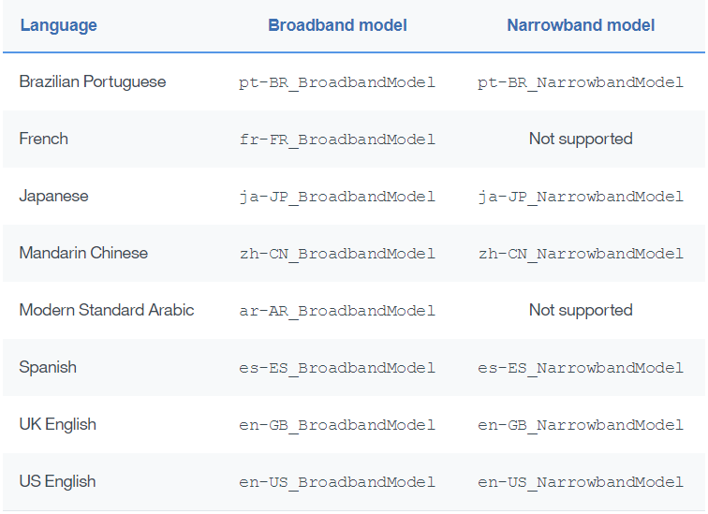
Watson Speech to Text
Limit: Languages

Slide 57
Watson Speech to Text
Streaming
• Natural with Websocket
• With HTTP:
curl -X POST -u {username}:{password}
--header "Content-Type: audio/flac"
--header "Transfer-Encoding: chunked"
--data-binary @{path}audio-file1.flac
--data-binary @{path}audio-file2.flac
"https://stream.watsonplatform.net/speech-to-text/api/v1/recognize"
Careful with timeouts!

Slide 58
Watson Speech to Text
Additional features
• Speaker label
• Keyword spotting
• Interim results and max alternatives
• Custom models

Slide 59
Watson Text to Speech
Features
• Streaming (Websocket interface)
• Audio format: Ogg, WebM, WAV, FLAC, MP3,...
• Different voices (for some languages)
• Input as text or SSML (Speech Synthesis Markup Language)
• Expressive SSML (SSML extension for speaking styles)
• Voice transformation (SSML extension to tune pitch, rate, timbre)
• Timing (for Websocket)
• Custom pronunciation (using IPA or IBM SPR)
• Languages: English (UK, US), Spanish (Castilian, Latin, US), Japanese,
French, Portuguese (Brazilian), German, Italian,

Slide 60
Watson Visual Recognition
Features
• Deep-learning methods to classify images
• Can be trained with your own model
• Face, words, persons detection
• Age estimation, tagging and classification
• Similar content suggestions
Use cases
Automatic organization of images, social media segmentation.

Slide 61

Watson Conversation
Features
• Creation of natural language dialogues
• Include profile tracking for learning
• Visual builder tool
Use cases
• Ordering online
• First line online support
• Intelligent home automation

Slide 62
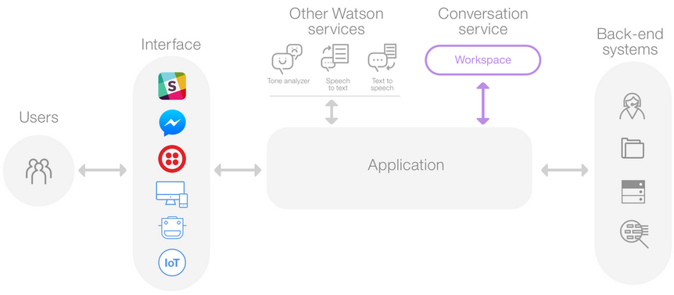
Watson Conversation

Slide 63
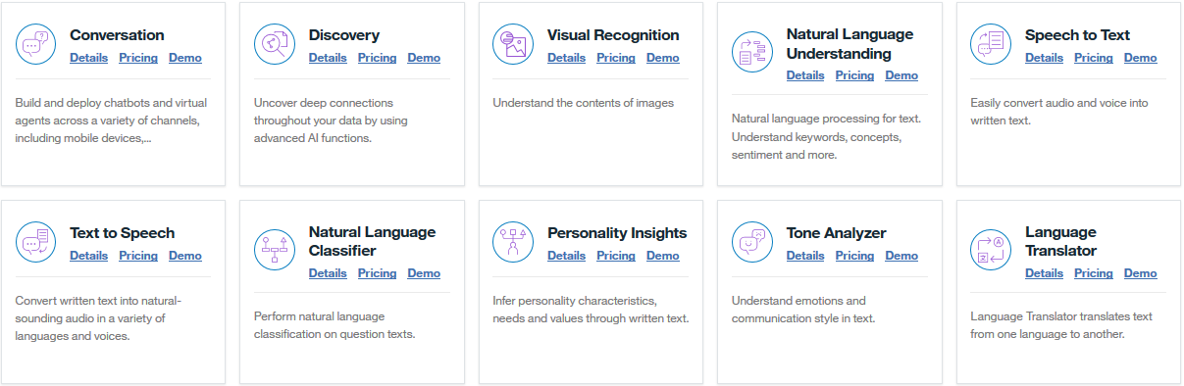
Watson Cloud Services – Others

Slide 64
Thank you
Notes:
Within this demo session we will show how Node.js application can use and display data from previously created model for customer satisfaction prediction.

