Slide 1
IBM Watson Cloud Services
A brief overview
Alexandre Quemy
IBM Analytics

Slide 2
AGENDA
What is Watson?
IBM Clouds basics
Watson Cloud Services overview
More complex use case

Slide 3
What are Watson Cloud Services?
Notes:
Within this section we will show how within 5 minutes we can create and deploy basic Node.js application with github as a code repository using Bluemix platform.

Slide 4
What is Watson?
Watson equations
AI methods + NLP = Watson Core
Watson Core + (REST) API + IBM Cloud = Watson Cloud Services
Watson Cloud Services + Engineer imagination = Cognitive Era
+ Products (combination of services for dedicated application / field)

Slide 5
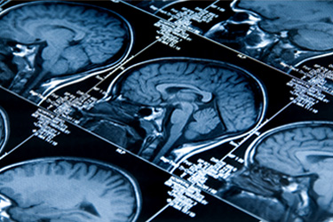
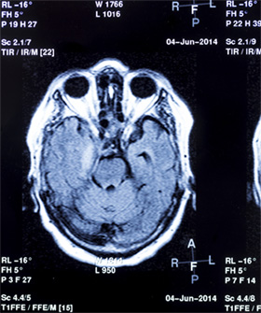
Some successful applications
Accelerate research and discovery
“ In the fields of radiology and cardiology there are over 40 modalities… and over 600 diseases to cover. ”
Watson Imaging Clinical Review
“ 80,000 to 160,000 people are killed or permanently disabled
every year as a result of misdiagnosis ”

Slide 6
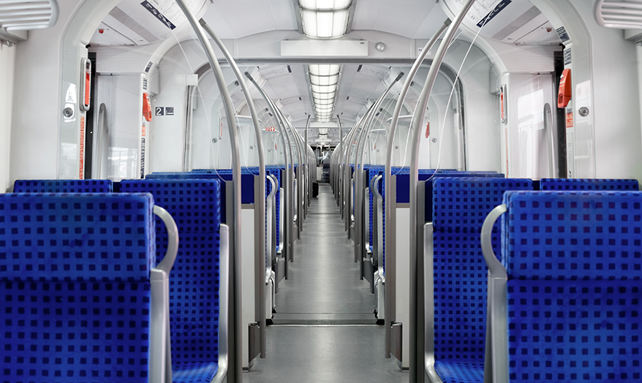
Some successful applications
Anticipate and preempt disruptions
“ SNCF: increasing safety, reliability and savings with
predictive maintenance ”
Watson Internet of Things (IoT)
“ [...] deploying thousands of sensors on trains and tracks which are securely sending
tens of thousands of data points in the cloud, all in real-time”

Slide 7
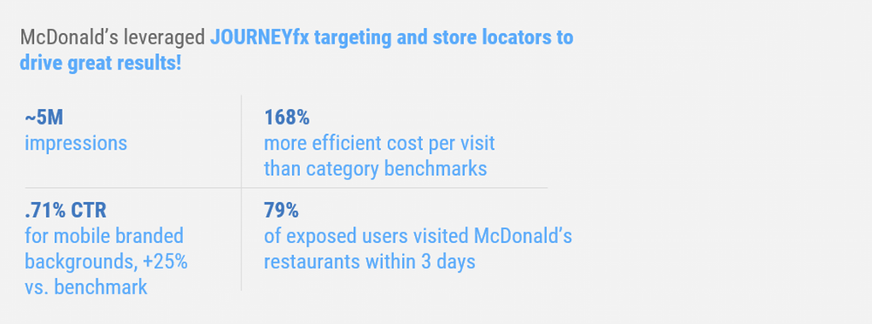
Some successful applications
Recommand with confidence

Slide 8
Some successful applications
Scale expertise and learning
Watson for Oncology:
Help identify evidenced-based, patient-centric treatment options.
Watson Drug Discovery:
IBM and Pfizer to Accelerate Immuno-oncology Research with Watson for Drug Discovery.
Barrow Neurological Institute engaged IBM Watson for Drug Discovery to search research documents for potential connections and help identify new RNA-binding proteins linked to ALS.

Slide 9
Some successful applications
Scale expertise and learning
90% concordance with tumor board* recommendations on breast cancer
* cancer specialists who review the most complex cancer cases each week
Source: Presentation by Prof. Dr. S.P. Somashekhar, Chairman, Manipal Comprehensive Cancer Center, Manipal Hospitals, Bangalore, India at the San Antonio Breast Cancer Symposium, December 9th, 2016

Slide 10
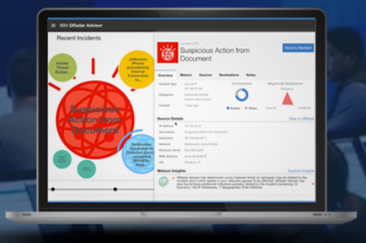
Some successful applications
Detect liabilities and mitigate risks
Cybersecurity: IBM QRadar Advisor with Watson
Enrich your interactions
First line support in Orange, IBM, etc.
IBM Ross to help lawyers

Slide 11
What is Watson?
Several services and products:
Conversation
Knowledge (management and discovery)
Vision
Speech
Language
Empathy

Slide 12
IBM Cloud Basics
Notes:
Within this section we will show how within 5 minutes we can create and deploy basic Node.js application with github as a code repository using Bluemix platform.

Slide 13
Watson Cloud Services
Generalities
• Each service provides a REST API. • Some services provide additional interfaces (e.g. Websocket). • Bluemix IBM Cloud to create service instance, deploy applications, etc. • SDKs for: Java, Python, Node.js, iOS, Unity officially, .Net, ...

Slide 14
Watson Cloud Services
Generalities
• Each service provides a REST API. • Some services provide additional interfaces (e.g. Websocket). • Bluemix IBM Cloud to create service instance, deploy applications, etc. • SDKs for: Java, Python, Node.js, iOS, Unity officially, .Net, ...
In practice: 1. Create a service instance in IBM Cloud 2. Use the services with the credential provided: a) REST API using cURL (or language specific wrapper) b) SDK

Slide 15
IBM Cloud
One place to rule them all:
https://ibm.com/cloud

Slide 17
Watson Cloud Services overview
Notes:
Within this section we will show how within 5 minutes we can create and deploy basic Node.js application with github as a code repository using Bluemix platform.

Slide 18
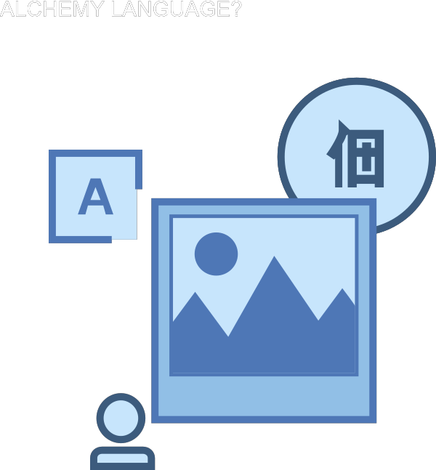
Watson Natural Language Understanding
Collection of API for Natural Language:
• Entity Extraction • Sentiment Analysis • Keyword Extraction • Concept Tagging • Relation Extraction • Language Detection • ...
... Merged into a single REST Endpoint

Slide 19
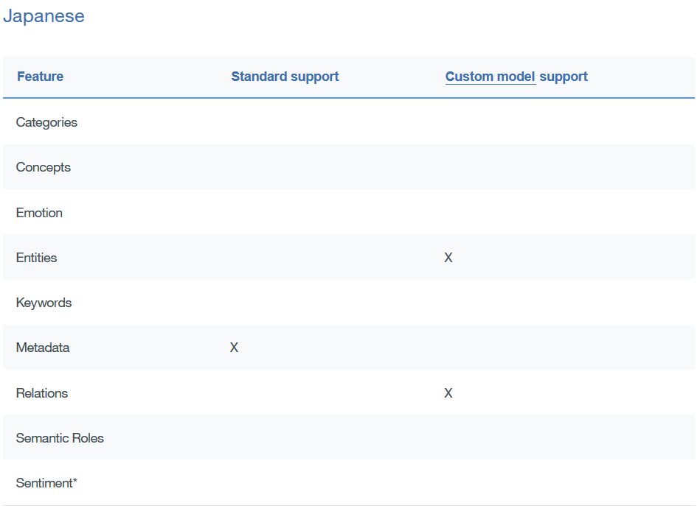
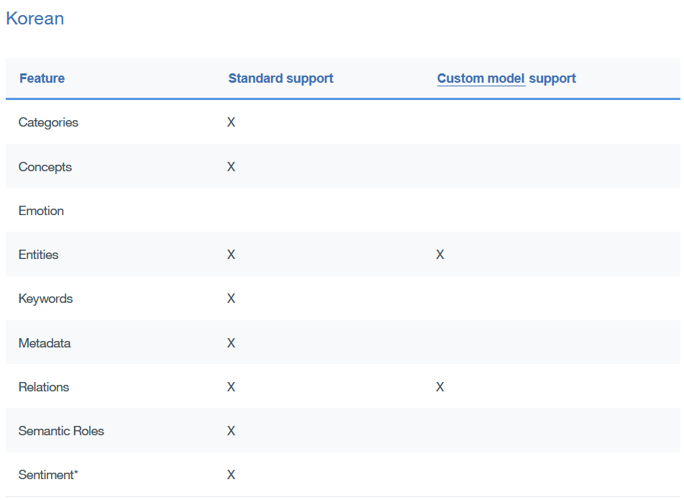
Watson Natural Language Understanding
Some characteristics:
• Replace AlchemyLanguage API • Custom models (using Watson Knowledge Studio) • Over a thousand nodes in a 5 level categories hierarchy • Automatic language detection • 433 entity types, >50 relations • 11 supported languages

Slide 20
Watson Natural Language Understanding
Example:
curl -X POST -H "Content-Type: application/json" -u "{username}":"{password}" -d @parameters.json "https://gateway.watsonplatform.net/natural-language-understanding/api/v1/analyze?version=2017-02-27"
{ "text": "IBM is an American multinational technology company headquartered in Armonk, New York, United States, with operations in over 170 countries.",
"features": {
"entities": {
"emotion": true,
"sentiment": true,
"limit": 2 },
"keywords": {
"emotion": true,
"sentiment": true,
"limit": 2 }
}
}

Slide 21
Watson Discovery
Document Corpus analysis:
• Environment: Container to store Collections • Collection: Set of documents • Document: Content + Metadata • Configuration: What data are extracted from documents • Query
One default environment: Discovery News, a pre-enriched public dataset.
CRUD API for Environment, Collections, Documents and Queries

Slide 22
Watson Discovery
The usual process:
• identify some sample content • upload the content (API, crawler, studio) • adjust the conversion process • define enrichments • normalize the results
Configuration

Slide 23
Watson Discovery
Conversion step:
Describe how to convert to JSON your original files from: Microsoft Word, PDF, HTML, JSON
Word
HTML
JSON
Internal JSON
PDF

Slide 24
Watson Discovery
Enrichement and Normalization:
Enrichement: Same as Watson Natural Language Understanding! Possibility to use Custom Entity / Relation Model
Normalization: • Library Jsoup parser: https://jsoup.org/apidocs/org/jsoup/select/Selector.html • From CSS: CSS selector • From HTML: exclude tags

Slide 25
Watson Discovery
Document Corpus analysis:
{ "extracted_metadata": { ... }, "html": "...", "text": "...", "extracted_fields": { "authors": [ "Jane Rain", "Joe Snow" ], "authors_str": "Jane Rain\n\nJoe Snow", "chapters": [ "The Rain in Spain\n\nfalls mainly on the plain.", "How I Learned to Stop Worrying\n\nand love my snowblower." ], "comments": [ "Rain gives me pain.", "All snow must go!" ] } }

Slide 26
Watson Discovery
Adding documents to a collection: Three ways of adding documents:
• API (developper) • Discovery Tool (prototyping, non-developper) • Data crawler (large database or multiple sources)

Slide 27
Watson Discovery
Querying:
curl -u "{username}":"{password}" "https://gateway.watsonplatform.net/discovery/api/v1/environments/{environment_id}/collections/{collection_id}/query ?version=2017-06-25 &natural_language_query='Hybrid%20cloud%20companies’ &passages=true"

Slide 28
Watson Discovery
Querying:
{ "matching_results":2, "passages":[ { "document_id":"ab7be56bcc9476493516b511169739f0", "passage_score":15.230205287402338, "passage_text":"a privately held company that provides hybrid cloud recovery, cloud migration and business continuity software for enterprise data centers and cloud infrastructure.", "start_offset":120 "end_offset":300 "field":"text" }, { "passage_text":"Disaster Recovery Services for Hybrid Cloud</title></head>\n<body>\n\n\n<p>Published: Thu, 27 Oct 2016 07:01:21 GMT</p>\n" "passage_score":10.153470191601558, "document_id":"fbb5dcb4d8a6a29f572ebdeb6fbed20e", "start_offset":70 "end_offset":120 "field":"html" }, ...

Slide 29
Watson Discovery
Querying:
Filters: top values, sum, min, max, average, timeslice, and histogram

Slide 30
Watson Discovery
Query:
Options:
highlight
count
sort
passages
deduplicate
Operators:
. [JSON delimiter]
: [Includes]
:: [Exact match]
:! [Does not include]
::! [Not an exact match]
~n [String variation]
...

Slide 31
Watson Discovery
Training the queries:
• Rating the results: Relevant / Not Relevant • Min 49 unique training queries
{"training": { "total_examples": 54, "available": true, "processing": false, "minimum_queries_added": true, "minimum_examples_added": true, "sufficient_label_diversity": false, "notices": 13, "successfully_trained": "2017-02-08T14:18:22.786Z", "data_updated": "2017-02-10T14:18:22.786Z" }}

Slide 32
Watson Discovery
Training the queries:
{ "natural_language_query": "why is the sky blue", "filter": "text:meteorology", "examples": [ {"document_id": "9afcf06e-2ef7-438e-b2a5-e4d9432dc877", "relevance": 0 }, {"document_id": "54f95ac0-3e4f-4756-bea6-7a67b2713c81", "relevance": 1 }, {"document_id": "01bcca32-7300-4c9f-8d32-33ed7ea643da", "cross_reference": "my_id_field:1463", "relevance": 4} ] }

Slide 33
Watson Natural Language Classifier
Features
• Deep learning classification for Natural Language queries • Provide classification with confidence interval
Use cases
Automatic tagging of content, classification of emails, intelligent dialogues.

Slide 34
Watson Natural Language Classifier
REST API

Slide 35
Watson Natural Language Classifier
Instance creation
• CSV format, UTF-8, escaped, double quotation marks. • Minimum of 5 records, maximum of 15000 records. • Maximum of 1024 characters per records. • Supported languages: en, ar, fr, it, pt, jp, es.
Output consideration • If less than 10 classes, relevance sum to 1

Slide 36
Watson Natural Language Classifier
Guidelines
• Avoid record with more than 60 words.
• Avoid to use more than ~100 classes.
• Do not use less than 5~10 records per class.
• Avoid to use more than 3 classes per record.

Slide 37
Watson Natural Language Classifier
A fast example:
curl -u aquemy:yoloPassword -X POST
-F training_data=@data_train.csv
-F training_metadata=$METADATA
”https://gateway.watsonplatform.net/natural-language-classifier/api/v1/classifiers”
METADATA={ "language":"en",
"name":"TutorialClassifier" }

Slide 38
Watson Natural Language Classifier
A fast example:
curl -G --user "{username}":"{password}„
"https://gateway.watsonplatform.net/natural-language-classifier/api/v1/classifiers/{classifier_id}/classify" –
-data-urlencode "text=How hot will it be today?"
{ "classifier_id": "10D41B-nlc-1",
"text": "How hot will it be today?",
"top_class": "temperature",
"classes": [ {
"class_name": "temperature",
"confidence": 0.9998201258549781 }, {
"class_name": "conditions",
"confidence": 0.00017987414502176904 }
] }

Slide 39
Watson Personality Insight
Features
• Personality (Five Factors Model), needs and values extraction • Needs at least 1.2k words. • Any source: twitter, book,... Use cases • Individual customer service, job applicant analysis, market analysis. • Study on the impact of your anouncements
With the most complex API...

Slide 40
Watson Personality Insight
{
"word_count": 15223,
"processed_language": "en",
"personality": [ . . . ],
"needs": [ . . . ],
"values": [ . . . ],
"behavior": [ . . . ],
"consumption_preferences": [ . . . ],
"warnings": []
}

Slide 41
Watson Personality Insight
Features
• Supported languages: 1. Arabic 2. English 3. Japanese 4. Korean 5. Spanish Meaning of the score:
• Personality: percentile among a sample population • Behavior: same but according to the temporal distribution • Consummer preferences: {0,0.5,1}

Slide 42
Watson Personality Insight
The science behind
• Mahmud, Jalal, Michelle X. Zhou, Nimrod Megiddo, Jeffrey Nichols, and Clemens Drews. Recommending targeted strangers from whom to solicit information on social media, Proceedings of the International Conference on Intelligent User Interfaces (2013): pp. 37-48. • Lee, Kyumin, Jalal Mahmud, Jilin Chen, Michelle X. Zhou, and Jeffrey Nichols. Who will retweet this?: Automatically Identifying and Engaging Strangers on Twitter to Spread Information, Proceedings of the International Conference on Intelligent User Interfaces (2014): pp. 247-256. • Hsieh, Gary, Jilin Chen, Jalal Mahmud, and Jeffrey Nichols. You read what you value: understanding personal values and reading interests. Proceedings of the SIGCHI Conference on Human Factors in Computing Systems (2014): pp. 983-986. • Arnoux, Pierre-Hadrien, Anbang Xu, Neil Boyette, Jalal Mahmud, Rama Akkiraju, and Vibha Sinha. 25 Tweets to Know you: A New Model to Predict Personality with Social Media. AAAI Publications, Eleventh International AAAI Conference on Web and Social Media (2017): pp. 472-475.
Notes:
https://console.bluemix.net/docs/services/personality-insights/science.html#science

Slide 43
Watson Tone Analyzer
Features • Analyze emotion and language tones in text • Provide Emotion, Language and Social analysis
Use cases • Study on the impact of your anouncements • Study of your customer reactions

Slide 44
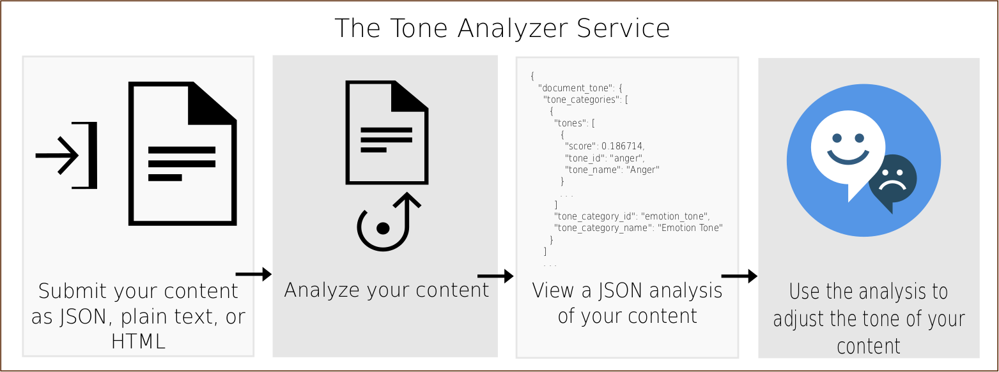
Watson Tone Analyzer

Slide 45
Watson Tone Analyzer
REST API Two endpoints: • General purpose endpoint • Customer engagment endpoint

Slide 46
Watson Tone Analyzer
Example
curl -X POST --user "{username}":"{password}"
--header "Content-Type: application/json"
--data-binary @./request.json "https://gateway.watsonplatform.net/tone-analyzer/api/v3/tone?version=2017-09-21"

Slide 47
Watson Tone Analyzer
Example
curl -X POST --user "{username}":"{password}"
--header "Content-Type: application/json"
--data-binary @./request.json "https://gateway.watsonplatform.net/tone-analyzer/api/v3/tone?version=2017-09-21"
{ "text": "Team, I know that times are tough! Product sales have been disappointing for the past three quarters. We have a competitive product, but we need to do a better job of selling it!" }

Slide 48
Watson Tone Analyzer
Example
{ "document_tone":
{ "tones": [
{ "score": 0.6165, "tone_id": "sadness", "tone_name": "Sadness" },
{ "score": 0.829888, "tone_id": "analytical", "tone_name": "Analytical" } ]
}, "sentences_tone": [
{ "sentence_id": 0,
"text": "Team, I know that times are tough!",
"tones": [
{ "score": 0.801827, "tone_id": "analytical", "tone_name": "Analytical" }
] },
{ "sentence_id": 1,
"text": "Product sales have been disappointing for the past three quarters.",
"tones": [
{ "score": 0.771241, "tone_id": "sadness", "tone_name": "Sadness" },
{ "score": 0.687768, "tone_id": "analytical", "tone_name": "Analytical" }
] },
{ "sentence_id": 2,
"text": "We have a competitive product, but we need to do a better job of selling it!",
"tones": [
{ "score": 0.506763, "tone_id": "analytical", "tone_name": "Analytical" }
] }
]
}

Slide 49
Watson Tone Analyzer
Format for the POST endpoints: • JSON (UTF-8) • HTML • Plain text
For HTML / plain text: Content-Type: text/plain;charset=utf-8
In general, using CURL, use –data-binary and not --data

Slide 50
Watson Tone Analyzer
Emotions classes:
General purpose endpoint • Anger • Fear • Joy • Sadness • Analytical • Confident • Tentative
Customer engagment endpoint
• Excited
• Frustrated
• Impolite
• Polite
• Sad
• Satisfied
• Sympathetic

Slide 51
Watson Tone Analyzer
Customer engagement:
{ "utterances": [
{ "text": "Hello, I'm having a problem with your product.",
"user": "customer" },
{ "text": "OK, let me know what's going on, please.",
"user": "agent" },
{ "text": "Well, nothing is working :(",
"user": "customer" },
{ "text": "Sorry to hear that.",
"user": "agent" }
] }

Slide 52
Watson Tone Analyzer
Customer engagement:
{ "utterances_tone": [
{ "utterance_id": 0,
"utterance_text":
"Hello, I'm having a problem with your product.",
"tones": [
{ "score": 0.718352,
"tone_id": "polite",
"tone_name": "Polite" }
]
},
…

Slide 53
Watson Tone Analyzer
The science behind:
• Gou, Liang, Michelle X. Zhou, and Huahai Yang. Know Me and ShareMe: Understanding automatically discovered personality traits from social media and user sharing preferences. Proceedings of the SIGCHI Conference on Human Factors in Computing Systems (2014): pp. 955-964. • Jian, Zhao, Liang Gou, Wang Fei, and Michelle X. Zhou. PEARL: An Interactive Visual Analytic Tool for Understanding Personal Emotion Style Derived from Social Media. In Proceedings of IEEE VAST (2014). • DiMicco, Joan M., and David R. Millen. Identity Management: Multiple Presentations of Self in Facebook. In Proceedings of the 2007 International ACM Conference on Supporting Group Work (2007). pp. 383-386. New York, NY, USA: ACM. • Byron, Kristin. Carrying too Heavy a Load? The Communication and Miscommunication of Emotion by Email. Academy of Management Review, Vol. 33(2) (2008): pp. 309-327.
Notes:
https://console.bluemix.net/docs/services/tone-analyzer/science.html#the-science-behind-the-service

Slide 54
Watson Translator
Features
• Context dependent translation („linguistic model”) 1. News (formal written language) 2. Conversational (informal language) 3. Patents (legal language) • Language identification (>60 languages) • Custom model for specific context (up to 10 per instance)
Remark: source and target languages are per model!

Slide 55
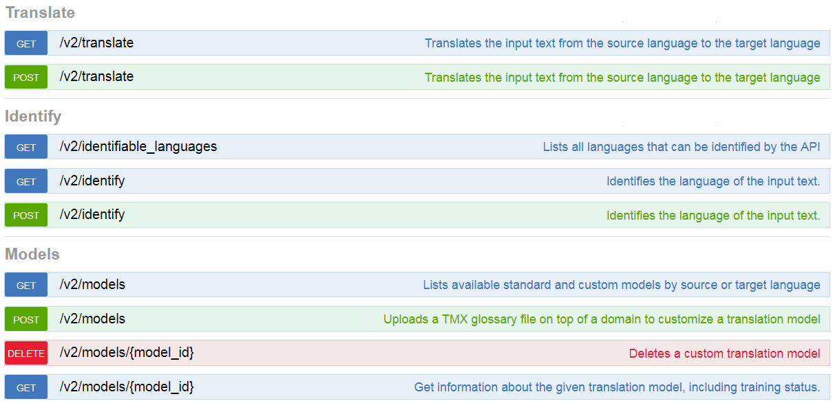
Watson Translator

Slide 56
Watson Translator
Example
curl -X POST --user {username}:{password}
--header "Content-Type: application/json"
--header "Accept: application/json"
--data $DATA "https://gateway.watsonplatform.net/language-translator/api/v2/translate"
DATA={
"text":"Hey world, whats up?",
"model_id":"en-es-conversational"
}"

Slide 57
Watson Translator
Example
curl -X POST --user {username}:{password}
--header "Content-Type: application/json"
--header "Accept: application/json"
--data $DATA "https://gateway.watsonplatform.net/language-translator/api/v2/translate"
DATA={
"text":"Hey world, whats up?",
"target":"fr",
"source":"en",
}"

Slide 58
Watson Translator
Custom models
• Not all models are customizable • Training data in Translation Memory Exchange (TMX) • Type of corpus: 1. forced_glossary: overwrite the previous examples. Absolute matching. 2. parallel_corpus: do not overwrite the previous examples. 3. monolingual_corpus: examples in target language (min 1000 sentences)

Slide 59
<?xml version="1.0" encoding="UTF-8"?>
<tmx version="1.4">
<header creationtool="" creationtoolversion=""
segtype="sentence" o-tmf="" adminlang="EN"
srclang="en" datatype="rtf" o-encoding="UTF-8" />
<body>
<tu>
<tuv xml:lang="en">
<seg>International Business Machines</seg>
</tuv>
<tuv xml:lang="fr">
<seg>International Business Machines</seg>
</tuv>
</tu>
<tu>
<tuv xml:lang="en">
<seg>patent</seg>
</tuv>
<tuv xml:lang="fr">
<seg>brevet</seg>
</tuv>
</tu>
</body>
</tmx>

Slide 60
Watson Speech to Text & Text to Speech
Features
• HTTP, Websocket, Asynchronous HTTP interface • Stream or recorded input • Several languages supported • Keyword, timestamp extraction, speaker recognition,.... • Custom corpora, custom words, custom acoustic models, custom language models
Use cases
Accessibility, transcription of conferences or meetings.

Slide 61
Watson Speech to Text & Text to Speech
Example
curl -X POST -u {username}:{password}
--header "Content-Type: audio/flac"
--data-binary @{path_to_file}audio-file.flac
"https://stream.watsonplatform.net/speech-to-text/api/v1/recognize"

Slide 62
Watson Speech to Text & Text to Speech
Example
{ "results": [ { "alternatives": [ { "confidence": 0.8691191673278809, "transcript": "several tornadoes touch down as a line of severe thunderstorms swept through colorado on sunday " } ], "final": true } ], "result_index": 0 }

Slide 63
Watson Speech to Text & Text to Speech
Audio format
• Ogg or WebM audio with the Opus or Vorbis codec, • MP3 or MPEG, • Waveform Audio File Format (WAV), • Free Lossless Audio Codec (FLAC) • Linear 16-bit Pulse-Code Modulation (PCM), • mu-law (or u-law) audio
Sampling rate
• Broadband, sampled at no less than 16kHz • Narrowband, sampled at no less than 8kHz

Slide 64
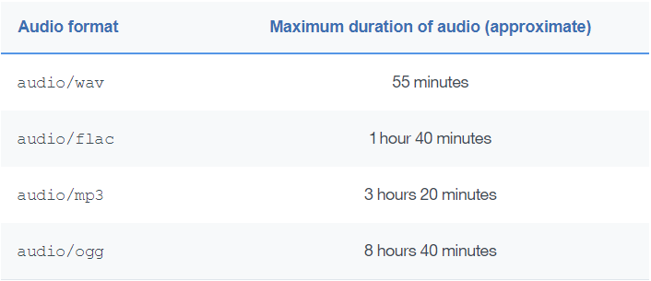
Watson Speech to Text & Text to Speech
Limit:100Mb files or stream

Slide 65
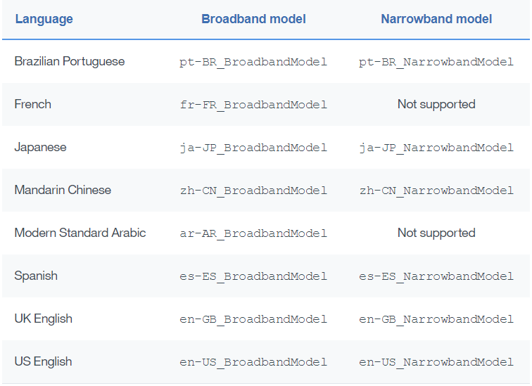
Watson Speech to Text & Text to Speech
Limit: Languages

Slide 66
Watson Speech to Text & Text to Speech
Streaming
• Natural with Websocket • With HTTP:
curl -X POST -u {username}:{password}
--header "Content-Type: audio/flac"
--header "Transfer-Encoding: chunked"
--data-binary @{path}audio-file1.flac
--data-binary @{path}audio-file2.flac
"https://stream.watsonplatform.net/speech-to-text/api/v1/recognize"
Careful with timeouts!

Slide 67
Watson Speech to Text & Text to Speech
Additional features
• Speaker label • Keyword spotting • Interim results and max alternatives • Custom models

Slide 68
Watson Speech to Text & Text to Speech
Speaker labels

Slide 69
Watson Speech to Text & Text to Speech
Keyword spotting

Slide 70
Watson Speech to Text & Text to Speech
Interim results and Maximum alternatives

Slide 71
Watson Speech to Text & Text to Speech
Custom Language Model

Slide 72
Watson Speech to Text & Text to Speech
Custom Acoustic Model

Slide 73
Watson Text to Speech
Features
• Streaming (Websocket interface) • Audio format: Ogg, WebM, WAV, FLAC, MP3,... • Different voices (for some languages) • Input as test or SSML (Speech Synthesis Markup Language) • Expressive SSML (SSML extension for speaking styles) • Voice transformation (SSML extension to tune pitch, rate, timbre) • Timing (for Websocket) • Custom pronunciation (using IPA or IBM SPR) • Languages: English (UK, US), Spanish (Castilian, Latin, US), Japanese, French, Portuguese (Brazilian), German, Italian,

Slide 74
Watson Text to Speech
TODO

Slide 75
Watson Visual Recognition
Features
• Deep-learning methods to classify images • Can be trained with your own model • Face, words, persons detection • Age estimation, tagging and classification • Similar content suggestions
Use cases
Automatic organization of images, social media segmentation.

Slide 76
Watson Cloud Services – Others

Slide 77
Watson Conversation Assistant
Features
• Creation of natural language dialogues • Include profile tracking for learning • Visual builder tool
Use cases
• Ordering online • First line online support • Intelligent home automation

Slide 78
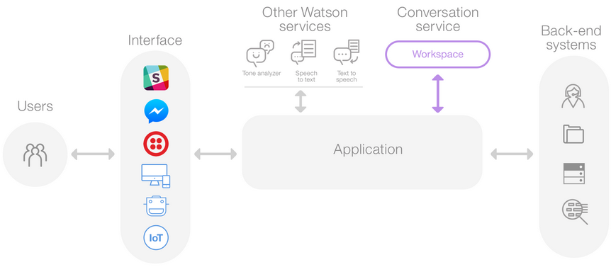
Watson Conversation

Slide 79
Watson Conversation
Features
TODO

Slide 80
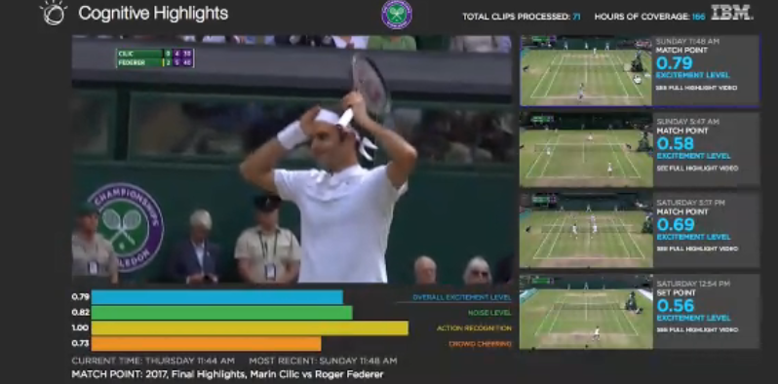
More Complex Use Case
Unsupervised Video Semantic Partitioning Using
IBM Watson and Topic Modelling.
Alexandre Quemy, Krzysztof Jamrog, Marcin Janiszewski, EDBT/ICDT, Workshops 2018: 44-49
Notes:
Within this section we will show how within 5 minutes we can create and deploy basic Node.js application with github as a code repository using Bluemix platform.

Slide 81
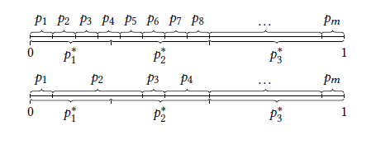
Video Semantic Partitioning Problem
Practical formulation:
feature streams, each being a signal on associated metric:

Slide 82
Feature Streams
Features from the visual part:
We extract frames every 3 seconds.
Between two frames, pixel-based Hamming distance and a perceptual hash:
For two blocs, we use as representant the last and first extracted frames.
With IBM Watson Visual Recognition we extracted from each frame a list of tags with confidence.
the words in block j
the confidence level for words
in common between j and j-1

Slide 83
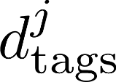
Feature Streams
Features from the audio part:
With IBM Watson Speech-To-Text, we extracted the transcript from the audio.
With IBM Watson Natural Language Understanding we extract from the transcript, the keywords and entities from each block.
Using the keywords and entities, we define two similar measures to :
{ "text": "IBM is an American multinational technology company headquartered in Armonk, New York, United States, with operations in over 170 countries.",
"features": {
"concepts": {
"limit": 20 },
"keywords": {
"limit": 20 }
}
}

Slide 84
Feature Streams
Features using topic model:
We normalized the transcript of each bloc (seen as „document”): Tokenization and token cleaning
Part of Speech (PoS) Tagging
Lemmatization N-Gram calculation and frequencies filtering
We used a Latent Dirichlet Allocation to obtain a distance between blocks Three hyperparameters: number of topics priors distribution (doc-topic and topic-word)

Slide 85
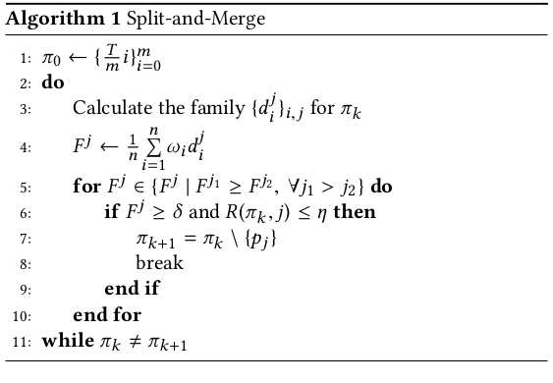
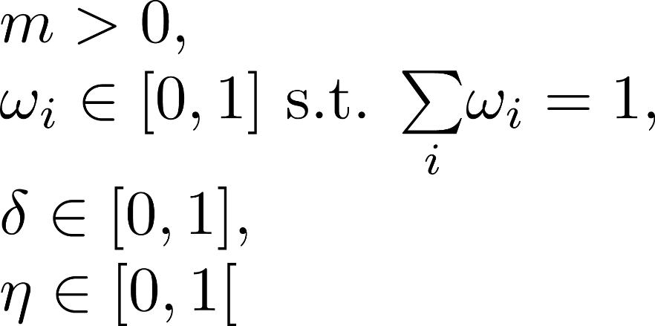
Split-and-Merge
Hyperparameters:

Slide 86
Experiments & Results
The protocol
Public survey: For each video, describe how you would break it into "steps" (a bit like a chapter in a book).
Additional indication: Weak transition
(1) Running an experiment in the IBM Quantum Experience3
(2) IBM Bluemix - 3 minutes demo (NodeJS, SSO)4
(3) IBM Watson for Oncology Demo5

Slide 87
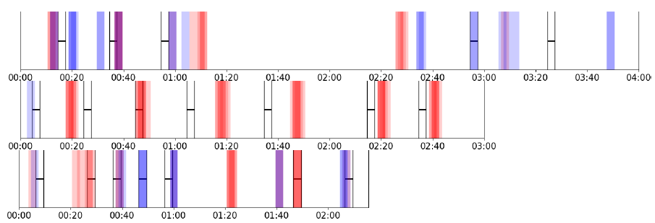
Experiments & Results
The results

Slide 88
Watson IoT Platform
Notes:
Within this section we will show how within 5 minutes we can create and deploy basic Node.js application with github as a code repository using Bluemix platform.

Slide 89
Watson Machine Learning
Notes:
Within this section we will show how within 5 minutes we can create and deploy basic Node.js application with github as a code repository using Bluemix platform.

Slide 90
Thank you
For questions: aquemy@pl.ibm.com
Notes:
Within this demo session we will show how Node.js application can use and display data from previously created model for customer satisfaction prediction.

