Slide 1


How does Stadia / Nvidia GameStream works?
Aka my painful adventure with PCI passthrough for consumer GPU
Aka Y U DO DAT NVIDIA? :’(
Alexandre Quemy
IBM Data and AI

Slide 2
Agenda
What is Cloud gaming
What is PCI Passthrough
Consumer GPU passthrough
Let’s do it
Demo
Conclusion
Notes:
Left censoring – a data point is below a certain value but it is unknown by how much.
Interval censoring – a data point is somewhere on an interval between two values.
Right censoring – a data point is above a certain value but it is unknown by how much.
Type I censoring occurs if an experiment has a set number of subjects or items and stops the experiment at a predetermined time, at which point any subjects remaining are right-censored.
Type II censoring occurs if an experiment has a set number of subjects or items and stops the experiment when a predetermined number are observed to have failed; the remaining subjects are then right-censored.
Random (or non-informative)

Slide 3
What is Cloud gaming?

Slide 4
What is Cloud gaming

Slide 5
What is Cloud gaming

Slide 6
The big players

Slide 7
What is PCI Passthrough?

Slide 8
PCI Passthrough

Slide 9
PCI Passthrough

Slide 10
Consumer GPU passthrough

Slide 11
Does PCI Passthrough always work?
Plenty of factors:
Correct implementation of IOMMU / ACS
Correct EFI support from GPU
(Hybrid) Muxed laptop
…
IOMMU: Input Output Memory Management Unit
Maps IOVA to physical address
Problems:
Often not 1-1 mapping
PCIe spec. allows peer-to-peer translation
Solution:
Buying the correct hardware
PCI ACS (= buying the correct CPU)

Slide 12
Does PCI Passthrough always work?
Plenty of factors:
Correct implementation of IOMMU / ACS
Correct EFI support from GPU
(Hybrid) Muxed laptop
…
Notes:
Not a problem since Microsft made it a requirement from 2008. However, it might happen that the EFI capabilities of the VBIOS is not properly loaded at boot in Linux and that you’ll need to dynamically load the VBIOS for your VM.

Slide 13
Does PCI Passthrough always work?
Plenty of factors:
Correct implementation of IOMMU / ACS
Correct EFI support
(Hybrid) Muxed laptop
…

Slide 14
Does PCI Passthrough always work?
Plenty of factors:
Correct implementation of IOMMU / ACS
Correct EFI support
(Hybrid) Muxed laptop
…
Advice: Triple check your hardware is capable of passthrough
https://en.wikipedia.org/wiki/List_of_IOMMU-supporting_hardware
https://ark.intel.com/content/www/us/en/ark/search/featurefilter.html?productType=873&0_VTD=True
https://www.techpowerup.com/vgabios/
For laptop: just pray

Slide 15
Standard Machine Learning POV
Device pass-through, however, can have a performance impact on virtualised memory management. The IOMMU configuration required for pass-through restricts the use of transparent huge pages. Memory must, therefore, be pinned in a guest VM using pass-through devices. This can limit the flexibility of software-defined infrastructure to over-commit virtualised resources (although over-committed resources are generally unlikely to be worthwhile in an HPC use case). Static huge pages can still be used to provide a boost to virtual memory performance.

Slide 16
Enabling processor architecture extensions for virtualisation.
Controlling hypervisor techniques for efficiently managing many guests, such as Kernel Same-page Merging (KSM). This can add CPU overhead in return for varying degrees of improvement in memory usage by de-duplicating identical pages. For supporting memory-intensive workloads, KSM can be configured to prevent merging between NUMA nodes. For performance-critical HPC, it can be disabled altogether.
Pinning virtual cores to physical cores.
Passing through the NUMA topology of the physical host to the guest enables the guest to perform NUMA-aware memory allocation and task scheduling optimisations.
Passing through the specific processor model of the physical CPUs can enable use of model-specific architectural extensions and runtime microarchitectural optimisations in high-performance scientific libraries.
Backing guest memory with huge pages reduces the impact of host Translation Lookaside Buffer (TLB) misses.

Slide 17
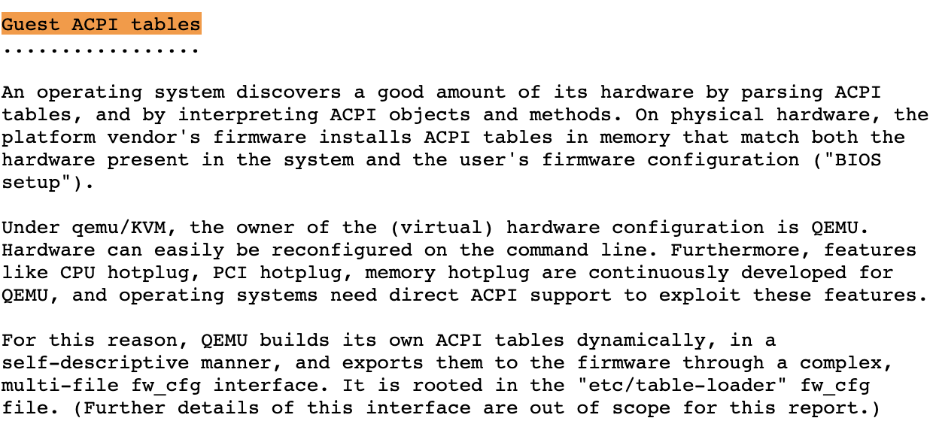
OVMF?
Open Virtual Machine Firmware
http://www.linux-kvm.org/downloads/lersek/ovmf-whitepaper-c770f8c.txt

Slide 18
Let’s do it?

Slide 19
The easy part: configuring the host
Activate Intel Virtualization Technology for Directed I/O in the BIOS
Deactivate Secure Boot if you have such feature in the BIOS
Enable IOMMU at kernel level:
dmesg | grep -i -e DMAR -e IOMMU

Slide 20
The easy part: configuring the host

Slide 21
The easy part: configuring the host
Isolating the GPU:
/etc/modprobe.d/vfio.conf
Check if it worked:

Slide 22
The fun part: configuring the VM

Slide 23
The fun part: configuring the VM

Slide 24
The fun part: configuring the VM

Slide 25
The nightmare part: the infamous error 43

Slide 26
Hidding the hypervisor
NVIDIA deactivates GeForce in VMs

Slide 27
Hiding the hypervisor
In your VM configuration:

Slide 28
Did it work?

Slide 30
VBIOS not recognized

Slide 31
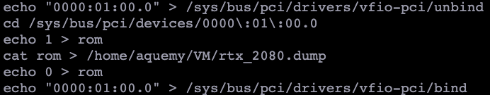
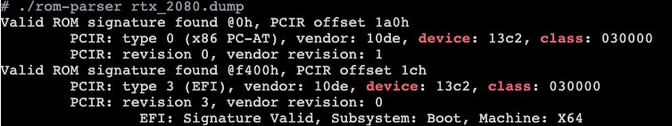
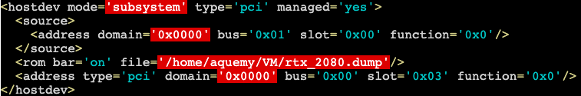
Let’s dump our VBIOS

Slide 32
Partially recognized VBIOS
Why?
Well… the VBIOS size is suspectedly small
PCIe x16 1.1
Not detected
Dude, I paid enough for RTX!

Slide 33
Perfectly recognized VBIOS
Dump from Bare Metal Windows

Slide 34
Did it work?

Slide 36
Ever heard of EDID?
Extended Display Identification Data
No way to force GPU into video mode
without EDID…
Headless / Dummy HDMI

Slide 37
Did it work?

Slide 39
Disabling Driver Signature Enforcement:
Patching in memory, too tricky for me
Supplying battery to the VM:
QEMU does not support it
https://bugs.launchpad.net/qemu/+bug/1502613
Detection of battery must be done by
a call from the driver to the OS!
Detection of battery!

Slide 40
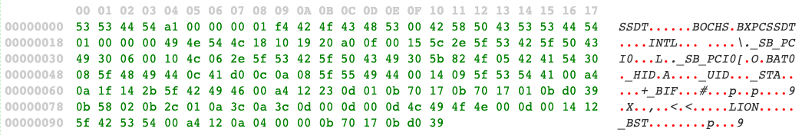

Battery check done via ACPI
Advanced Configuration and Power Interface
Let’s create a SSDT ACPI
Secondary System Description Table
Let’s pass it to the VM
Detection of battery!

Slide 41
Did it work?

Slide 43

Wanna stream boi?
Looking Glass
Open Source NVIDIA GameStream Protocol
Use nvFCB/nvIFR framework
Open Source NVIDIA GameStream Protocol
Pros:
Access app on any device
Cons:
Latency depends on network
Can be CPU intensive due to hardware accelerated codec
Pros:
No overhead:
frame buffer copied from GPU to the host
no CPU offloading
Perfect app integration into host
Extremely low latency (~3 to 5ms)
Cons:
No steeaming
Why not both?!
BECAUSE NVIDIA NVFCB IS NOT SUPPORTED BY GEFORCE

Slide 45
(And now, as an interlude, the short story of Intel HDCP)
Notes:
https://starwarsintrocreator.kassellabs.io/#!/BM-zBhWsD-CjgD74Jztw/edit

Slide 46
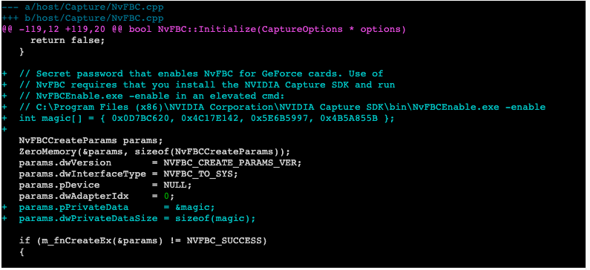
NVIDIA disabled nvFBC at software level!

Slide 47
Demo

Slide 48
Conclusion

Slide 50

Thank you

